Slide 1
Join us on Twitter
@AIR_Info
##DisabilityLabor

Slide 2
One Size Does Not Fit All:
A New Look at the Labor
Force Participation of
People With Disabilities
Authors: Dr. Michelle Yin, Dahlia Shaewitz
Notes:
Title, lead Author Michelle Yin could not be here…
We have seen a number of Federal policies address employment issues for people with disabilities, however, the rates of employment for this population haven’t improved. In fact, some research shows that it has actually gotten worse. This was our incentive to dig into the data and search for some ideas as to what is going on with the population of people with disabilities.
This paper provides descriptive research on labor force participation at the Federal and state level, and broken down by disability type. Labor force participation is the share of people who are either employed or actively looking for jobs. We found some interesting information by breaking down these numbers.

Slide 3
Overview
  Labor Force Participation Rate Continues to Drop
  25% in 2001 to 16% in 2014 for People with Disabilities
No improvement, despite policies
Does one size fit all?
Notes:
Most people in the public hear about employment rates, or unemployment, but most don’t pay close attention to labor force participation
LFPR has decreased since the 2008 Recession for the entire nation, and we saw a greater drop for PWD, from 25% in 2001 to 16% in 2014.
As the economy has recovered, we haven’t seen a corresponding improvement in LFPR for PWD, despite various policies and initiatives…
Federal policy has shifted since the 1970s from income supports to promoting labor participant and employment; however, Federal policy and state implementation has not resulted in any shift in the employment picture for people with disabilities.
We asked ourselves: Does one size policy really fit all? Or, does policy need to be designed and implemented differently to serve people with different disabilities. [I still find the introduction of this idea confusing here…I wonder if you can cut this until you introduce it in 2 slids

Slide 4
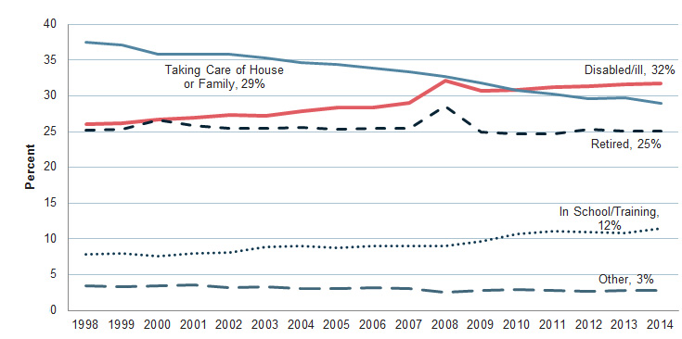
Reasons for Disengagement from the Workforce
Notes:
We began by taking a national look at labor force participation. Disability is the primary reason Americans are not in the workforce—32% of people not looking for a job reported that they are disabled; this figure continues to rise.
By comparison, taking care of the house or family has declined to 29% and in school or training is at 12%. We see a blip increase in retirees around 2008 during the Great Recession, but the numbers have leveled off at 25%.

Slide 5
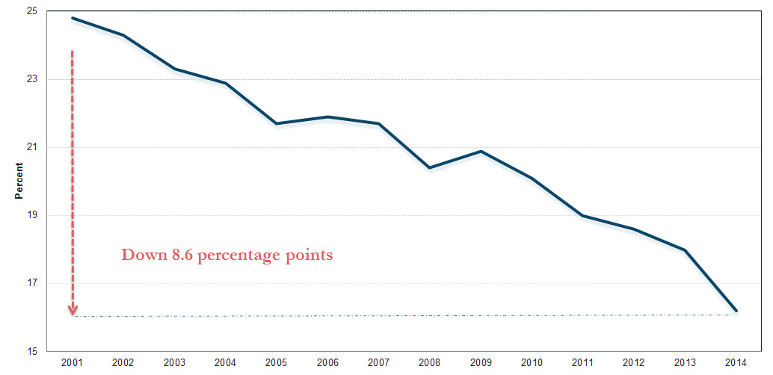
Labor Force Participation Rate for People With Disabilities Ages 21–65
Notes:
In the next graph we show labor force participation for working age people with disabilities, age 21-65. This shows a steep 8.6 percent decline in workforce participation—that is a decline from 25% in 2001 to 16% in 2014.
Importantly, the drop for PWD is nearly 3 times the overall decline for the entire US population.

Slide 6
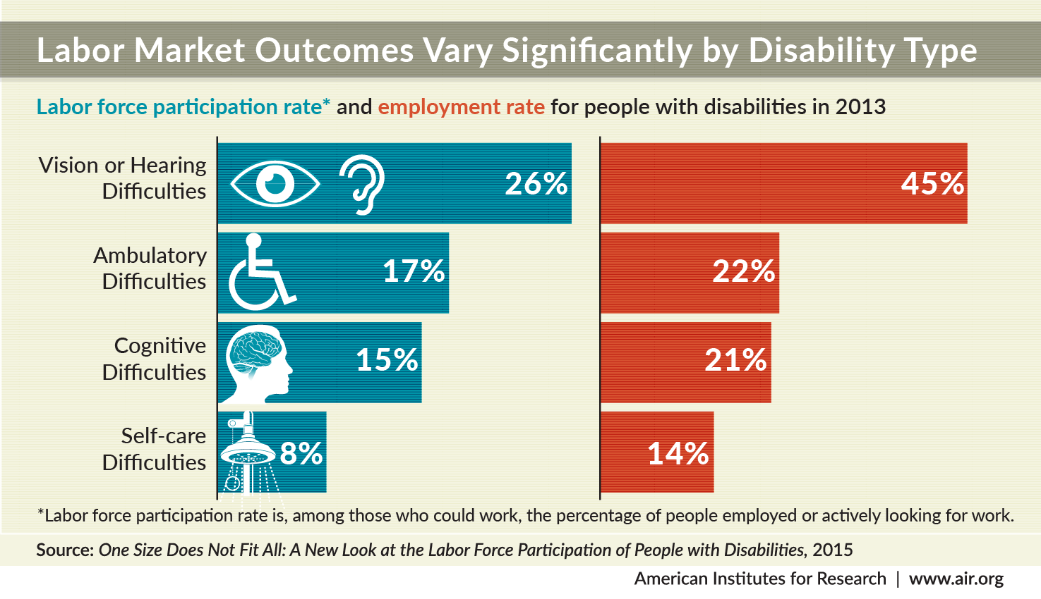
Notes:
Now, here is where one size fits all comes in…When we dug down into the data, we found that labor force participation rates vary depending on the type of disability. Here is a simple infographic that displays the rates side by side for the 4 disability types reported in the American Community Survey.
There are clear differences depending on the type of disability.
More people with vision or hearing difficulties are in the labor force than those with cognitive or ambulatory disabilities. People with self-care difficulties have the lowest rates of workforce participation.
And once in the labor force, we find that people with hearing or vision difficulties also have a better time finding employment than the other categories. We would like to know why, of course.
We see that policies are written for people with disabilities as if this is a coherent, singular group. In fact, the needs of people with disabilities depends on the type of disability they have, and the barriers they face are different as well.
We also recommend that national policies to support people with disabilities to enter competitive employment need to be differentiated to address the inconsistencies in employment and labor force participation rates.

Slide 7
LFPR by State and Disability Type, 2013
Notes:
I hope you enjoy maps, because I’ve got three sets. Here you see the labor force participation rate for the 4 disability categories—pay close attention to the lightly shaded states where participation rates are lowest.
For those who cannot see the maps, the states with the lightest shading include states that are mostly in the south and southwest.
[If asked: West Virginia, Kentucky, Tennessee, Mississippi, Alabama, Louisiana, Arkansas, Missouri, Arizona, New Mexico, and Idaho.]

Slide 8
Disability Rate by State and Type, 2013
Notes:
Now, keep in mind the previous map as we look at the next set—this set reflects disability rates, again by type of disability and by state. Here look at the darkest shading—for those who cannot see the slide, the darkest shaded states are those with the highest disability rates. Compared to the previous slide, many of these states with the highest disability rates also have the lowest workforce participation rates.
Again, the states with the highest disability rates are primarily those in the south and southwest. Most of the same states we noticed in the previous map.
[If asked: West Virginia, Kentucky, Tennessee, Mississippi, Alabama, Louisiana, Arkansas, Oklahoma, and New Mexico.]

Slide 9
ER by State and Disability Type, 2013
Notes:
On this slide we present employment rates by state and disability type—again, we see a similar pattern. Those states with low employment rates are the same as some of those we presented on the previous two slides.
What does this mean for people with disabilities? They are in higher concentrations in states where they are less likely to be part of the labor force. States that face economic challenges have less opportunity for employment, and this affects people with disabilities at a greater magnitude than non-disabled workers.
The loss of potential employees is tremendous—people who could be working but are not in the labor force at all. And when they are in the labor force, they struggle to find employment.
[If asked: West Virginia, Kentucky, Tennessee, Mississippi, Alabama, Louisiana, Arkansas, Missouri, Idaho, also in some cases the Carolinas, Florida, Michigan and Washington. ]

Slide 10
LFPR by Disability Type by State in 2013, Top 10 States
Rank | Cognitive difficulties |  | Ambulatory difficulties |  | Vision or hearing difficulties |  | Self-care difficulties
1 | Connecticut | 40% | Wyoming | 43% | Wyoming | 72% | Alaska | 34%
2 | Minnesota | 40% | Alaska | 42% | Nebraska | 66% | Wyoming | 33%
3 | Alaska | 38% | Maryland | 36% | South Dakota | 65% | Montana | 32%
4 | Wyoming | 38% | Minnesota | 35% | Connecticut | 64% | Minnesota | 26%
5 | North Dakota | 38% | Connecticut | 34% | Minnesota | 64% | Rhode Island | 25%
6 | Wisconsin | 37% | Nevada | 33% | North Dakota | 62% | Kansas | 25%
7 | New Hampshire | 36% | South Dakota | 32% | Hawaii | 61% | Maryland | 24%
8 | South Dakota | 36% | New Hampshire | 32% | Alaska | 61% | Utah | 23%
9 | Iowa | 36% | Montana | 32% | Maryland | 60% | Wisconsin | 22%
10 | District of Columbia | 36% | New Jersey | 32% | Iowa | 60% | Hawaii | 22%
Notes:
I mentioned states that appear to struggle with employing people with disabilities. Here I want to share the TOP TEN states that have higher rates of labor force participation—the largest percentages of people with disabilities who are in the labor force.
In particular, Wyoming, Minnesota, and Alaska have some of the highest rates of labor force participation across all categories, but for most states this pattern varies. For example, DC is 10th ranked for workforce participation of people with cognitive difficulties, but they are in the bottom 10 states for people with vision or hearing difficulties and self-care difficulties.

Slide 11
Top 10 Occupations for People with Disabilities in 2013
Rank | 2013
1 | Janitors and Building Cleaners
2 | Cashiers
3 | Laborers and Freight, Stock, and Material Movers, Hand
4 | Driver/Sales Workers and Truck Drivers
5 | Cooks
6 | Retail Salespersons
7 | Nursing, Psychiatric, and Home Health Aides
8 | Stock Clerks and Order Fillers
9 | Other production workers including semiconductor processors and cooling and freezing equipment operators
10 | Secretaries and Administrative Assistants
Notes:
While we recognize that the job categories haven’t shifted in 10 years, that’s true of workers without disabilities as well. However, its important to note that the types of jobs that people with disabilities are working in are, in the main, low-wage earning with little room for growth and low likelihood of good healthcare benefits.

Slide 12
Challenges & Next Steps
Challenges:
  Joining the labor force is high risk; payoff is 37% less
  Job opportunities require education/training/skills
  Employers may resist hiring people with disabilities
Next Steps:
  Federal policy to look at disability types
  State policy & implementation analysis – what’s working and why?
  Communicating with employers
  Examining disability-owned companies
Notes:
Challenges remain for moving PWD into the workforce—including the huge risk of moving off income supports like social security to join a labor force where PWD have been shown to earn less, and require training in skills that employers want. And employers remain resistant to hiring more people with disabilities.
Some of this is shifting already—with Employment First initiatives occurring in many states, there is a greater focus on employment for certain disability types. We would like to learn more about the states that are doing well and how they are succeeding.
Also, communication campaigns to employers are really important. Helping them see the benefits to hiring people and clarifying what accommodations are needed and what they really cost, and pointing them to tax incentives to support hiring. In addition, we know very little about people with disabilities who are themselves employers or companies that are disability-owned. What industries are they in? What supports do they need and what can they offer as model employers?
While our work shows the challenges to employment for people with disabilities, this is not meant to be a discouraging note. Rather, we want to shine a light on areas of this large and complex problem to help policymakers at the federal and state level consider what strategies might work to make a difference—and what policies are needed to shift these numbers significantly.

Slide 13
For Your Metro Reading
One Size Does Not Fit All: A New Look at the Labor
Force Participation of People With Disabilities
  Research Brief examines employment by disability type, http://www.air.org/resource/one-size-does-not-fit-all-new-look-labor-force-participation-people-disabilities
An Uneven Playing Field: The Lack of Equal Pay for People With Disabilities
  Research Brief highlights income disparities of people with disabilities, http://www.air.org/resource/uneven-playing-field-lack-equal-pay-people-disabilities

Slide 14
Dahlia Shaewitz
202-403-6840
dshaewitz@air.org
1000 Thomas Jefferson Street NW
Washington, DC 20007
TTY: 887-334-3499
www.air.org

