Slide 1
Introduction to the GTL Mentoring and Induction Toolkit
  [Facilitator]
    [Date]
Notes:
All materials within the GTL Mentoring and Induction Toolkit may be used and adapted to fit the needs of the state or local context. If modifications are made to content, please use the following statement: These materials have been adapted in whole or in part with permission from the Center on Great Teachers and Leaders.

Slide 2
Mission
The mission of the Center on Great Teachers and Leaders (GTL Center) is to foster the capacity of vibrant networks of practitioners, researchers, innovators, and experts to build and sustain a seamless system of support for great teachers and leaders for every school in every state in the nation.
Notes:
Read the Center on Great Teachers and Leaders (GTL Center) mission statement.

Slide 3
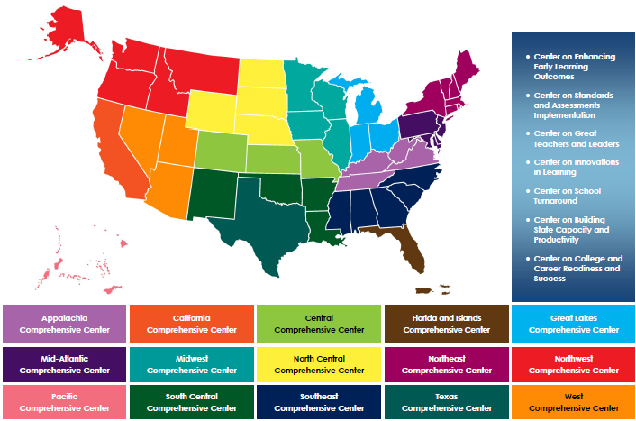
Comprehensive Centers Program
Notes:
The U.S. Department of Education’s Comprehensive Centers program consists of seven national content centers and 15 regional centers. The Center on Great Teachers and Leaders (GTL Center) is a national content center focused on educator quality that supports the 12 regional comprehensive centers shown on this slide. Sign up for the GTL Center mailing list at http://www.gtlcenter.org/content/sign-our-mailing-list.

Slide 4
Mentoring and Induction Toolkit
The purpose of the GTL Center’s Mentoring and Induction Toolkit is to give regional comprehensive centers (RCCs) and state education agencies (SEAs) tools, resources, and support to facilitate meaningful conversations with local education agencies (LEAs) to design and implement effective, high-quality mentoring and induction programs.
Notes:
This presentation is part of the Mentoring and Induction Toolkit developed by the GTL Center. Designed expressly to support states that are working closely with districts to build strong mentoring and induction (M&I) programs, this ready-to-use toolkit guides state and district leaders through the most critical aspects of developing effective M&I programs. Toolkit resources are designed to build the mentoring and induction content knowledge of school, district, state, and regional center personnel and facilitate the design and implementation of high-quality mentoring and induction programs at the district and school levels.

Slide 5
Overview of the Toolkit
Module 1: Introduction to the GTL Mentoring and Induction Toolkit
Module 2: Mentor Recruitment, Selection, and Assignment
Module 3: Mentor Professional Learning, Development, and Assessment
Module 4: Beginning Teacher Professional Learning and Development
Module 5: The Role of the Principal in Mentoring and Induction
Module 6: Mentoring and Induction for Educators of Students with Disabilities
Module 7: Collecting Evidence of Induction Program Success
Notes:
The GTL Center’s Mentoring and Induction Toolkit is divided into seven modules. This presentation is part of Module 1: “Introduction to the GTL Mentoring and Induction Toolkit.”

Slide 6
Module Components
Anchor Presentation: Summarizes research and best practices related to the topic.
Handouts: Provide information to supplement the anchor presentation.
Team Tools: Help teams plan, design, and implement the components of a comprehensive mentoring and induction program.
Notes:
Each module consists of three components: an anchor presentation (PowerPoint), handouts (PDF or Word documents), and team tools (Word documents).

Slide 7
Access to Toolkit Materials
Anchor presentations, handouts, and team tools are available on the GTL Center website.
RCC and SEA personnel may request consultation from GTL experts to learn more about customizing the toolkit materials.
Notes:
Module materials are publicly available on the GTL Center website.

Slide 8
Module 1 Objectives
Participants will:
Build a shared understanding of the definition and critical features of a comprehensive mentoring and induction program.
Identify GTL Center tools that can help teams design and implement a comprehensive system of mentoring and induction supports.
Notes:
Read objectives.

Slide 9
What is Induction?
Induction is a system of coordinated and aligned supports designed to provide new educators with a supportive pathway into the profession.
Notes:
Read definition on slide.

Slide 10
Mentoring Versus Induction
Mentoring is one-on-one support and feedback provided by an experienced veteran educator to a new or struggling educator.
Induction is a larger system of support for new educators that often includes mentoring but also includes additional supports such as ongoing professional development, curriculum planning, and orientation.
Notes:
The terms mentoring and induction are often used interchangeably. However, mentoring is one-on-one support and feedback provided by an experienced veteran teacher to a new or struggling teacher. An induction program is a larger system of support that often includes mentoring but also includes additional supports, such as help with curriculum planning and professional development. Mentoring is critical feature of a comprehensive induction program, but should not be the only feature.

Slide 11
What Is the Purpose of Induction?
Teacher and leader development occurs on a continuum that spans the entire career of an educator.
Mentoring and induction activities facilitate the preservice to inservice transition for new educators.
Preservice
Mentoring and Induction
Inservice
Notes:
Mentoring and induction occurs at a critical transition point in the teacher and leader career development continuum. Mentoring and induction supports help new educators navigate the transition from supervised clinical practice experiences within preservice preparation programs to full responsibility and independence in the inservice setting. Effective mentoring and induction supports during this time of transition can help new educators more rapidly adjust to their responsibilities while providing professional learning experiences that anchor the knowledge and skills learned in their preparation programs to real-life situations.

Slide 12
National Landscape
29 states have policies requiring some type of mentoring or induction support for new teachers.
24 states require new teachers to complete or participate in an induction or mentoring program to receive professional teaching licensure.
20 states have policies requiring support for first-time principals.
9 states require support for new teachers beyond their first two years in the classroom.
Source: New Teacher Center, 2016b.
Notes:
In order to promote a continuum of teacher and leader career development, many states have adopted policies that require some type of mentoring or induction support for new educators. In 2016 the New Teacher Center conducted a review of mentoring and induction policies across 50 states. The full report can be accessed at https://newteachercenter.org/wp-content/uploads/2016CompleteReportStatePolicies.pdf.

Slide 13
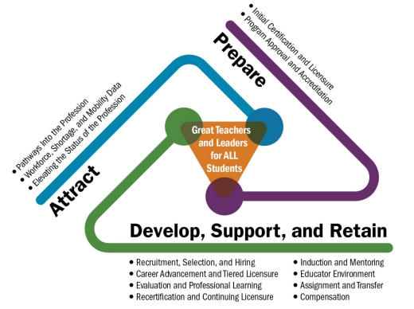
Talent Development Framework
Source: GTL Center, 2014.
Notes:
Mentoring and induction is a critical component of a comprehensive talent development strategy. This graphic was taken from the GTL Center’s Talent Development Framework for 21st Century Educators: Moving Toward State Policy Alignment and Coherence. The Talent Development Framework is a tool that guides SEAs through a process to inventory, prioritize, and plan for a coherent and aligned educator talent development strategy. This figure illustrates how the framework groups state policies and practices into three key interdependent clusters:
Attract the right talent into the profession to meet your students’ needs
Prepare future teachers and school leaders to meet your students’ needs
Develop, support, and retain educators in the field to ensure that they can continue to meet your students’ needs
Mentoring and induction is a key practice within the Talent Development Framework that helps to develop, support, and retain new educators. SEAs that are interested in exploring mentoring and induction as a part of an integrated talent development strategy can access the Talent Development Framework at https://gtlcenter.org/sites/default/files/14-2591_GTL_Talent_Dev_Framework-ed_110714.pdf.

Slide 14
Connecting Efforts
When part of a coordinated talent development strategy, mentoring and induction can connect with and support many state- and district-driven initiatives, such as:
Improving equitable access to excellent educators.
Alleviating teacher shortages.
Addressing school turnaround.
Notes:
It is important to recognize that mentoring and induction are important elements of any coordinated talent development strategy, especially at the state level. When part of an integrated talent development strategy, mentoring and induction can play an important role in connecting with and supporting many state- and district-driven initiatives, such as:
Improving equitable access to excellent educators
Alleviating teacher shortages
Addressing school turnaround

Slide 15
Mentoring and Induction in Every Student Succeeds Act Plans
Mentoring and/or induction is:
  Included in 45 state Every Student Succeeds Act (ESSA) plans.
  Identified as a strategy for promoting educator retention in 12 states.
  Identified as a strategy for promoting equity in 13 states.
27 states provide detailed plans for mentoring and induction.
25 states plan to use funding from Title II, Part A, to support mentoring and induction.
Notes:
States often cite educator talent development and equitable access as reasons for pursuing greater supports for new educators, including mentoring and induction. In February 2018 GTL Center staff completed a review of submitted Every Student Succeeds Act (ESSA) consolidated state plans. Some states are leveraging ESSA to focus on mentoring and induction, including the use of Title II funds to support these programs. Below is more detail about mentoring and induction in state ESSA plans:
Grand total on how many states listed M&I in their plans:
No plans for M&I (6):
Round 1 (1): Vermont
Round 2 (5): Nebraska, Utah, Virginia, Wisconsin, Wyoming
Some plans (i.e., mention M&I but do not describe efforts in depth) (18):
Round 1 (5): Arizona, Illinois, Louisiana, Nevada, New Jersey
Round 2 (13): Florida, Maryland, Minnesota, Mississippi, Montana, New Hampshire, North Carolina, North Dakota, Oklahoma, Rhode Island, South Carolina, Texas, West Virginia
More detailed, robust plans (27):
Round 1 (10): Colorado, Connecticut, Delaware, DC, Maine, Massachusetts, Michigan, New Mexico, Oregon, Tennessee
Round 2 (17): Alabama, Alaska, Arkansas, California, Georgia, Hawaii, Idaho, Indiana, Iowa, Kansas, Kentucky, Missouri, New York, Ohio, Pennsylvania, South Dakota, Washington
Other Data:
Mentoring and/or induction is required for new teachers and/or principals in 13 states:
Round 1 (3): Connecticut, Massachusetts, Tennessee
Round 2 (10): California, Florida, Hawaii, Kansas, Kentucky, Missouri, New York, North Carolina, Pennsylvania, South Carolina
Mentoring and/or induction is a strategy for promoting teacher and/or principal retention in 12 states:
Round 1 (2): Delaware, New Jersey
Round 2 (10): Alaska, California, Georgia, Hawaii, Idaho, North Carolina, North Dakota, Texas, Washington, West Virginia
Mentoring and/or induction is a strategy for promoting equity in 13 states:
Round 1 (6): Arizona, Colorado, Delaware, Maine, Nevada, New Jersey
Round 2 (7): Arkansas, Mississippi, New York, North Dakota, Pennsylvania, South Dakota, West Virginia
25 states plan to use funding from Title II, Part A to support mentoring and/or induction:
Round 1 (13 states): Arizona, Connecticut, Delaware, DC, Louisiana, Maine, Massachusetts, Michigan, Nevada, New Jersey, New Mexico, Oregon, Tennessee
Round 2 (12 states): Alaska, Hawaii, Idaho, Indiana, Kansas, Mississippi, Missouri, North Dakota, Ohio, Oklahoma, Pennsylvania, Washington

Slide 16
Equitable Access
Improvements in equitable access are achieved by focusing on schools with the most severe and persistent equity gaps.
Investing in mentoring and induction supports in high-need schools can help address gaps between preservice preparation and inservice expectations.
Unfortunately, research suggests that teachers in high-need schools are less likely to receive mentoring and induction supports (Kardos & Johnson, 2010).
Notes:
To comply with ESSA and the use of Title II dollars, mentoring and induction programs must focus on ensuring equitable access to effective teachers, especially in schools identified for comprehensive and targeted support and improvement. Investing in mentoring and induction supports in schools that are less likely to have experienced, effective teachers can help address gaps between preservice preparation and inservice expectations. For example, many teachers don’t receive adequate preparation to address some of the common issues encountered in high-need schools, such as chronic absenteeism, discipline, and trauma-informed care. Access to mentoring and induction supports that focus on these issues would help the teacher to be more successful and thus more likely to stay in the school.
Unfortunately, evidence suggests that teachers in high-need schools are less likely to receive mentoring and induction than their peers in high-income schools. Kardos & Johnson (2010) found that new teachers in low-income schools were less likely to have the following supports compared to new teachers in high-income schools:
Have a formal mentor during their first year (65% versus 91%)
Have a mentor in the same school (53% versus 82%)
Have a mentor in the same grade level (28% versus 61%)
Have a mentor in the same subject area (40% versus 60%)
Have at least three conversations with their mentors about classroom management, lesson planning, and classroom instruction during their first year of teaching (45% versus 65%).

Slide 17
How Can Effective Mentoring and Induction Close Equity Gaps?
  Mentoring and induction can:
  Attract effective teachers by offering better supports and working environment in hard-to-staff schools.
  Improve teacher effectiveness in high-need schools by strengthening preparation.
  Increase teacher retention in high-need schools by offering ongoing support and opportunities for growth.
Notes:
Mentoring and induction can be a good strategy to close equity gaps, but only when there is a focus on strengthening the educator talent pool in high-need schools that are the least likely to have experienced, effective teachers. Policymakers should consider how to design mentoring and induction programs that are relevant to these schools (Kardos & Johnson, 2010).

Slide 18
Alleviating Teacher Shortages
New teachers are less likely to leave the profession if they are provided with a mentor in their content area and if they participate in formal planning and collaboration with other teachers (Ingersoll & Smith, 2004; Ingersoll & Strong, 2011).
Mentoring aligned with job roles and responsibilities is especially important for teachers in critical shortage areas such as special education (Billingsley, Griffin, Smith, Kamman, & Israel, 2009).
Notes:
Research conducted over the past twenty years suggests comprehensive mentoring and induction experiences can lead to improved teacher retention, which is a critical aspect of alleviating teacher shortages. This can also lead to improvements in equitable access when induction programs target high-shortage subject areas and schools.

Slide 19
Addressing School Turnaround
Mentoring and induction supports should target the specific needs of educators in turnaround settings:
  Turnaround Leadership
  Talent Development
  Instructional Transformation
  Culture Shift
Source: Four Domains for Rapid School Improvement: A Systems Framework, Center on School Turnaround, 2017.
Notes:
Turnaround schools often have high percentages of new and inexperienced teachers. These teachers need high-quality mentoring and induction supports that reflect local context and are part of an integrated, systemic approach to school turnaround and improvement. The Four Domains for Rapid School Improvement: A Systems Framework from the Center on School Turnaround is a framework to assist states, districts, and schools in leading and managing rapid improvement efforts. The framework outlines the critical practices of successful school turnaround in four domains: turnaround leadership, talent development, instructional transformation, and culture shift. Mentoring and induction, when implemented with consideration for the unique needs of beginning teachers in turnaround schools, is a strategy that can drive improvements across all four domains.
The full Framework can be found at http://centeronschoolturnaround.org/wp-content/uploads/2017/02/CST_Four-Domains-Framework-Final.pdf.

Slide 20
Toolkit Connection: School Turnaround
Does your team need help designing mentoring and induction in a turnaround setting? Try these toolkit resources!
Mentoring and Induction in Turnaround Schools Self-Assessment: Helps teams assess, reflect, and monitor progress on district- and school-level implementation of M&I in turnaround settings.
Mentoring and Induction in Turnaround Schools Crosswalk and Reflection: Outlines an integrated model for M&I in turnaround settings and helps teams reflect on implementation at the school, district, and state levels.
Notes:
In partnership with the Center for School Turnaround (CST), the GTL Center has developed two tools to address the specific needs of new teachers in turnaround schools. These tools are based on the Four Domains for Rapid School Improvement: A Systems Framework from CST and the High-Quality Mentoring and Induction Practices from the New Teacher Center (NTC). NTC’s high-quality mentoring and induction practices will be introduced later in this presentation. Teams interested in further exploration of mentoring and induction in turnaround settings may use these tools as a starting point.
Toolkit materials can be accessed on the GTL Center website: https://gtlcenter.org/.

Slide 21
Why Does Induction Matter?
Improves teacher retention
Increases teacher effectiveness
Improves student achievement
Expands pathways into teacher leadership
Improves school climate and working conditions
Notes:
Empirical evidence exists to support the claim that mentoring and induction activities have a positive impact on teacher commitment and retention, teacher classroom instructional practices, and student achievement (Ingersoll & Strong, 2011; Strong, 2006). Furthermore, mentoring and induction can expand pathways into teacher leadership and improve school climate and working conditions.
A recent longitudinal study of the New Teacher Center (NTC) induction model conducted by SRI Education illustrated that two years of comprehensive induction support for teachers resulted in positive impacts on student achievement, such that students in Grades 4–8 of teachers who participated in NTC induction scored higher on average than students of control teachers. These impacts resulted in the equivalent of 2-4 additional months of student learning in reading/English language arts and 2-5 additional months of student learning in mathematics, depending on the grade level tested (Schmidt, Young, Cassidy, Wang, & Laguarda, 2017).
New teachers are less likely to leave the profession if they are provided with a mentor in their content area and if they participate in formal planning and collaboration with other teachers (Ingersoll & Smith, 2004; Ingersoll & Strong, 2011).
68 percent of National and State Teachers of the Year who had an assigned or informal mentor ranked mentoring among their top three most important supports for developing their effectiveness as a teacher. Respondents who had a mentor ranked “modeled effective teaching practices” as the most important characteristic of their mentor for developing their effectiveness as a teacher (Behrstock-Sherratt, Bassett, Olson, & Jacques, 2014).

Slide 22
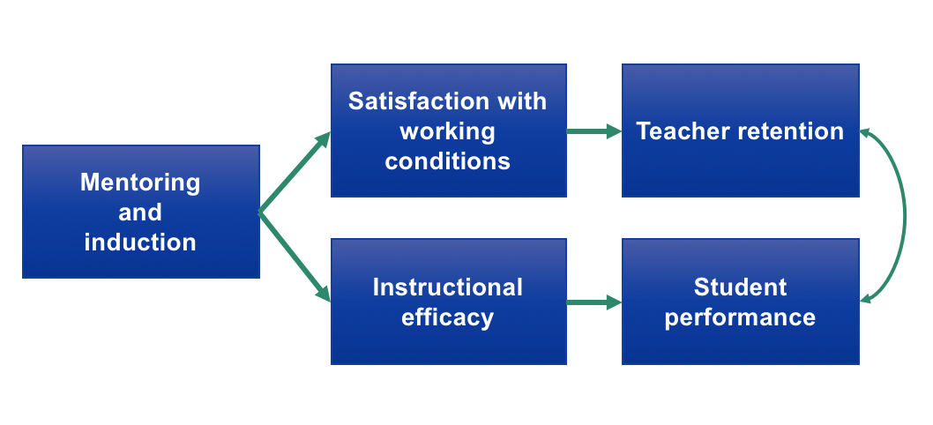
Impact of Mentoring and Induction
Based on a review of research from Ingersoll and Strong, 2011.
Notes:
This figure is based on findings from The Impact of Induction and Mentoring Programs for Beginning Teachers: A Critical Review of the Research (Ingersoll and Strong, 2011). Although the research is somewhat limited because of the variation in induction components and the quality of the design of most studies, some studies have shown that mentoring and induction can have a positive impact on teachers’ satisfaction with working conditions, which leads to improved rates of teacher retention. Research also shows that mentoring and induction supports can help teachers improve their instructional practice and increase student achievement. Teacher retention and student achievement are closely linked because teachers are more likely to stay in schools where they feel successful. In turn, schools with high rates of teacher retention tend to have more experienced and effective teachers who are able to positively impact student learning. The review of research can be accessed at http://journals.sagepub.com/doi/abs/10.3102/0034654311403323.

Slide 23
Toolkit Connection: Data
Does your team need help analyzing data? Try these toolkit resources!
Mentoring and Induction Data Protocol: Gives teams an inquiry-based structure to examine outcomes related to mentoring and induction, including teacher retention, teacher performance, and student achievement data.
Root Cause Analysis Workbook: Guides teams through a process to explore root causes to identify context-specific strategies for strengthening induction programs.
Notes:
Toolkit materials can be accessed on the GTL Center website: https://gtlcenter.org/.

Slide 24
Other Tools to Explore Data
GTL Center’s Equitable Access & Diversifying the Educator Workforce Project includes a data tool for practitioners and a companion guidebook that can:
  Reveal insights about the diversity of the educator workforce at the state, district, school, or preparation program level.
  Identify the main drivers behind the existing disparities within the educator workforce.
  Pinpoint crucial points across the educator career continuum where implementing carefully selected strategies can help diversify the educator workforce and improve equitable access.
Notes:
Materials can be accessed at https://gtlcenter.org/state-collaborations/equitable-access.

Slide 25
Components of Induction
The components of a comprehensive induction program vary by district but usually include the following:
Orientation activities
New teacher mentoring
Professional development and learning communities for beginning teachers and mentors
Professional supports for principals and program leadership
Programmatic supports
Notes:
Components of comprehensive induction program vary by district, but usually include some combination of the following elements:
Orientation activities that provide beginning teachers information about both the school’s mission, goals and teaching/learning philosophies, and basic policies regarding curriculum, assessment, students with special needs, and student discipline;
A strong mentoring program that assists veteran teachers in learning and developing educative mentoring practices;
On-going, organized professional development opportunities for beginning teachers that are based on high standards for teaching and learning;
Professional learning communities in which teachers use multiple sources of information and data to assess and improve teaching and learning;
Professional supports for principals and program leadership;
Programmatic supports (e.g., surveys, standards, stipends).

Slide 26
What Do Effective Induction Programs Look Like?
Rigorous mentor selection based on qualities of an effective mentor
Ongoing professional development and support for mentors
Sanctioned time for mentor–teacher interaction
Multiyear mentoring
Intensive and specific guidance moving teaching practice forward
Professional teaching standards and data-driven conversations
Ongoing beginning teacher professional development
Clear roles and responsibilities for administrators
Collaboration with all stakeholders and a focus on program improvement
Source: New Teacher Center, 2016a.
Notes:
This slide lists the High-Quality Mentoring and Induction Practices from the New Teacher Center (https://newteachercenter.org).

Slide 27
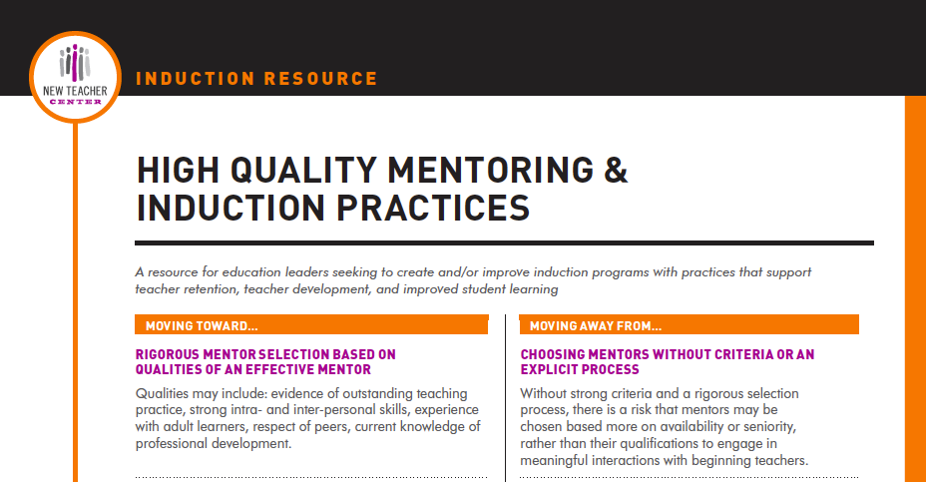
Handout 1
Notes:
Review Handout #1: High-Quality Mentoring and Induction Practices.

Slide 28
Challenges in High-Need Schools
Fewer resources
Limited capacity for new programs
Many accountability and school improvement–related state programs and requirements
Higher rates of beginning teachers
Lower rates of experienced and effective teachers
Notes:
In order to be effective, mentoring and induction supports have to be responsive to the issues faced by high-need schools experiencing persistent and severe equity gaps. This slide lists some of the common challenges experienced in high-need schools.

Slide 29
Strategies for Effective Mentoring and Induction in High-Need Schools
New Teacher Center Practice | Challenges in High-Need Schools | Program Adjustments
Rigorous mentor selection based on qualities of an effective mentor | Insufficient pool of high-quality mentors | Implement strategies to develop pool of mentors (transfer, cross-school mentorship).
Sanctioned time for mentor–teacher interactions | More difficult to identify time; insufficient capacity | Include strategies to allow more planning time.
Professional teaching standards and data-driven conversations | Many challenges beyond academic standards (addressing chronic absenteeism, trauma-informed care) | Ensure relevance of mentoring content and combination of academic rigor with nonacademic support.
Collaboration with all stakeholders and a focus on program improvement | Teachers in high-need schools may experience fear of displacement because of evaluations, reconstitution, and closure | Consider ways to allow new teachers time to use mentoring in a culture of commitment that enables success.
Notes:
This table shows the high-quality mentoring and induction practices from the New Teacher Center along with common challenges faced by high-need schools when implementing these practices. The final column lists potential program adjustments that can help address these challenges.

Slide 30
Toolkit Connection: Induction
Does your team need help thinking through the structural pieces of an induction program? Try this toolkit resource!
Induction Program Inventory: Helps teams plan for the building blocks of a comprehensive induction program, including structures to support beginning teachers, mentors, principals, and district leaders.
Notes:
Toolkit materials can be accessed on the GTL Center website: https://gtlcenter.org/.

Slide 31
Induction in Practice
There is wide variation in the ways in which mentoring and induction activities and programs are implemented at schools and in districts (DeCesare, Workman, & McClelland, 2016; New Teacher Center, 2016b; Strong, 2009).
Districts cite lack of funding, lack of time, and lack of stipends as a barrier to implementing adequate mentoring programs (DeCesare, Workman, & McClelland, 2016).
Notes:
Despite promising results, teacher induction programs often are not consistently developed and applied.
In a snapshot of district policies for mentoring new teachers in five Midwestern states, including nearly 1,000 districts, researchers from the Regional Educational Laboratory (REL) Central found wide variation in the way in which M&I programs are implemented at schools and in districts. These differences included variations in the type of mentoring (whether done by full-time classroom teachers or teachers who were released full or part time to serve as mentors), the number of years new teachers experience induction, and wide variation in the requirements for mentors to have any professional development for their role as mentors (DeCesare, Workman, & McClelland, 2016).
For the full REL Central report, see https://eric.ed.gov/?id=ED565612.

Slide 32
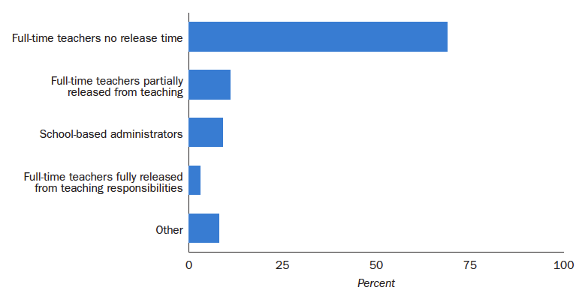
Who Provides Mentoring?
Source: DeCesare, Workman, & McClelland, 2016.
Notes:
For more information please refer to the report How Do School Districts Mentor New Teachers? from the Regional Educational Laboratory Central (https://files.eric.ed.gov/fulltext/ED565612.pdf).

Slide 33
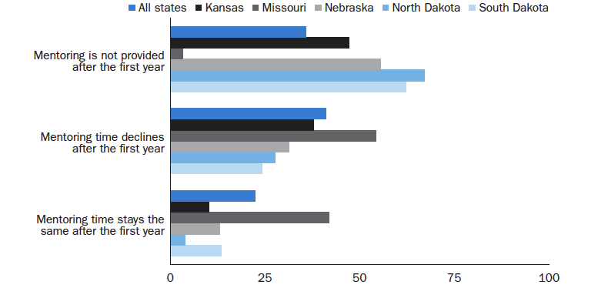
How Long Are Mentoring Supports Provided?
Source: DeCesare, Workman, & McClelland, 2016.
Notes:
For more information please refer to the report How Do School Districts Mentor New Teachers? from the Regional Educational Laboratory Central (https://files.eric.ed.gov/fulltext/ED565612.pdf).

Slide 34
Funding for Mentoring and Induction
Teacher attrition in the United States, overall, costs more than $2 billion annually, at a rate of nearly $10,000 per teacher who leaves the profession (The Alliance for Excellent Education, 2014).
Investing in comprehensive induction can create a payoff of $1.37 for every $1.00 invested (Villar, 2004).
Based on a review of submitted ESSA state plans, 25 states plan to use Title II, Part A, funds to support mentoring and induction programs.
Notes:
GTL Center staff conducted a review of submitted ESSA consolidated state plans in February 2018. Based on this review of submitted state plans, 25 states intend to use Title II, Part A funds to support mentoring and induction programs.

Slide 35
References
Alliance for Excellent Education. (2014). On the path to equity: Improving the effectiveness of beginning teachers. Washington, DC: Author. Retrieved from https://all4ed.org/wp-content/uploads/2014/07/PathToEquity.pdf
Behrstock-Sherratt, E., Bassett, K., Olson, D., & Jacques, C. (2014). From good to great: Exemplary teachers share perspectives on increasing teacher effectiveness across the career continuum. Washington, DC: Center on Great Teachers and Leaders. Retrieved from https://files.eric.ed.gov/fulltext/ED555657.pdf

Slide 36
References (continued)
Billingsley, B. S., Griffin, C. C., Smith, S. J., Kamman, M., & Israel, M. (2009). A review of teacher induction in special education: Research, practice, and technology solutions. National Center to Inform Policy and Practice in Special Education Professional Development. (NCIPP Doc. No. RS-1). Retrieved from http://ncipp.education.ufl.edu/files_6/NCIPP_Induc_010310.pdf
Center on Great Teachers and Leaders. (2014). Talent development framework for 21st century educators: Moving toward state policy alignment and coherence. Washington, DC: American Institutes for Research. Retrieved from http://www.gtlcenter.org/sites/default/files/14-2591_GTL_Talent_Dev_Framework-ed_110714.pdf

Slide 37
References (continued)
Center on School Turnaround. (2017). Four domains for rapid school improvement: A systems framework [The Center for School Turnaround at WestEd]. San Francisco, CA: WestEd. Retrieved from https://centeronschoolturnaround.org/wp-content/uploads/2018/04/CST_Four-Domains-Framework-Final.pdf
DeCesare, D., Workman, S., & McClelland, A. (2016, April). How do school districts mentor new teachers? (REL 2016-125). Washington, DC: U.S. Department of Education, Institute of Education Sciences, National Center for Education Evaluation and Regional Assistance, Regional Educational Laboratory Central.

Slide 38
References (continued)
Ingersoll, R. M., & Smith, T. M. (2004). Do teacher induction and mentoring matter? NASSP Bulletin, 88(638), 28–40.
Ingersoll, R. M., & Strong, M. (2011). The impact of induction and mentoring programs for beginning teachers: A critical review of the research. Review of Educational Research, 81(2), 201–233.
Kardos, S. M., & Johnson, S. M. (2010). New teachers’ experiences of mentoring: The good, the bad, and the inequity. Journal of Educational Change, 11(1), 23–44.
New Teacher Center. (2016a). High-quality mentoring and induction practices. Santa Cruz, CA: Author. Retrieved from https://newteachercenter.org/wp-content/uploads/high-quality-mentoring_induction-resource.pdf

Slide 39
References (continued)
New Teacher Center. (2016b). Support from the start: A 50-state review of policies on new educator induction and mentoring. Santa Cruz, CA: Author. Retrieved from https://newteachercenter.org/wp-content/uploads/state-teacher-induction-2016-exec-summ-only-final-version-v3.pdff
Schmidt, R., Young, V., Cassidy, L., Wang, H., & Laguarda, K. (2017). Impact of the New Teacher Center’s new teacher induction model on teachers and students. Menlo Park, CA: SRI Education. Retrieved from https://newteachercenter.org/wp-content/uploads/NTC_i3-Validation-eval-brief_062017_final.pdf

Slide 40
References (continued)
Strong, M. (2006). Does new teacher support affect student achievement? (Research Brief). Santa Cruz, CA: New Teacher Center. Retrieved from http://www.newteachercenter.org/sites/default/files/ntc/main/
resources/BRF_DoesNewTeacherSupportAffectStudentAchievement.pdf
Strong, M. (2009). Effective teacher induction and mentoring: Assessing the evidence. New York, NY: Teachers College Press.

Slide 41
References (continued)
Villar, A. (2004). Measuring the benefits and costs of mentor-based induction: A value-added assessment of new teacher effectiveness linked to student achievement. Santa Cruz, CA: New Teacher Center.

Slide 42
More questions?
Contact the GTL Center!
1000 Thomas Jefferson Street NW
Washington, DC 20007-3835
877-322-8700
gtlcenter@air.org
www.gtlcenter.org | www.air.org

