Slide 1
Mentor Recruitment, Selection, and Assignment
  [Facilitator]
    [Date]
Notes:
All materials within the GTL Mentoring and Induction Toolkit may be used and adapted to fit the needs of the state or local context. If modifications are made to content, please use the following statement: These materials have been adapted in whole or in part with permission from the Center on Great Teachers and Leaders.

Slide 2
Mission
The mission of the Center on Great Teachers and Leaders (GTL Center) is to foster the capacity of vibrant networks of practitioners, researchers, innovators, and experts to build and sustain a seamless system of support for great teachers and leaders for every school in every state in the nation.
Notes:
Read the Center on Great Teachers and Leaders (GTL Center) mission statement.

Slide 3
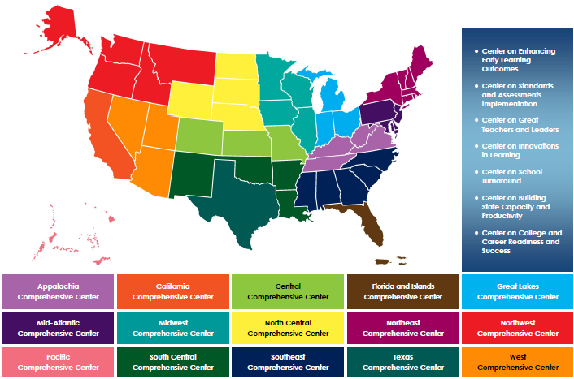
Comprehensive Centers Program
Notes:
The U.S. Department of Education’s Comprehensive Centers program consists of seven national content centers and 15 regional centers. The Center on Great Teachers and Leaders (GTL Center) is a national content center focused on educator quality that supports the 12 regional comprehensive centers shown on this slide. Sign up for the GTL Center mailing list at http://www.gtlcenter.org/content/sign-our-mailing-list.

Slide 4
Mentoring and Induction Toolkit
The purpose of the GTL Center’s Mentoring and Induction Toolkit is to give regional comprehensive centers (RCCs) and state education agencies (SEAs) tools, resources, and support to facilitate meaningful conversations with local education agencies (LEAs) to design and implement effective, high-quality mentoring and induction programs.
Notes:
This presentation is part of the Mentoring and Induction Toolkit developed by the GTL Center. Designed expressly to support states that are working closely with districts to build strong mentoring and induction (M&I) programs, this ready-to-use toolkit guides state and district leaders through the most critical aspects of developing effective M&I programs. Toolkit resources are designed to build the mentoring and induction content knowledge of school, district, state, and regional center personnel and facilitate the design and implementation of high-quality mentoring and induction programs at the district and school levels.

Slide 5
Overview of the Toolkit
Module 1: Introduction to the GTL Mentoring and Induction Toolkit
Module 2: Mentor Recruitment, Selection, and Assignment
Module 3: Mentor Professional Learning, Development, and Assessment
Module 4: Beginning Teacher Professional Learning and Development
Module 5: The Role of the Principal in Mentoring and Induction
Module 6: Mentoring and Induction for Educators of Students with Disabilities
Module 7: Collecting Evidence of Induction Program Success
Notes:
The GTL Center’s Mentoring and Induction Toolkit is divided into seven modules. This presentation is part of Module 2: “Mentor Recruitment, Selection, and Assignment.”

Slide 6
Module Components
Anchor Presentation: Summarizes research and best practices related to the topic.
Handouts: Provide information to supplement the anchor presentation.
Team Tools: Help teams plan, design, and implement the components of a comprehensive mentoring and induction program.
Notes:
Each module consists of three components: an anchor presentation (PowerPoint), handouts (PDF or Word documents), and team tools (Word documents).

Slide 7
Access to Toolkit Materials
Anchor presentations, handouts, and team tools are available on the GTL Center website.
RCC and SEA personnel may request consultation from GTL experts to learn more about customizing the toolkit materials.
Notes:
Module materials are publicly available on the GTL Center website.

Slide 8
Module 2 Objectives
Participants will:
Learn research-based strategies and best practices for mentor recruitment, selection, and assignment.
Explore resources developed by the GTL Center to support mentor recruitment, selection, and assignment.
Notes:
Read objectives.

Slide 9
Why Recruitment, Selection, and Assignment?
“Recruitment and selection of mentors are possibly the most important variables in the success or failure of a mentor program.” Moir, Barlin, Gless, & Miles, 2009
“Collectively, mentoring and other supports have a much greater impact on novices’ reports of teaching experiences and future teaching plans than participation in an induction program on its own.” Kapadia & Coca, 2007
Notes:
Read the quotes on the slide.

Slide 10
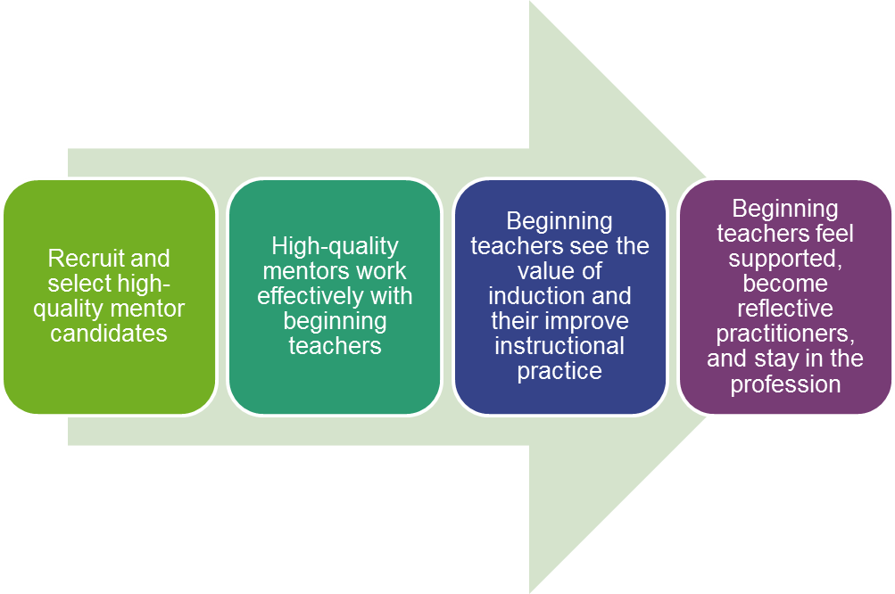
Linking Mentor Recruitment and Teacher Retention
Notes:
When done effectively, mentor recruitment and selection can lead to high-quality relationships between mentors and beginning teachers. These high-quality relationships help beginning teachers improve their instructional practice, demonstrating the value of comprehensive induction. When beginning teachers see the value in their induction program, they are more likely to feel supported, and as a result are more likely to stay in the profession.

Slide 11
A New Vision of Mentoring
Review Handout 1—“A New Vision for Mentor Recruitment, Selection, and Assignment.”
Where does your district or school team fall in the implementation of these practices? Is your team using “old school” practices or comprehensive practices?
Notes:
Review Handout #1: A New Vision for Mentor Recruitment, Selection, and Assignment. Discuss the reflection questions on the slide with your team.

Slide 12
Basic Mentor Recruitment Tools
Statement of induction program purpose
List of mentor roles and responsibilities
Defined mentor selection criteria
Collaborative mentor selection team
Notes:
This is a list of basic tools that are needed to effectively recruit mentors. These tools can help to take a team from the “old school” way of mentor recruitment, selection, and assignment towards more comprehensive recruitment, selection, and assignment practices. The following slides will describe and provide examples of each of the tools.

Slide 13
1. Statement of Program Purpose
What makes a strong statement of induction program purpose?
It identifies the effective instructional practices that should be continually reinforced through mentoring and induction activities;
It addresses school or district context; and
It provides consistent messaging about the focus and goals of the induction program.
Notes:
Creating a statement of induction program purpose ensures that the strategies used within induction programs help improve the instructional practice of beginning teachers. Induction and mentoring supports will not lead to instructional improvement unless they continually allow beginning teachers to practice and receive feedback on effective instructional strategies.
Similarly, strong statements of induction program purpose are grounded in local context. For example, the mentoring needs of beginning teachers in a small, rural school district may be different than the mentoring and induction needs of beginning teachers in a large, urban district. The statement of program purpose should reflect how mentoring and induction supports will address local context and needs.
Finally, a clear statement of induction program purpose is a valuable tool for consistently messaging the focus and goals of the induction program to a variety of stakeholders including beginning teachers, mentors, and leaders.

Slide 14
What Do You Think About This Program Purpose?
Challenge: Our district struggles with retention of first- and second-year teachers.
Root Cause: Our district lacks a standardized system to support new teachers.
Statement of Program Purpose: Our district will develop a comprehensive mentoring and induction program for first- and second-year teachers.
Notes:
The challenge and root cause in this example lack specificity. This lack of specificity is reflected in the statement of program purpose, which does not identify the effective instructional practices that will be reinforced through mentoring and induction activities. Additionally, the statement of program purpose is generic and does not address the unique context of the district.

Slide 15
Improved Program Purpose
Challenge: Early-career teachers in our district move from low-performing, racially diverse schools to high-performing, less diverse schools, leaving the low-performing schools with higher attrition and less effective teaching.
Root Cause: Early-career teachers in our district are not prepared to address the needs of students in low-performing, racially diverse schools.
Statement of Program Purpose: Our district will develop a mentoring and induction program to provide targeted support for early-career teachers in low-performing schools focused on developing their skills in culturally relevant pedagogy.
Notes:
In this example the challenge and root causes are much more detailed and clearly defined. The underlined portions of the statement of program purpose reflect the district’s unique context (low-performing schools) and the effective instructional practices that will be reinforced throughout the program to address the root cause (skills in culturally relevant pedagogy).

Slide 16
Toolkit Connection: Root Cause Analysis
Does your team need help crafting a statement of induction program purpose? Try this toolkit resource!
Root Cause Analysis Workbook (Module 1): Guides teams through a process to explore root causes in order to identify context-specific strategies for strengthening induction programs.
Notes:
Toolkit materials can be accessed on the GTL Center website: https://gtlcenter.org/.

Slide 17
2. Mentor Roles and Responsibilities
A job description for prospective mentors might include:
  Number of hours per week mentors will meet with and observe beginning teachers.
  Number of beginning teachers the mentor will support.
  Description of the types of support that mentors will provide to beginning teachers (e.g., observation and debrief cycles, co-planning, etc.).
  Required mentor professional learning and development activities.
  Required goal setting, professional planning, or self-assessment.
  Expectations for collaboration with colleagues.
  Expectations for communication with administrators.
  Confidentiality guidelines.
Notes:
A detailed job description for prospective mentors outlining the responsibilities and expectations of the position is a critical recruitment tool. This slide outlines some things to consider when creating a job description for mentors.

Slide 18
Mentors as Teacher Leaders
Mentors are first and foremost leaders of instruction.
Mentors must be able to demonstrate their effectiveness as teachers AND their potential to be effective coaches.
Notes:
The most important role of a mentor is that of a teacher leader. Not only must mentors be effective teachers, they must also possess the ability to coach others to become effective teachers. This means having the ability to break down complex instructional strategies and concepts into bite-sized pieces for beginning teachers and coach them to implement these strategies and concepts. This also means that mentors must be instructional strategy experts who have a proven track record of meeting the needs of diverse learners and raising student achievement.

Slide 19
Mentors Versus Instructional Coaches
Mentors
Support the growth and development of first- and second-year teachers.
Provide individual weekly mentoring support through observations and job-embedded coaching for a group of new teachers.
Provide professional learning for new teachers in specific topic areas.
Use a variety of data methods to guide beginning teachers in reflecting on practice and monitoring progress.
Participate in training and professional learning throughout the school year.
Instructional Coaches
Design and implement schoolwide systems of professional learning.
Design and lead professional learning for groups of teachers.
Utilize knowledge of standards, pedagogy, and research to advance teaching practice and student learning.
Use assessment data to drive improvements in teaching and learning.
Develop as professional leaders to advance coaching and the teaching profession.
Source: New Teacher Center, 2017.
Notes:
Many schools and districts struggle with the distinction between the roles and responsibilities of mentors and instructional coaches. This slide outlines guidance from the New Teacher Center around the roles and responsibilities of mentors versus instructional coaches.

Slide 20
Crafting the Job Description
Review Handout 2—“Roles and Responsibilities of an Effective Mentor.”
Based on your district or school’s induction program goals, what roles and responsibilities should be expected of mentors?
Are there other mentor roles and responsibilities that should be added to the list?
Notes:
Review Handout #2: Roles and Responsibilities of an Effective Mentor. Discuss the reflection questions on the slide with your team.

Slide 21
3. Mentor Selection Criteria
Research on mentor characteristics and skills is limited, but some studies suggest that knowledge of student assessment (both formative and summative) and standards (both learning and teaching) are critical elements for successful mentoring (Achinstein & Athanases, 2006).
Notes:
Research suggests that the most critical elements for effective mentoring are 1.) knowledge of formative and summative assessment; and 2.) knowledge of teaching and learning standards.

Slide 22
State and District Policies
State and district policies should be taken into account when developing mentor selection criteria.
At least 29 states have policies establishing some minimum selection criteria (New Teacher Center, 2016).
Some states and districts have mentor professional standards that can be used to inform selection criteria.
  Example: New Teacher Center Mentor Practice Standards
Notes:
When considering mentor selection criteria, make sure your team is taking into account state and district policies. According to a 2016 report from the New Teacher Center, more than half of states have specific policies that address mentor selection and at least 29 states have policies that define who is eligible to serve as a mentor. Criteria that are commonly used by states to define who is eligible to serve as mentor include years of teaching experience, minimum teacher evaluation/teaching effectiveness ratings, and requirements to hold a particular type of teaching license. The full text of the report can be accessed at https://newteachercenter.org/wp-content/uploads/2016CompleteReportStatePolicies.pdf.
Some states and districts also have mentor standards that can be used to inform the selection process. An example of mentor professional standards from the New Teacher Center can be found at http://info.newteachercenter.org/l/576393/2018-08-14/346x78b.

Slide 23
Qualities of an Effective Mentor
Let’s watch a mentor at work!
Review Handout 3—“Qualities of an Effective Mentor.”
What qualities and characteristics of the mentor supported the conversation with her beginning teacher?
What items on this list matched what you saw in the video? What items should be added?
Notes:
After watching the video, review Handout #3: Qualities of an Effective Mentor. Discuss the reflection questions on the slide with your team.

Slide 24
Identifying the Pool of Applicants
Engage in a personalized effort to identify and pursue teachers who would make extraordinary mentor candidates.
Launch a communication campaign that underscores the value and rigor of the new induction program.
Include high-level influencers in recruitment.
Focus on raising the prestige of the mentor position.
Highlight any incentives that can be offered (e.g., reduced workload, stipends, pathways to teacher leadership).
Notes:
Effective mentoring programs invest a lot of time and resources into mentor recruitment. The high-leverage strategies outlined on this slide can help make the difference between a mediocre, unsustainable induction program and an effective, sustainable one.

Slide 25
Mentor Diversity
Research suggests that students benefit from having teachers of the same race (Egalite, Kisida & Winters, 2015).
Mentoring and induction supports for teachers of color can help to improve their retention and diversify the workforce.
Therefore, mentoring and induction should be prioritized as a strategy to address equity gaps in districts and schools in which the teacher workforce is not representative of the student population (Carver-Thomas, 2018).
Notes:
Research suggests that students benefit academically, socially, and emotionally from having teachers of the same race. But with a predominantly white teacher workforce, white students are more likely than others to be taught by a teacher of the same race. (Egalite, Kisida & Winters, 2015). Thus, diversifying the teacher workforce is another way to address equity gaps. Using mentoring and induction to support teachers of color in their first year can impact the diversity of the workforce by improving retention of these teachers. Therefore, mentoring and induction should be prioritized in districts and schools in which the teacher workforce is not representative of the student population as a strategy to address equity gaps (Carver-Thomas, 2018).

Slide 26
Mentor Selection Criteria Categories
Critical elements of effective mentoring
Attitude and dispositions
Professional competence and experience
Communication skills
Interpersonal skills
Notes:
These mentor selection criteria categories were adapted from Tool: Selecting and Assigning Mentors, which is part of Assist Beginning Teachers from the Michigan Department of Education. For selection criteria within each category, see the Mentor Selection Criteria Tally in the Mentoring and Induction Toolkit.

Slide 27
Toolkit Connection: Mentor Selection
Does your team need help developing mentor selection criteria? Try this toolkit resource!
Mentor Selection Criteria Tally and Master Score Sheet: Leads teams through a consensus-building process to develop and prioritize rigorous, research-based mentor selection criteria.
Notes:
Toolkit materials can be accessed on the GTL Center website: https://gtlcenter.org/.

Slide 28
4. Mentor Selection Team
Recommended members of the mentor selection team:
Mentor program leaders
Site and district administrators
Union or teacher association leaders
Veteran teacher leaders
Former or current mentors
University clinical and tenured faculty
District leaders
National Board Certified teachers
Source: Moir et al., 2009.
Notes:
Decisions about mentor recruitment, selection, and assignment should be made by a collaborative team rather than individuals. A collaborative decision-making process ensures that critical resources are dispersed to meet the needs of beginning teachers across the district, rather than individual schools.

Slide 29
Recruiting in Challenging Contexts
Some schools and districts may have a limited pool of teachers who are ready to become mentors.
Consider the following strategies for recruiting mentors in these contexts:
  Sharing mentors across schools within a district
  Recruiting retired teachers or principals as part-time mentors
  Exploring options for virtual or “e-mentoring”
Notes:
Some schools and districts—particularly small schools, rural schools, or schools with high rates of teacher turnover—may struggle with identifying teachers who have enough experience and are ready to become mentors. These schools and districts may benefit from strategies to expand the available pool of mentors. For example, districts may choose to recruit and select mentors at the district level so that skilled mentors can be equitably dispersed across higher-need and lower-need schools. In these cases it may be helpful to match beginning teachers with two mentors: an informal “in-building” mentor who provides help with building-related issues (e.g., clarifying school policies and procedures) and an “out-of-building” mentor from another school who provides instructional support. Other creative recruiting options include recruiting retired educators to serve as part-time mentors or exploring options for virtual or e-mentoring.

Slide 30
Making Assignments and Matches
Whenever possible, matches should be made after the beginning teacher is hired.
The selection team should play a primary role in mentor matching.
Individual needs of the beginning teacher and mentor selection strengths should be prioritized in the match.
Other important items to consider include the following:
  Content area/grade level
  Interpersonal compatibility
  Proximity
  Compatible planning time
Source: Saphier, Freedman, & Ascheim, 2001.
Notes:
Ideally, assignment of mentors to beginning teachers will not be decided until after the beginning teacher is hired and his/her individual needs are considered in the match. Logistical factors such as content area, grade level, physical proximity, and compatible schedules/planning time are also important considerations when assigning mentors.

Slide 31
Other Considerations
Every effort should be made to match the beginning teacher to the mentor in close proximity to the hiring date.
Whenever possible, mentoring should begin before the start of the academic year.
Out-of-building mentors should be considered for teachers in some subjects (e.g., art, world languages) for which only one position exists in the building. An in-building informal mentor should also be assigned to help with building-related issues (e.g., schedules, parent conferences).
Special education teachers will need additional specialized mentoring.
Source: Saphier, Freedman, & Ascheim, 2001.
Notes:
Every effort should be made to match the beginning/new teacher to a mentor as close as possible to the hiring date so mentoring can begin before the start of the school year. Mentoring experiences that begin in the summer can be helpful for smoothing the transition of beginning teachers.
It can be difficult to assign an in-building mentor to a new teacher who is the only one in that position in the building (e.g., art teacher, special educator, etc.). In this case, an out-of-building mentor who shares the same position should be assigned. However, an in-building go-to person should also be assigned to help the new teacher with building-related issues such as the schedule, parent conferences, communication, etc. This is typically an informal position with no stipend or job description.

Slide 32
Toolkit Connection: Workbook
Does your team need help related to mentor recruitment, selection, and assignment? Try this toolkit resource!
Mentor Recruitment, Selection, and Assignment Design Workbook: Helps teams incorporate research-based best practices into the design of their M&I programs, including:
  Innovative mentor recruitment strategies
  Rigorous mentor selection criteria and processes
  Best practices in mentor matching and assignment
Notes:
Toolkit materials can be accessed on the GTL Center website: https://gtlcenter.org/.

Slide 33
Team Talk
Imagine you are meeting with a prospective candidate for a mentor position in a school that desperately needs her to take the position. The school has more than a dozen new teachers a year, most of whom drop out of teaching after one or two years at the school. This candidate has exemplary ratings and is well-respected by her peers. She seems reluctant to become a mentor.
What information do you share with her to draw her into the role? Discuss with an elbow partner.
Notes:
Discuss the reflection prompt as a team.

Slide 34
Recap
  When engaging top-tier candidates:
  Clarify program goals and the mentor role.
  Articulate the importance of the mentor role in school, teacher, and student success.
  Emphasize the impact a sustained induction program can make.
  Be transparent—Share the criteria and processes used by the selection committee.
Notes:
Mentor recruitment, selection, and assignment are critical activities in building an effective, sustainable induction program. Remember these tips when developing program guidance.

Slide 35
Resources
Attleboro, Massachusetts, Public Schools—Recruitment/Matching Plan
Belchertown, Massachusetts, Public Schools—Comprehensive Induction Plan Including Mentor Application and Roles
Newton, Massachusetts, Public Schools—Induction Handbook, Calendar, Roles, and Responsibilities
Michigan ASSIST—Resources and Mentor Selection Tool
Delaware Department of Education—Mentor Roles and Responsibilities
Austin Independent School District—Induction Calendar and Mentor Commitment Form
Hillsborough, Florida—Effective Teaching Recruitment Brochure
Notes:
This slide contains additional resources related to mentor recruitment, selection, and assignment that may be helpful to district teams.

Slide 36
References
Achinstein, B., & Athanases, S. Z. (2006). Mentors in the making: Developing new leaders for new teachers. New York, NY: Teachers College Press.
Carver-Thomas, D. (2018). Diversifying the teaching profession: How to recruit and retain teachers of color. Palo Alto, CA: Learning Policy Institute.
Egalite, A. J., Kisida, B., & Winters, M. A. (2015). Representation in the classroom: The effect of own-race teachers on student achievement. Economics of Education Review, 45, 44-52.

Slide 37
References (continued)
Kapadia, K., & Coca, V., with Easton, J. Q. (2007). Keeping new teachers: A first look at the influences of induction in the Chicago Public Schools. Chicago, IL: University of Chicago, Consortium on School Research. Retrieved from https://consortium.uchicago.edu/publications/keeping-new-teachers-first-look-influences-induction-chicago-public-schools
Moir, E., Barlin, D., Gless, J., & Miles, J. (2009). New teacher mentoring: Hopes and promise for improving teacher effectiveness. Cambridge, MA: Harvard Education Press.

Slide 38
References (continued)
New Teacher Center. (2016). Support from the start: A 50-state review of policies on new educator induction and mentoring. Santa Cruz, CA: Author. Retrieved from https://newteachercenter.org/wp-content/uploads/state-teacher-induction-2016-exec-summ-only-final-version-v3.pdf
New Teacher Center. (2017). Resources to help you change the odds for students: Develop teacher leaders. Santa Cruz, CA: Author. Retrieved from https://newteachercenter.org

Slide 39
References (continued)
Odell, S. J., & Huling, L. (2000). Quality mentoring for novice teachers. Washington DC: Association of Teacher Educators.
Saphier, J., Freedman, S., & Ascheim, B. (2001). Beyond mentoring: Comprehensive induction programs: How to attract, support and retain new teachers (2nd ed.). Newton, MA: Teachers21.

Slide 40
More questions?
Contact the GTL Center!
1000 Thomas Jefferson Street NW
Washington, DC 20007-3835
877-322-8700
gtlcenter@air.org
www.gtlcenter.org | www.air.org

