Slide 1

Professional Learning with Impact
Workshop
Fall 2021
The contents of this slide deck were developed under a grant from U.S. Department of Education, Office of Elementary and Secondary Education, Award No. U411B180032; However, those contents do not necessarily represent the policy of the Department of Education, and you should not assume endorsement by the Federal Government.

Slide 2

Welcome & Getting Focused

Slide 3


Since we last met….
The first weeks of school have been like . . .
OR
BOOK TITLE
SONG TITLE
because…
Please put your title in the chat.

Slide 4




Workshop Outcomes
Increase agency in the PLI process through collaborative conversation skills.
Connect student, team and individual goals to Coaching Rounds.
Recall, Review, and Reconnect to Stages 1 -3 of Teacher Learning Teams
Determine the key actions for teams in Stages 4 & 5 by examining protocols and build readiness for engaging in these Stages

Slide 5

Working Agreements
Approach the learning with a sense of curiosity
Ask questions - a lot of questions
Remember that we are all lead learners in this work
Be an active contributor to the thinking and learning

Slide 6
Agenda
Collaborative Conversation Skills
Teacher Agency in the Coaching Round Process
Scenario: How student/team/teacher goals lead to Video Reflections with Practice
Your Turn! Uploading and Tagging Video in Whetstone
Teacher Learning Teams: Stages 1-3 Quick Review
Teacher Learning Teams: Deep Dive into Stages 4-5
Wrap-Up and Debrief

Slide 7
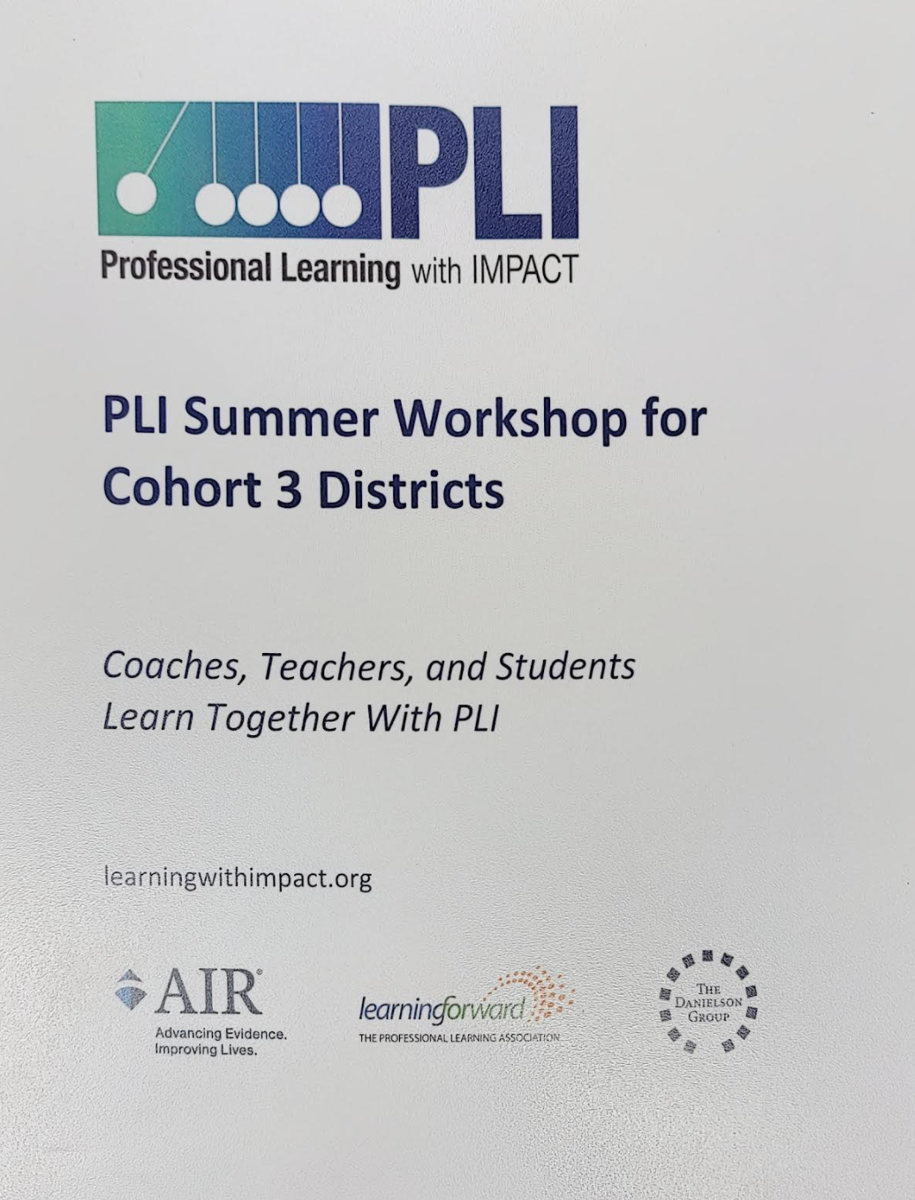
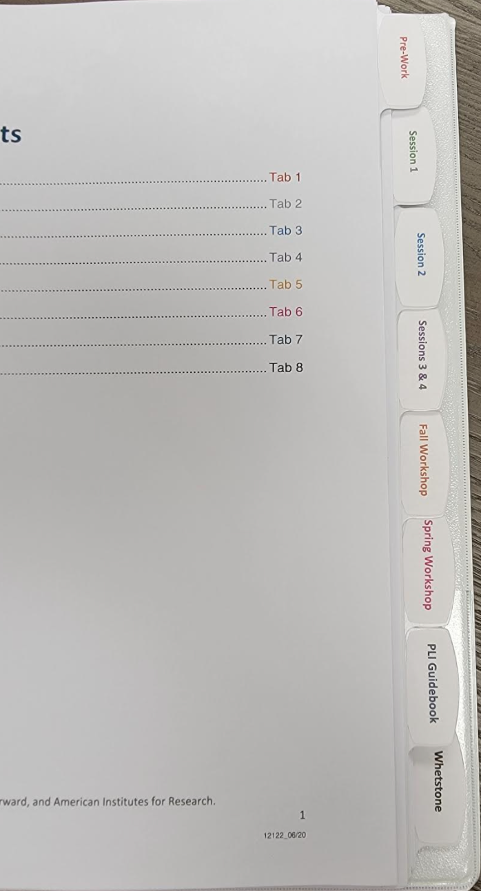
Materials by Your Side
Professional Learning with Impact (PLI) Binder
Materials provided for this workshop
Breakout Room Slide Deck
Access to Whetstone account
Highlighter
Paper and pencil/pen

Slide 8
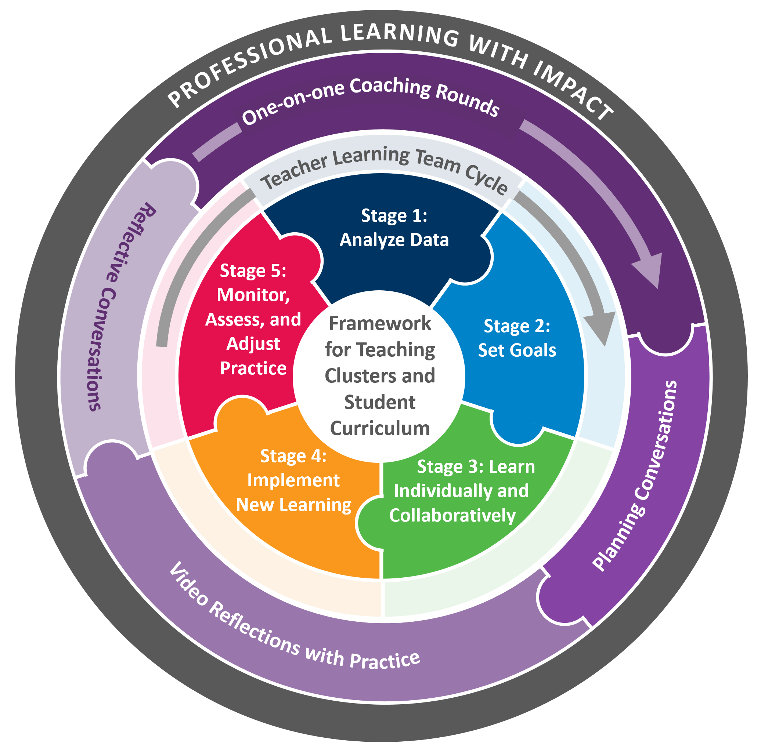
Professional Learning with Impact (PLI) Program Overview
Notes:
Review program, briefing figure from inside out
PLI is a product an instructional coaching model centered in the framework for teaching clusters that DG has been developing for years and the teacher learning team cycle of inquiry that LF has been developing for years
Exploring collaboratively and individually
Material that teachers and students engage with - clusters and curriculum
Collaborative process through which teachers improve - TLT and coaching
Mutually reinforcing each other
Cyclical

Slide 9
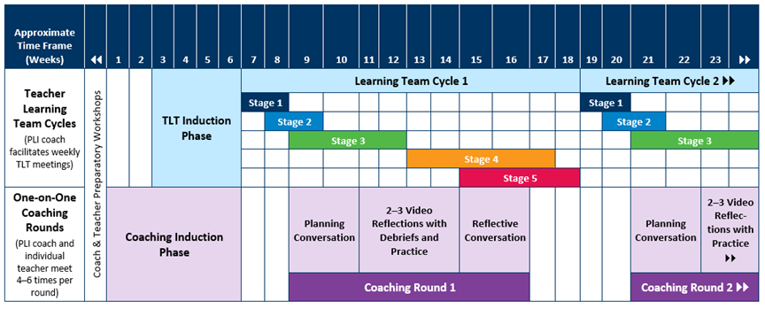
PLI activities - Where Are You Now?

Slide 10

The power of professional learning comes when educators can have focused
discussions about the teaching and learning that they witness…
The process of discussing what one has learned …with colleagues, and how it
can be applied to one’s own practice, are the actions needed to enhance teaching
and learning. Danielson, Talk About Teaching
Notes:
Everyone engages in collaborative conversations. We should know how to engage in conversations skillfully.
By learning to be more effective in our discussions about teaching and learning, we will be intentional in our practice.

Slide 11
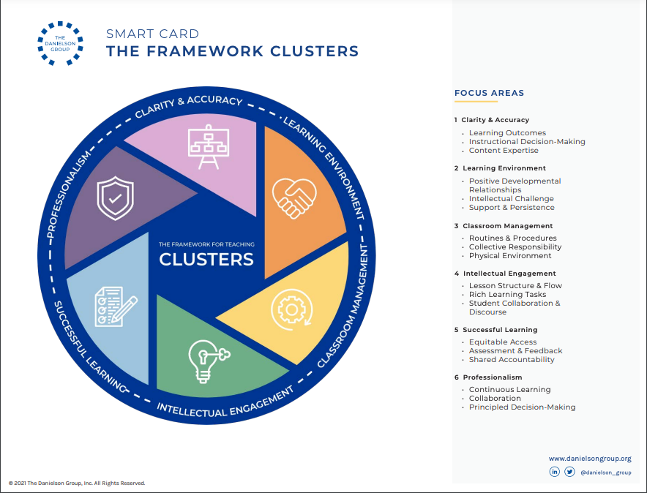
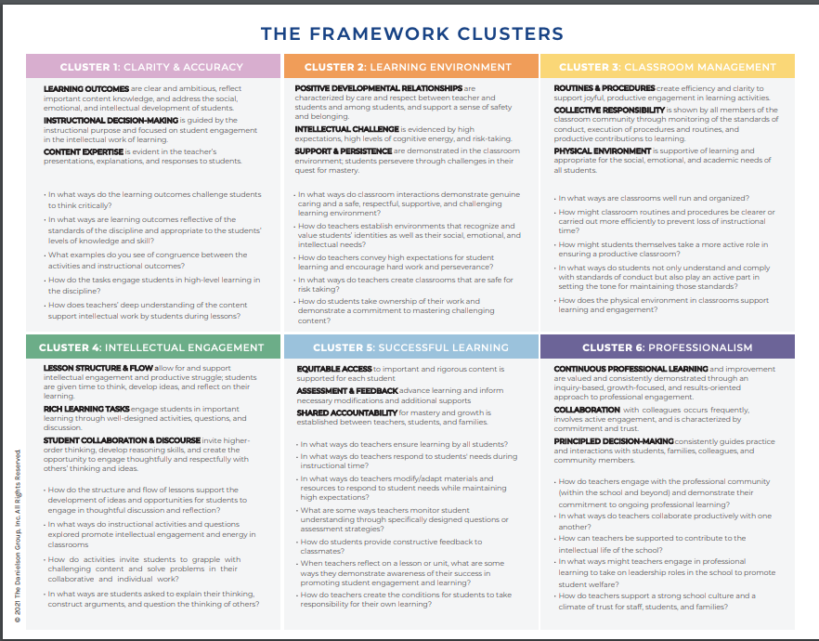
Notes:
Introducing the Smart Card. Have the participants find their Smart Cards. This was given to them for this workshop.
Ask the participants to look over the Smart Card independently. Give them 3 minutes to do this.

Slide 12


In your breakout room, select:
Facilitator - leads discussions
Recorder - takes notes to share with the whole group
Time Keeper - keeps track of time
Technology Lead - operates the technology in breakout rooms
Notes:
Tell participants that we will be getting into our first breakout group and using breakout rooms throughout our time together. We have thoughtfully made decisions on how the groups will be formed based on the activity, so at times they will be random and other times, they will be in school teams.
The first order of business when getting into breakout groups is to define 4 important roles.

Slide 13

4R’s: Round Robin, Rapid Recall
1
In break out rooms by school teams,
recall key ideas for each FFT Cluster in round-robin fashion.
There will be 1 minute for each FFT Cluster.
Each person will share key ideas of the FFT Cluster until time up.
There will be a broadcast when it is time to move to the next FFT Cluster.
Notes:
8 minutes total. Broadcast every minute to the breakout rooms when it is time for them to move to the next FFT Cluster.

Slide 14
Notes:
Returning from the breakout room, emphasize the use of the Smart Card and summarize by asking the following questions (responses in chat):
Which FFT Cluster have you been most engaged with so far?
Which FFT Cluster did you learn more about?
In PLI, whether during TLTs or 1:1 Coaching Rounds, both coach and teacher engage in collaborative conversations using FFT Clusters to anchor thinking.

Slide 15
Collaborative Conversations with FFT Clusters
What are some qualities of effective questions or prompts that invite thinking?
Put 2 qualities in the Chat box that come to mind.
Notes:
After the participants put qualities in the chat, mention some qualities and how these qualities are effective in collaborative conversations and with tagging video. Teachers will tag video and coaches will tag video, so having these skills will be beneficial to reflective practice.

Slide 16

COLLABORATIVE CONVERSATION SKILLS CARD SORT
2
In Breakout Rooms:
Open the jamboard for your district.
Analyze each statement or questions or similarities and differences:
Which prompt thinking?
Which ones might you feel comfortable or confident answering?
Sort the statements and questions into two groups/piles:
invites thinking
doesn’t invite thinking

Slide 17
A
B
Tell me how the rubric improved skills.
So you said, ”The engagement strategies I tried did not work.”
Can you think of any reason for the student’s behavior in the breakout room?
Why did you select that focus area?
In what ways did the instructional strategy connect to the student learning goal?
Considering the FFT Cluster focus areas in this coaching round, what are some key learnings?
What might be some refinements or next steps for the next practice period?

Slide 18
Is this A or B?
What could you have done differently in this lesson?
It seems that you were concerned about one table’s lack of participation in the activity, what might be some reasons for their lack of participation?
Do you think it would have helped if you engaged the students more?
How might you prioritize the comprehension tasks?

Slide 19
Rewrite
From this example...
1. What is one thing you would change in this lesson?
2. Why did you select that focus area?
3. Can you think of any reason for the student’s behavior during independent work?
to these exemplars.
1. Given your concerns about this lesson, what might be some possible changes to address your concern?
2. In what ways does this focus area connect to your learning goal?
3. What might be some reasons for students’ behavior in this breakout room?
Notes:
The rationale for practicing writing of questions/comments is for tagging video.
DIRECTIONS:
Pick one of these 3 examples and rewrite them to invite thinking.

Slide 20
Summarizing: Inviting and Sustaining Thinking
Use non-dichotomous questions
Use plurals
Use exploratory language

Slide 21
Paraphrasing: Acknowledge and Clarify
Provides an opportunity to identify and directly reflect content and emotions.
Communicate speaker’s desire to understand and our value for the person.
Intentionally eliminate person pronouns like “I.”

Slide 22
Tips for Paraphrasing
In other words,
So you’re feeling,……
You’re noticing that….
You’re suggesting that…..

Slide 23
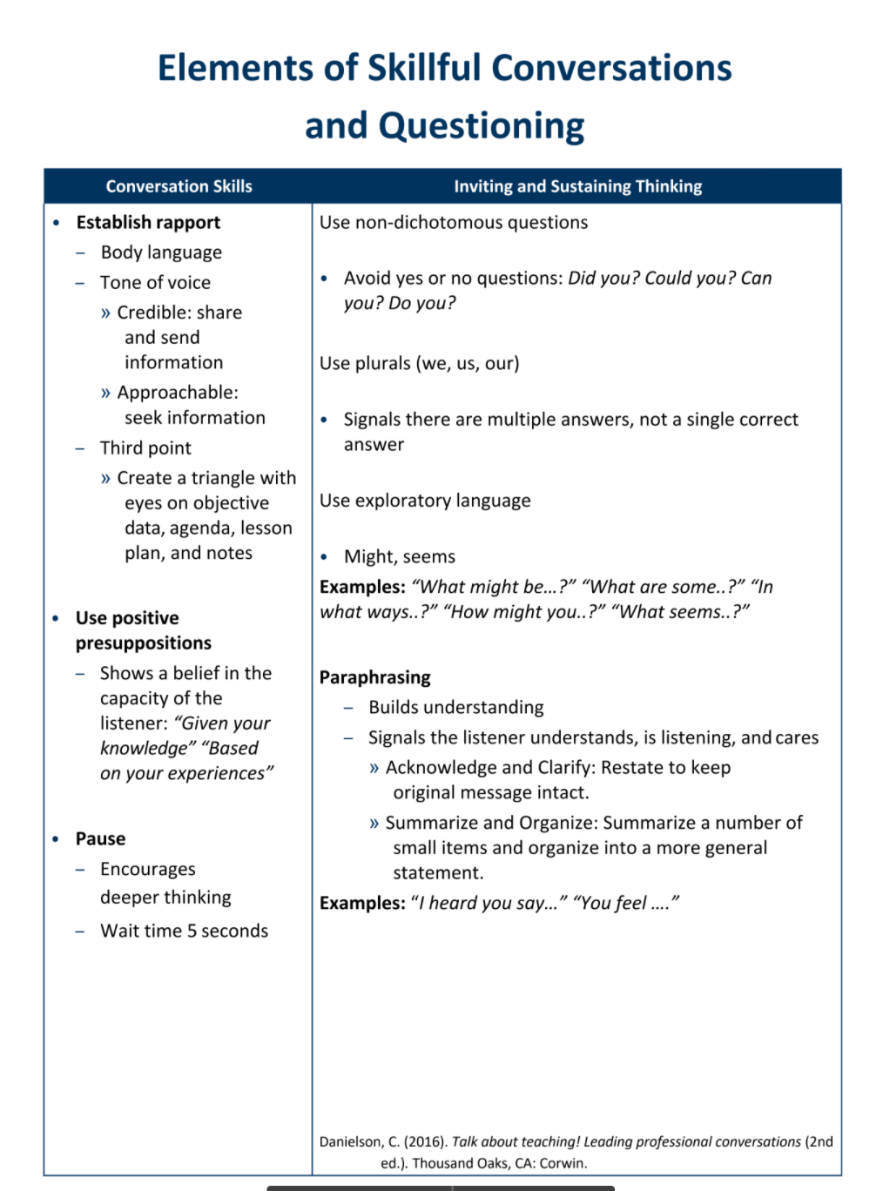
Elements of Skillful Conversations and Questioning
Locate this document in your PLI Binder
> Session 3 & 4 tab
Notes:
Everyone engages in collaborative conversations. We learn more in conversations that elicit our thinking.

Slide 24

Collaborative Conversations
Establishing Rapport
Using positive presuppositions
Inviting and sustaining thinking
  Asking non-dichotomous questions
  Using plural forms
  Promoting analytic thinking
  Encouraging metacognition
  Examining assumptions and implications
Probing
Paraphrasing
Which skills are already part of your repertoire?
What might be some skills to add next to your repertoire?
Notes:
Using the “Elements of Skillful Conversations and Questioning” handout,
explain that we just introduced Inviting and Sustaining Thinking which is in italics in this slide.
Independently have them read Establishing Rapport, Using Positive Presuppositions, Pause and Paraphrasing. Give them additional think time to answer the two questions at the bottom of the slide. They will be going into breakout rooms with partner next to discuss.

Slide 25
Practicing Skills
3
In breakout rooms with a partner:
Determine who is A and who is B.
A shares responses to the two questions:
Which skills are already part of your repertoire?
What might be some skills to add next to your repertoire?
B practices asking invitational questions and paraphrasing.
Reverse roles.
Notes:
6 min

Slide 26
The Power of Teacher Agency by L. Calvert
In the context of professional learning, teacher agency is the capacity of teachers to act purposefully and constructively to direct their professional growth and contribute to the growth of their colleagues.
Rather than responding passively to learning opportunities, teachers who have agency are aware of their part in their professional growth and make learning choices to achieve their goals.
Learning Forward April 2016 | Vol. 37 No. 2
Notes:
Segway - by learning to become effective in collaborative conversations, you can increase your agency.

Slide 27
Teacher Agency in Coaching Rounds
Teacher agency
direct their professional growth is voice.
make learning choices to achieve their goals is choice.
Independently,
Review Chapter 6 (pages 44-50) and annotate the pages for teacher agency by using V for voice and C for choice.
Notes:
The two bullets are phrases from the quote used in the previous slide. We will have the participants skim the chapter with the lens of teacher agency and annotate with V for voice and C for choice when the read something that exemplifies how the teacher has agency in the coaching round process. Provide 5 minutes for the participants to do the annotations.
Next they will go into a breakout room by school teams.

Slide 28
How do teachers have voice and choice?
4
In the breakout rooms with school teams,
each person shares the annotations they made for voice or choice.
What questions might you have about coaching rounds?
Notes:
8 min in breakout rooms.
After they return to the gallery, inquire about any questions.

Slide 29
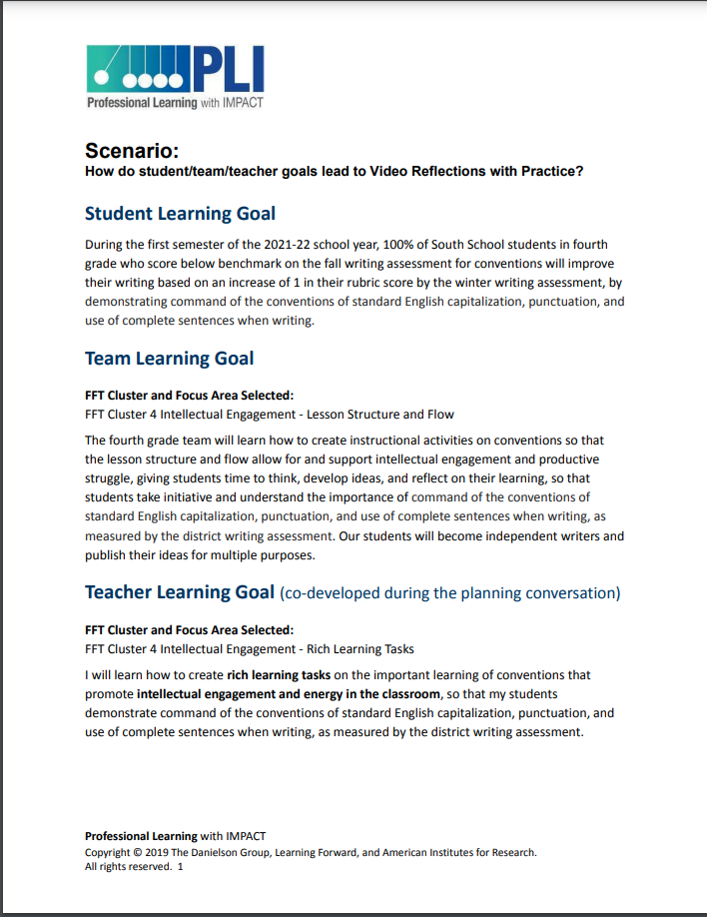
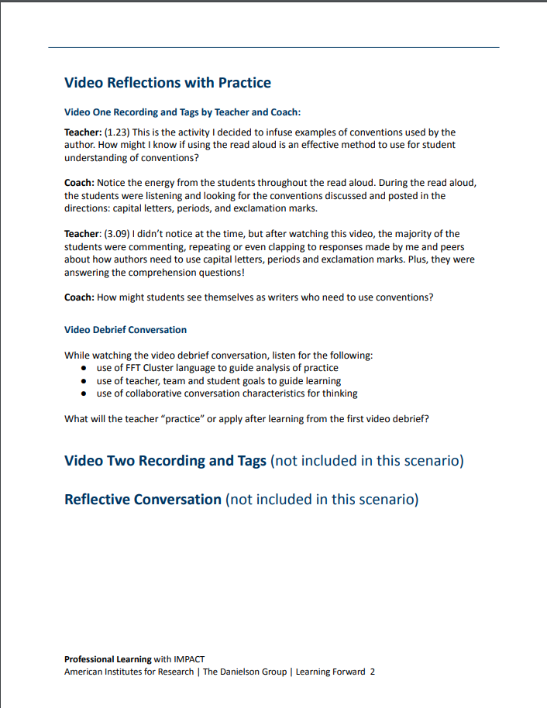
Scenario
Let’s look at how the student learning goal >
team learning goal > teacher learning goal
leads to the video reflections with practice.
Read and find the connections between
student learning goal
team learning goal
teacher learning goal
Read the teacher and coach video tags.

Slide 30
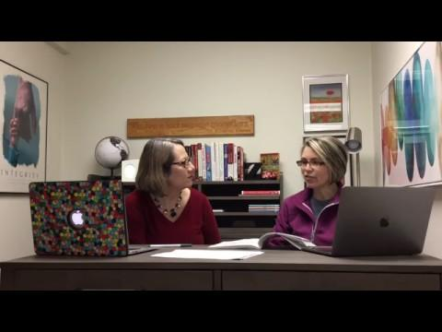
Video One Recording and Tags by Teacher and Coach:
Teacher: (1.23) This is the activity I decided to infuse examples of conventions used by the author. How might I know if using the read aloud is an effective method to use for student understanding of conventions?
Coach: Notice the energy from the students throughout the read aloud.
During the read aloud, the students were listening and looking for the
conventions discussed and posted in the directions:
capital letters, periods, and exclamation marks.
Teacher: (3.09) I didn’t notice at the time, but after watching this video,
the majority of the students were commenting, repeating or even clapping
to responses made by me and peers about how authors need to use
capital letters, periods and exclamation marks. Plus, they were answering the
comprehension questions!
Coach: How might students see themselves as writers who need to use conventions?
Student Learning Goal
Teacher Learning Goal
Team
Learning
Goal
Video Debrief Conversation
use of FFT Cluster language to guide analysis of practice
use of teacher, team and student goals to guide learning
use of collaborative conversation characteristics for thinking
What will the teacher “practice” or apply after learning from the first video debrief?
Notes:
The teacher and coach tags are on this slide so that participants can see the connections being made between the teacher and coach tags to the debrief conversation.

Slide 31
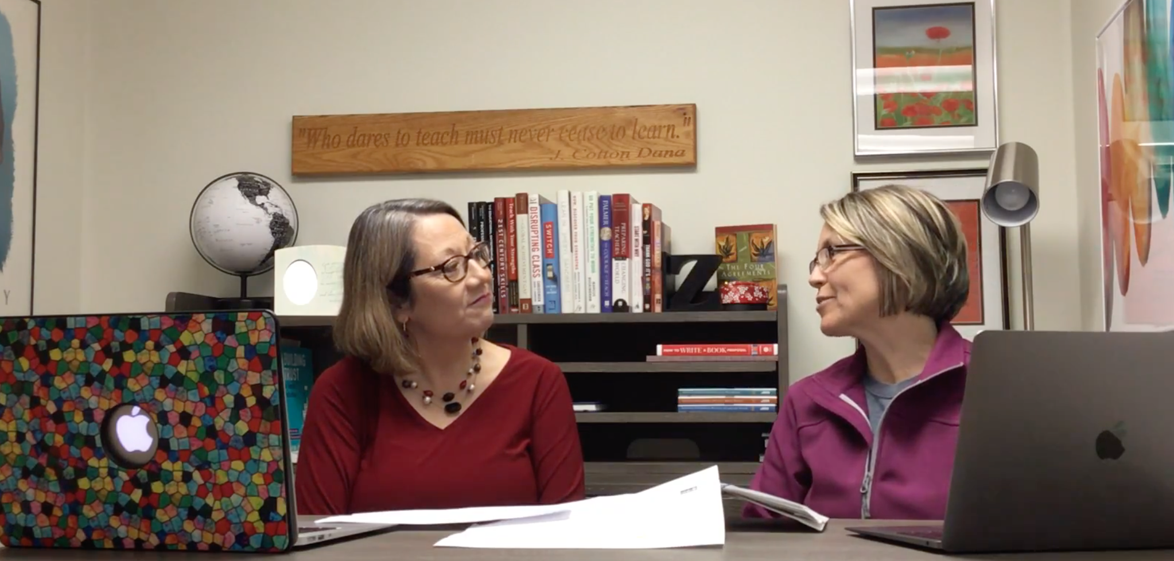
Video Debrief in Gallery
use of FFT Cluster language to guide analysis of practice
use of teacher, team and student goals to guide learning
use of collaborative conversation characteristics for thinking
What will the teacher “practice”
or apply after learning from the
first video debrief?
Notes:
After this debrief of the video, have the participants take out the Coaching with the FFT Clusters document that was provided for this workshop. This was shared this summer, but we are sharing again because it is a one pager that has all the reminders on it.
This is the Coaching with the FFT Clusters document: https://drive.google.com/file/d/1PdFZi4Gd5aru7KKvj-t2DDUKu8TrPway/view?usp=sharing.

Slide 32
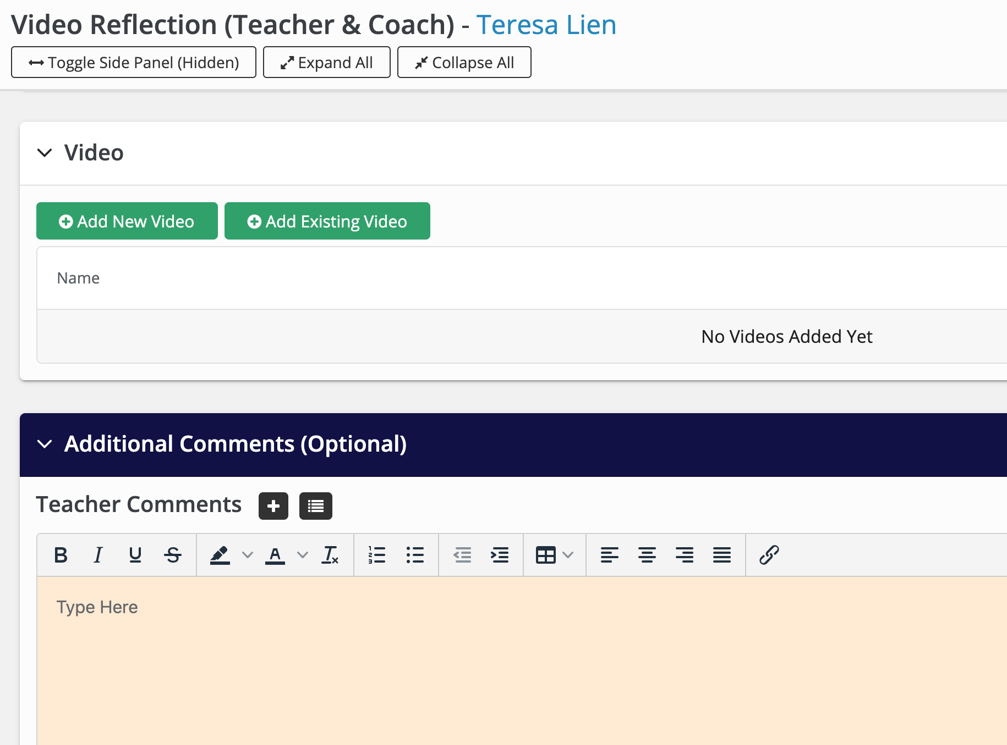
Your Turn!
5
In breakout rooms with a partner,
practice uploading a video in your own account and tag with comments to your coach.
Think collaborative conversation skills.
Use the Your Turn document to navigate through this exercise
If you do not have a video of your own, use the video provided in the Your Turn document.
Notes:
15 min
Remind coaches that they will be needing these skills too because they will be uploading and tagging the video captured of coaching conversations.

Slide 33
break

Slide 34
PLI activities - Where Are You Now?

Slide 35
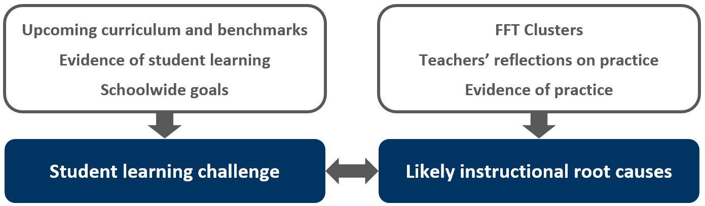
Stage 1: Analyze Data

Slide 36
Stage 1: Analyze Data: Review
6
01
02
03
Review/Skim Stage 1 in Manual (pg. 21-23 )
In breakout rooms, read the reflective statements around data and determine your most comfortable and your least comfortable for your team.
Each team share out their most comfortable or their least
Notes:
Share out:
what can we share with each other to support our comfort/skills with data analysis?

Slide 37
Stage 1: Analyze Data: Review
We collect data to determine gaps between our vision and current state.
2. We know what types of data we will need to access regularly to define our current state and we know how to access them.
3. We are confident that we have the skills and knowledge to interpret and use data to guide decisions about learning and improvement.
4. We can create a safe environment for analyzing data so team members are comfortable discussing potentially difficult topics.
5. We know what data we will regularly collect to inform our current learning and improvement process.
6. We know how to use protocols to support the data analysis stage.
7. We know what information is available to define our desired state and we know where to find it.

Slide 38
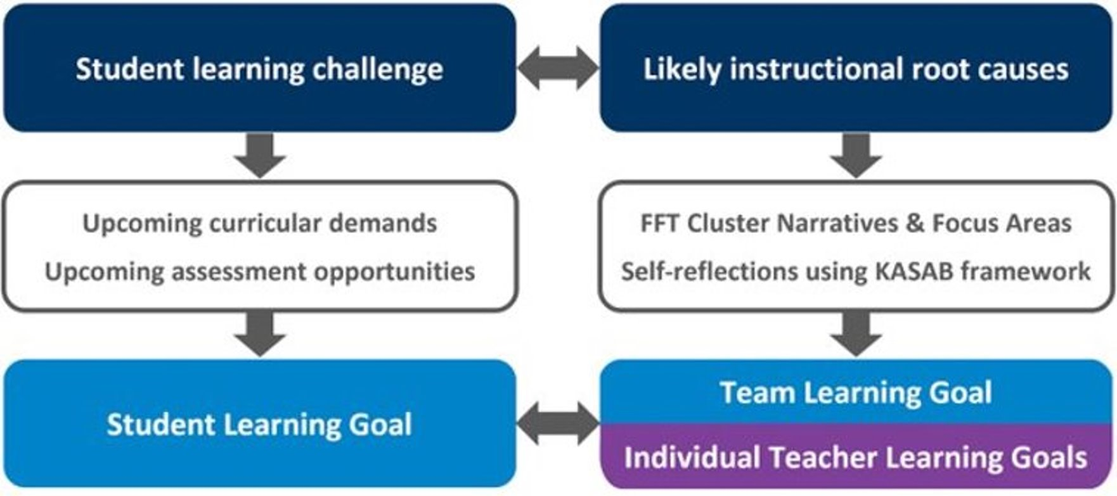
Stage 2: Set Goals
Stage 2: Set Student and Educator Goals

Slide 39
Student and Team Learning Goals—Examples
Student Learning Goal
Team Learning Goal
By the end of the second quarter, fourth-grade students will demonstrate proficiency or above in understanding the four concepts of text structure, oral, character traits, problem and solution by eplanning examples of each concept in writing a paragraph measured by the district writing assessment.
If the team makes strategic modifications to their writing lessons so students use all four text structures in a short story by leveraging district sources of support based on assessments and for student learning and progress aligned to outcomes, then our students will demonstrate proficiency with text structure, moral character traits and problem and solution
SMART format
If____, then ____ statement
Notes:
Example. What do you notice?

Slide 40

7
Matching Goal Statements
Examine the student and educator goals in the Jamboard.
Read the goals and match the educator goal with the student goal that it supports
Notes:
4 min

Slide 41
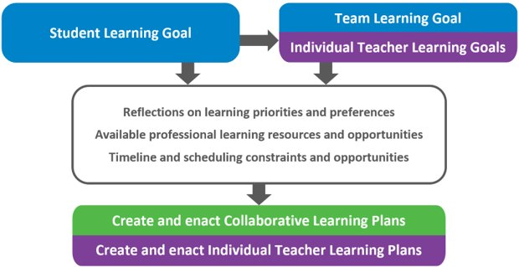
Stage 3: Learn Individually and Collaboratively
Stage 3: Learn Individually and Collaboratively
Notes:
Page 32, Guiding questions, Key actions and protocol
(5 min)

Slide 42




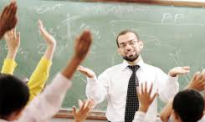
KASAB as Framework for Teacher Learning Goals
Knowledge | Conceptual understanding of information, theories, principles, research
Attitude | Beliefs about the value of particular information or strategies
Skill | Strategies and processes to apply knowledge
Aspirations | Desires, or internal motivation, to engage in a particular practice
Behaviors | Consistent application of knowledge and skills
Notes:
In chat, ask people to share a sentence to describe that component in their own words before revealing the description

Slide 43
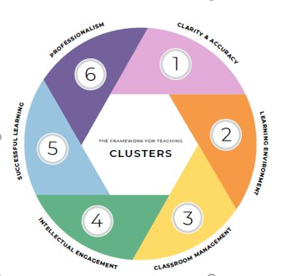
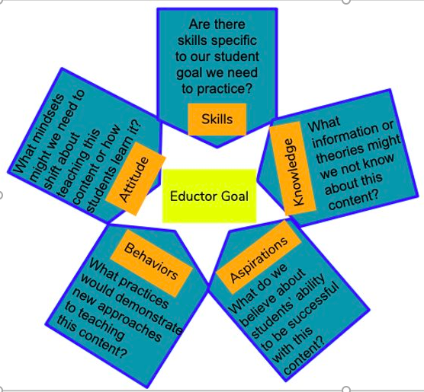
8
Application of KASAB
Go back to the three examples of Team Learning Goals:
  As you review the educator goal through the lens of KASAB, what elements of that framework stand out?
  Which of the FFT clusters might be the focus of this goal? How do you know?
Notes:
https://docs.google.com/document/d/1EvH5XhiB6tUDdFczUGfGR4rotGskifAWVREOwSSHLAI/edit?usp=sharing
5 min

Slide 44
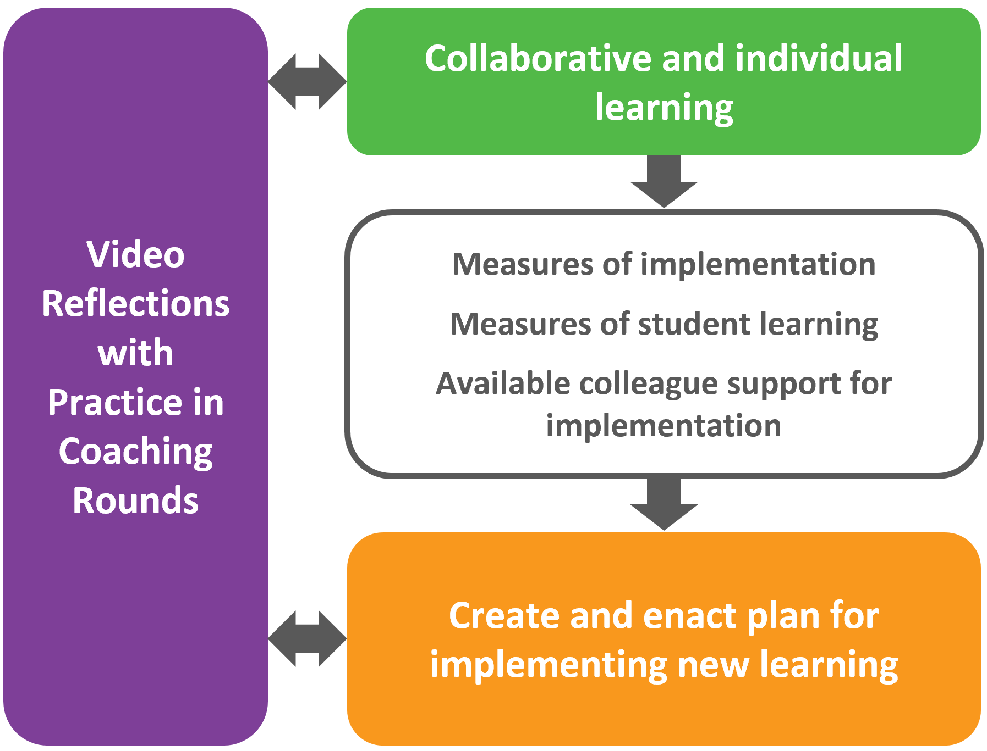
Stage 4: Implement New Learning
Notes:
Similar
Guiding questions and key actions and protol beginning on page 36
(5 min)

Slide 45
Stage 5: Monitor, Assess, and Adjust
Implement new learning.
Collaboratively analyze collected data on teaching and student learning.
Make collaborative, evidence-informed adjustments.
Reflect on and document progress: Student and Team Learning Goals.
Reflect on and document progress:
Individual Learning Goals.
Notes:
Suggested edits:
Be curious
Ask questions
All learning together
Be an active contributor
Page 40
(5 min)

Slide 46
Stages 4 & 5:
9
01
02
03
Jigsaw the guidebook sections for Stage 4 & 5
Dig Deeper into each stage using the narrative and protocols
Find an image/metaphor that how these 2 stages are different from Stages 1-3
Be ready to share out in whole group during the debrief
Notes:
Ask questions
All learning together
Be an active contributor
1 min

Slide 47
Stage 4 & 5: Deeper Dive Part 2
Drilling Down to the Details
9
Stage 4 Practice
Read the stage 4 narrative on pg. 64 in the Guidebook.
As you consider this team’s journey, what do you anticipate might be similar to yours? What might be different?
Read through the protocol on page 37.
Consider which step might prove the most challenging.
Where will you get the support needed to complete that step?
Stage 5 Practice
Read the stage 5 narrative on pg. 65-66 in the Guidebook.
As you consider this team’s journey, what do you anticipate might be similar to yours? What might be different?
Read through the protocol on page 41.
Consider which step might prove the most challenging.
Where will you get the support needed to complete that step?
Jigsaw pages 34-41
pgs. 34-35
pgs. 36-37
pags. 38-41
For now, leave out the protocol as you jigsaw.
Share out your learning with the other two sections.
Notes:
Similar
Guiding questions and key actions and protol beginning on page 36
(5 min)

Slide 48
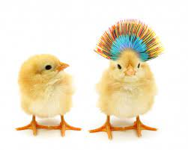
Create an Image or a Metaphor that Explains….
How are these last two stages
are different from the first three?

Slide 49
Let’s Review!
9
2
6
1
3
5
4
7
8
Notes:
Introducing the “PLI” acronym
Review program, briefing figure from inside out
PLI is a product an instructional coaching model centered in the framework for teaching clusters that DG has been developing for years and the teacher learning team cycle of inquiry that LF has been developing for years
Exploring collaboratively and individually
Material that teachers and students engage with - clusters and curriculum
Collaborative process through which teachers improve - TLT and coaching
Mutually reinforcing each other
Cyclical

Slide 50
Closure- Reminder of the Why
Improved student engagement
Improved academic achievement
Teacher professional learning
Improved classroom practice
Increased teacher knowledge and skills
Increased self-efficacy for improving classroom practice and student engagement
Teacher design of effective instruction
Notes:
Lead through whole group

