Slide 1


Professional Learning With
Impact Coach Preparatory Workshop
Professional Learning with Impact Coach Preparatory Workshop. Summer 2021. This work is licensed under a Creative Commons Attribution-NonCommercial-ShareAlike 4.0 International (CC BY-NC-SA 4.0) License.
The contents of this slide deck were developed under a grant from U.S. Department of Education, Office of Elementary and Secondary Education, Award No. U411B180032; However, those contents do not necessarily represent the policy of the Department of Education, and you should not assume endorsement by the Federal Government.

Slide 2
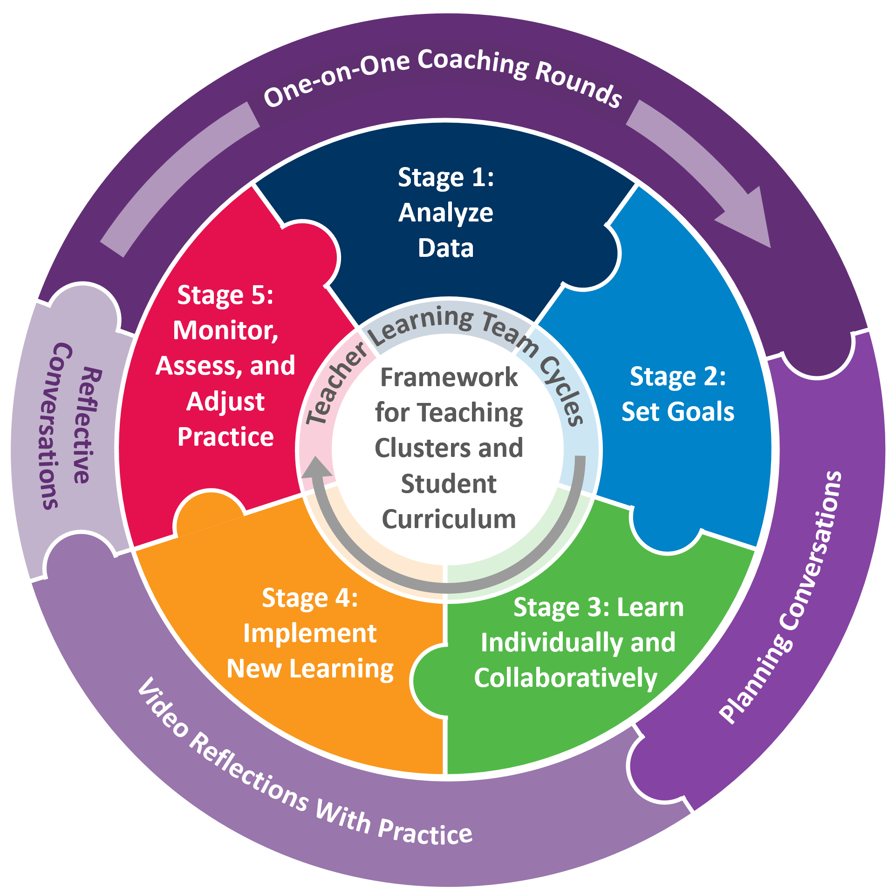

Session 1
Notes:
Introducing the “PLI” acronym
Review program, briefing figure from inside out
PLI is a product an instructional coaching model centered in the framework for teaching clusters that DG has been developing for years and the teacher learning team cycle of inquiry that LF has been developing for years
Exploring collaboratively and individually
Material that teachers and students engage with - clusters and curriculum
Collaborative process through which teachers improve - TLT and coaching
Mutually reinforcing each other
Cyclical

Slide 3
Professional Learning With Impact (PLI) Program Overview
Notes:
Introducing the “PLI” acronym
Review program, briefing figure from inside out
PLI is a product an instructional coaching model centered in the framework for teaching clusters that DG has been developing for years and the teacher learning team cycle of inquiry that LF has been developing for years
Exploring collaboratively and individually
Material that teachers and students engage with - clusters and curriculum
Collaborative process through which teachers improve - TLT and coaching
Mutually reinforcing each other
Cyclical

Slide 4
PLI Theory of Action
Improved student engagement
Improved academic achievement
Teacher design of effective instruction
Improved classroom practice
Increased teacher knowledge and skills
Increased self-efficacy for improving classroom practice and student engagement
Teacher professional learning

Slide 5
Opportunities to Provide Feedback on Program Design and Implementation
PLI coaches:
  Exit survey on workshop quality (fill out before you leave!)
  PLI coaches’ logs
  45-minute phone interview (two per year, fall and spring)
PLI teachers:
  Teacher survey (spring―teachers only)
Anyone:
  Contact any partner any time with questions, concerns, or kudos!
Notes:
Remind participants that this is the first of three years and that one of the central purposes of these grants is to support continuous improvement. They have a role in helping to improve PLI before it is scaled up and implemented in more districts and schools.

Slide 6
Who’s who in PLI?
PLI coaches from partner districts | Danielson Group program specialists | Learning Forward program specialists | American Institutes for Research researchers | Whetstone
Implement PLI through TLT facilitation and one-on-one instructional coaching. | Provide support for one-on-one instructional coaching. | Provide support for TLT facilitation. | Oversee PLI project. Evaluate implementation and impact of PLI. | Design and provide support for PLI platform.

Slide 7
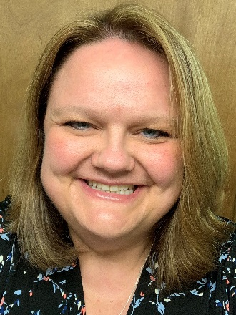
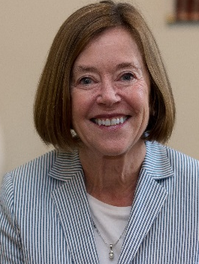
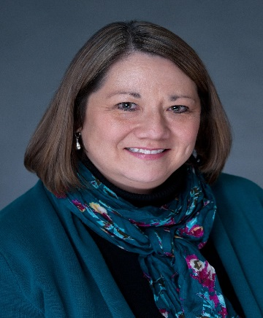
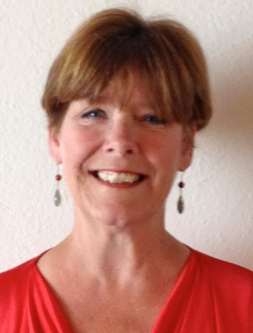
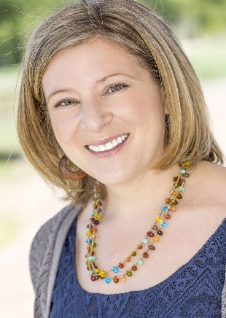

Meet the Facilitators/Lead Learners/Program Specialists
Tanya Batzel
Jorie Ellis, PhD
Teresa Lien
Peggy Olcott
Kellie Randall
Learning Forward
Senior Consultant
303-918-4873
tanya.batzel@
learningforward.org
Danielson Group
Curriculum Designer
503-970-3370
ellis@danielsongroup.org
Danielson Group
Project Coordinator
608-963-4594
lien@danielsongroup.org
Danielson Group
Curriculum Designer
206-335-0362
olcott@danielsongroup.org
Learning Forward
Senior Consultant
303-570-3911
kellie.randall@
learningforward.org

Slide 8
Outcomes of the PLI Team Sessions
By the end of the training, you will
understand the PLI program and how its components work together;
know the features of the Framework for Teaching (FFT) Clusters that support reflection and analysis of instruction;
apply the five stages of the teacher learning team cycle; and
know the process of 1:1 coaching rounds.
Notes:
Compare these to the tree map

Slide 9

Agenda: Session 1
(3.5 hours)
Welcome and Introductions
PLI Component Overview
Equity in the Framework for Teaching Clusters
Induction Phrase: Laying the Foundation
Stage 1: Identifying Learning Challenges and Root Causes
Wrap-Up and Debrief

Slide 10

Materials by Your Side
PLI Guidebook
Framework for Teaching Clusters Primer document
Session 1 and 2 Breakout Room Notetaker (open from chat)
Highlighter
Paper and pencil/pen

Slide 11
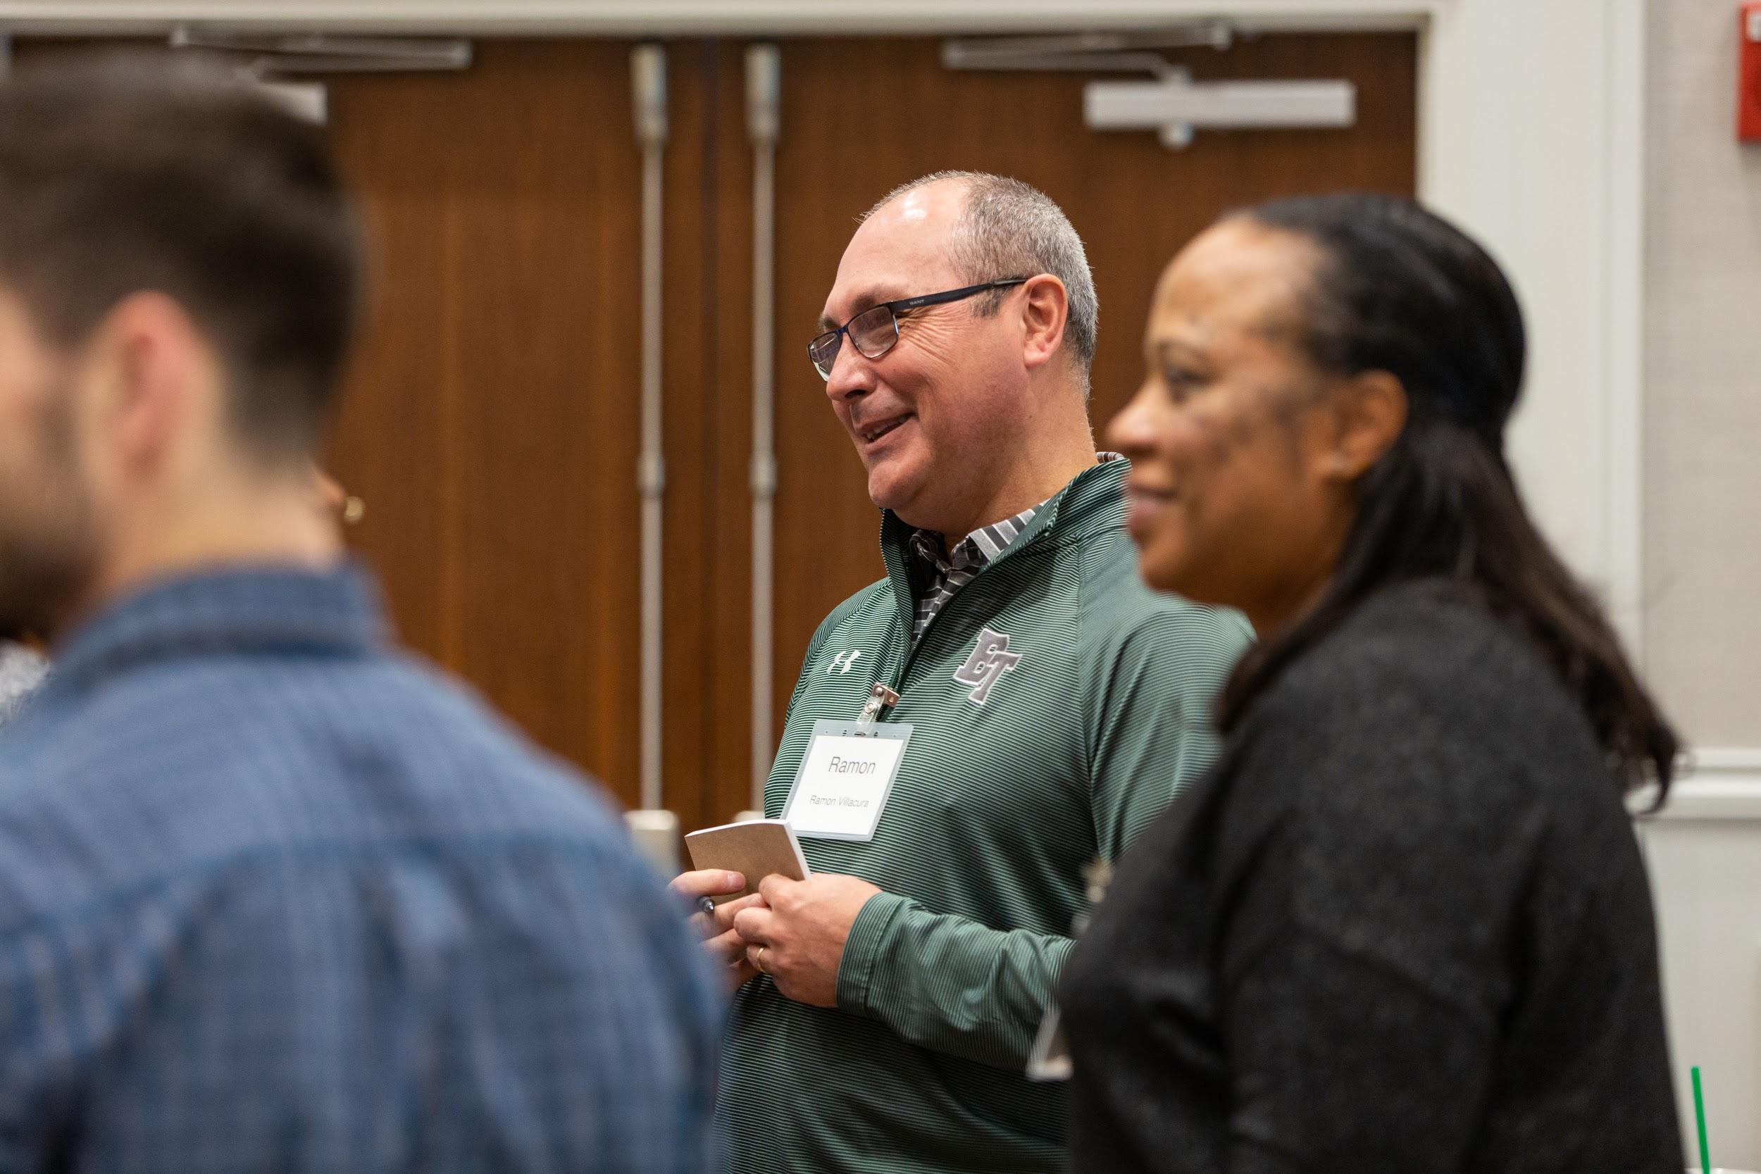
GROUND RULES
BE OPEN.
BE PRESENT.
Notes:
1 min
Explain that we have two ground rules for our workshop. Give specific examples that make sense for you, them, and the context. For example:
Be open - to new ideas, new ways of thinking, differences of opinion, challenges to your own thinking, someone else’s perspective. Openness also includes flexibility to change course or do things differently.
Be present - mentally engaged, avoiding your cell phone, standing or taking a break if you need to, actively listening when others are sharing.

Slide 12

Describing Our Current Practices
Collaborating with our team:
We use agendas and protocols to guide our conversations.
We have a predictable flow to our conversations.
We stop, study, and learn new practices and skills that align with what our students need.
Working with a coach:
We engage in coaching cycles around a teacher-identified goal.
Our work with our coach aligns to our collaborative team work.
Coaches provide specific teacher-directed feedback based on common language of instruction.

Slide 13
Professional Learning With Impact (PLI) Program Overview
Notes:
Introducing the “PLI” acronym
Review program, briefing figure from inside out
PLI is a product an instructional coaching model centered in the framework for teaching clusters that DG has been developing for years and the teacher learning team cycle of inquiry that LF has been developing for years
Exploring collaboratively and individually
Material that teachers and students engage with - clusters and curriculum
Collaborative process through which teachers improve - TLT and coaching
Mutually reinforcing each other
Cyclical

Slide 14
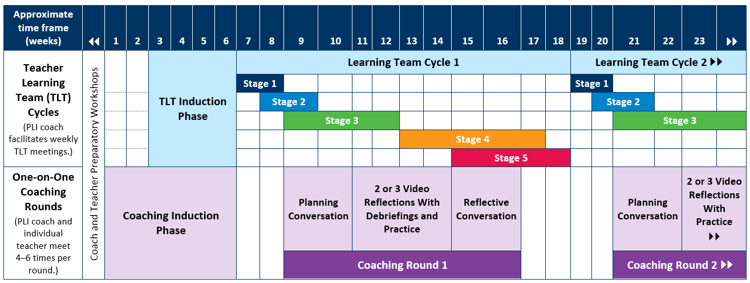
PLI Activities and Time Frames
Notes:
Coaches wear multiple hats; serve as the facilitors of the TLTs and provide one-on-one coaching to participating teachers – this is a representation of the flow of work not mandates of how many weeks things MUST take

Slide 15
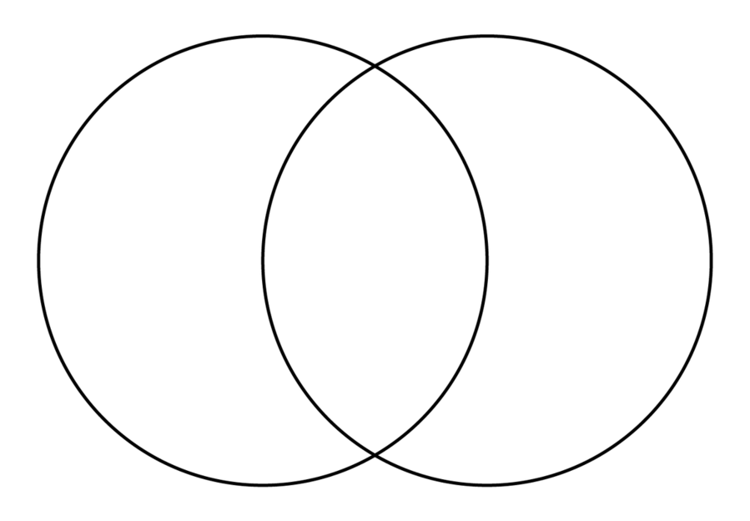
Compare/Contrast
Our Current Practices
Both
PLI Model

Slide 16

Unpacking the Components of PLI

Slide 17
Professional Learning With Impact (PLI) Program Overview
Start here.
Notes:
Introducing the “PLI” acronym
Review program, briefing figure from inside out
PLI is a product an instructional coaching model centered in the framework for teaching clusters that DG has been developing for years and the teacher learning team cycle of inquiry that LF has been developing for years
Exploring collaboratively and individually
Material that teachers and students engage with - clusters and curriculum
Collaborative process through which teachers improve - TLT and coaching
Mutually reinforcing each other
Cyclical

Slide 18

Rationale for Framework for Teaching Clusters
The Clusters are an attempt to distill the “big ideas” of the Framework for Teaching into an efficient tool that can serve as the foundation for many purposes, most importantly professional growth by teachers, not only through their own reflection on practice, but also through their conversations with colleagues, mentors and coaches, and supervisors.
—Charlotte Danielson
Source: https://danielsongroup.org/framework/framework-clusters
Notes:
Quote: http://blogs.edweek.org/edweek/finding_common_ground/2011/10/a_framework_for_good_teaching_a_conversation_with_charlotte_danielson.html

Slide 19
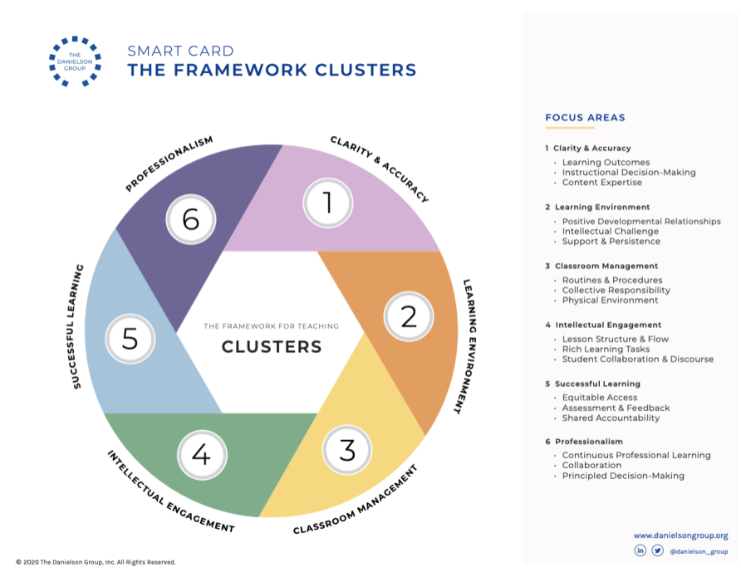


Slide 20

Implicit in the FFT is an equity imperative.
A commitment to excellence is not complete without a commitment to equity.
Charlotte Danielson
EACH AND EVERY student should have:
Opportunities to achieve and succeed
Open doors to higher education and careers
Additional levels of support when needed
A chance to overcome individual or community-wide doubts about their capability
“
Notes:
1 min
Implicit in the Framework is an equity imperative.
One of the most important themes is equity. Charlotte Danielson says, A commitment to excellence in teaching is not complete without a commitment to equity for all students. While this is not an exhaustive definition, important points to keep in mind when we think about equity are that each and every student should have:
This equity imperative - world-class teaching and learning for all students - is a fundamental principle of the Framework for Teaching.
As illustrated by the common themes, teaching is complex work. Making the decisions that lead to excellence for one student is difficult enough. But our work requires that we provide that level of excellence to each student.
The Common Themes of the Framework for Teaching guide these decisions.

Slide 21
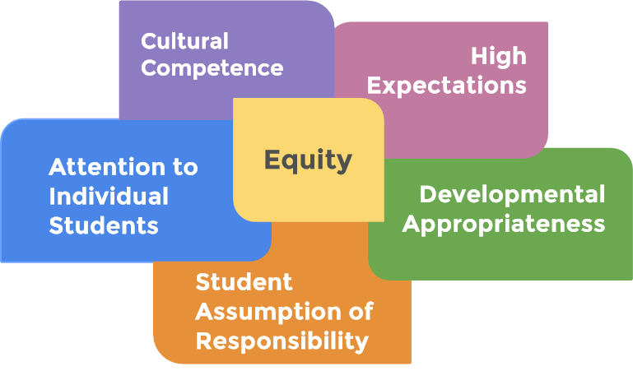
Introduction to the Common Themes
The Common Themes pervade the FFT and support our equity imperative.
What words come to mind when you think of a Common Theme?
Notes:
1 min
In developing the Framework for Teaching, Charlotte Danielson identified a set of Common Themes. Understanding them is essential to understanding the Framework for Teaching.
The Common Themes are important aspects of teaching. Coupled with a constructivist approach, these themes help us think about HOW learning occurs in classrooms not just for one student, but for all students. Not just some of the time or to a degree, but deeply and as frequently as possible.
It is important to note that the Common Themes are not components of the Framework for Teaching, because they don’t describe what teachers do. Instead, they describe the manner in which teachers do what they do. A close examination of the component level rubrics gives clues as to how the Common Themes are integrated across all of the domains and components of the Framework. One key to effective teacher practice is to implement the components with the common themes in mind.
For example, if a teacher has high expectations, those expectations will be reflected in the outcomes they set (they’re at a challenging level), in the questions they pose (at a high cognitive level), in the feedback they give to students (an expectation of high-level learning), and in the manner in which they communicate with families (assuming the student is capable of high levels of achievement.)

Slide 22
Show Wordle.

Slide 23


In your breakout room, select:
Facilitator - leads discussions
Recorder - takes notes to share with the whole group
Time Keeper - keeps track of time
Technology Lead - operates the technology in breakout rooms
Notes:
Tell participants that we will be getting into our first breakout group and using breakout rooms throughout our time together. The first order of business when getting into breakout groups is to define 3 important roles.
Generally speaking, we will let you know how much time you have in each breakout session. You will also get a message when you have one minute remaining. The timekeeper will help to keep the group on track. The recorder should be responsible for taking notes, but, does not have to be the person reporting out for the group when we all get back together in the main room.

Slide 24
What role do the Common Themes play in each FFT Cluster?
In breakout rooms (the number of the breakout room is the FFT Cluster you will concentrate on for this activity):
Technology Lead will open the electronic copy of the FFT Cluster primer, turn on the highlight function, and share their screen.
Using the Wordle as a guide, the participants will read the the FFT Cluster and note words and phrases that connect to any of the Common Themes.
The facilitator will lead this sharing and the technology lead highlights the words or phrases that connect to the Common Themes.
When returning to the gallery, the technology lead will share their screen and the recorder shares the connections.

Slide 25
Share Your Thinking
In order of the FFT Clusters (Cluster 1, Cluster 2, Cluster 3 and so on),
the technology lead will share their screen with the highlighted pages of the FFT Cluster.
the recorder will share the connections between the Common Themes and the assigned FFT Cluster.

Slide 26
Why FFT Clusters for teacher learning?
“Conversations about teaching must be about the cognition. It’s not sufficient to describe, or discuss, or even critique what a teacher has done; it’s essential also to explore the reasoning that underlie those actions.”
—Charlotte Danielson (2015, p. 7)
Source: Danielson, C. (2015). Talk about teaching! Leading professional conversations. Corwin.
Notes:
The cognitive nature of teaching, coaching supports the ongoing development of thinking of the concepts (Ch 3 Big Ideas) that impact practice. By using the FFT Clusters and anchoring in the language, expliciting exploring the concepts in the coaching conversations will support the teaching in purposeful decision making based on these concepts that impact practice, in addition to the mechanics of teaching (or vs the mechanics of teaching).

Slide 28
Clarity of Instructional Purpose and Accuracy of Content | Safe, Respectful, Supportive, and Challenging Learning Environment | Classroom Management
Student Intellectual Engagement
Successful Learning by All Students
Professionalism
The Framework for Teaching Clusters

Slide 29
FFT Cluster Features
Each FFT Cluster contains five key features:
A NARRATIVE description of the content of each cluster and the assumptions that underlie them
Three FOCUS AREAS to support professional growth and deepen understanding
A set of CONSIDERATIONS and INDICATORS prompt reflection, analysis, and goal setting
A set of RUBRICS provide a more detailed description of practices

Slide 30
Personalizing FFT Clusters
Individually, select a FFT Cluster that interests you.
Read the narrative and focus areas for your selected FFT Cluster.
Jot down two examples for this FFT Cluster in action.
What might it look like in a classroom?
Identify one focus area from this FFT Cluster that would deepen the practice of the two examples of classroom practice you described.
Be prepared to share your examples of classroom practice and the focus area with your school team in a breakout room.
When everyone returns to the gallery, the recorder will share the FFT Cluster and one example of the classroom practice in action.
Notes:
Handout: Cluster 1 Clarity and Accuracy 3-2-1+1
Reading from Six Clusters to Support Teacher Growth and Student Learning (Cluster 1 Clarity and Accuracy)

Slide 31

The First 6 Weeks: The Induction Phase
PLI Induction Phase

Slide 32
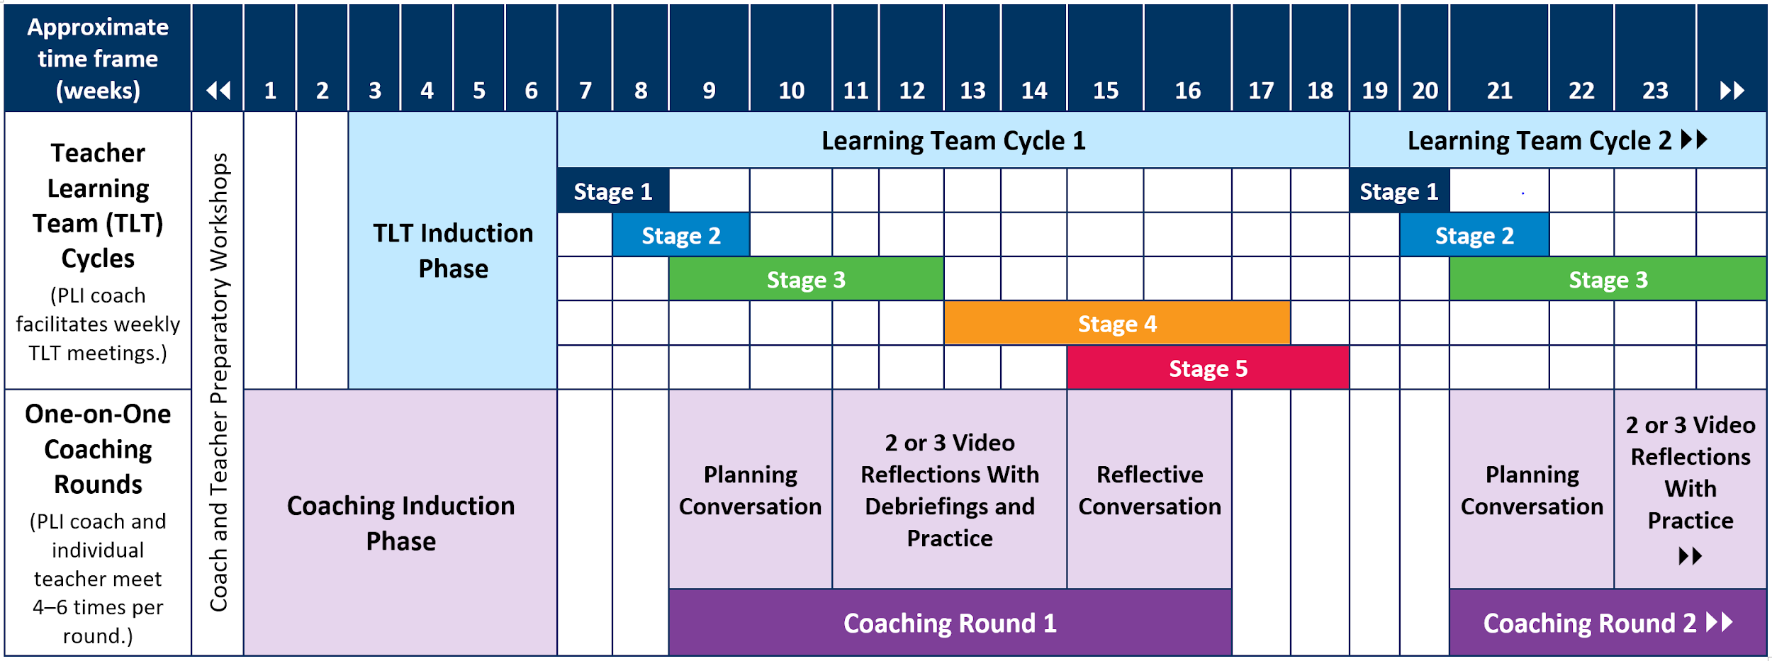
The First 6 Weeks
(PLI Induction Phase)
Notes:
include graphic of the stages schedule - highlight where we are

Slide 33
Jigsaw
Open the PLI Guidebook to page 16.
Jigsaw the chapter these three ways:
Page 16: Read the beginning of Chapter 4 and stop at the “Team Learning During the Induction Phase.”
Page 16: Read “Team Learning During the Induction Phase” and stop at “One and One Coaching” on page 17.
Read “One on One Coaching” on pages 17 and 18.
Each person shares the key points from their assigned section.

Slide 34
TLT Cycle Stage 1: Analyze Data
Notes:
Jigsaw Chapter 1in the guidebook (text, protocol, narrative).

Slide 35
Where are we?
Notes:
Introducing the “PLI” acronym
Review program, briefing figure from inside out
PLI is a product an instructional coaching model centered in the framework for teaching clusters that DG has been developing for years and the teacher learning team cycle of inquiry that LF has been developing for years
Exploring collaboratively and individually
Material that teachers and students engage with - clusters and curriculum
Collaborative process through which teachers improve - TLT and coaching
Mutually reinforcing each other
Cyclical

Slide 36
TLT Cycle Stage 1: Analyze Data
Key Steps in Stage 1
Identify and collect essential information.
Analyze student learning data.
Write data summary statements.
Identify likely instructional root cause.
Summarize instructional root causes.
Notes:
Jigsaw Chapter 1in the guidebook (text, protocol, narrative). Replace graphic with one from guidebook

Slide 37
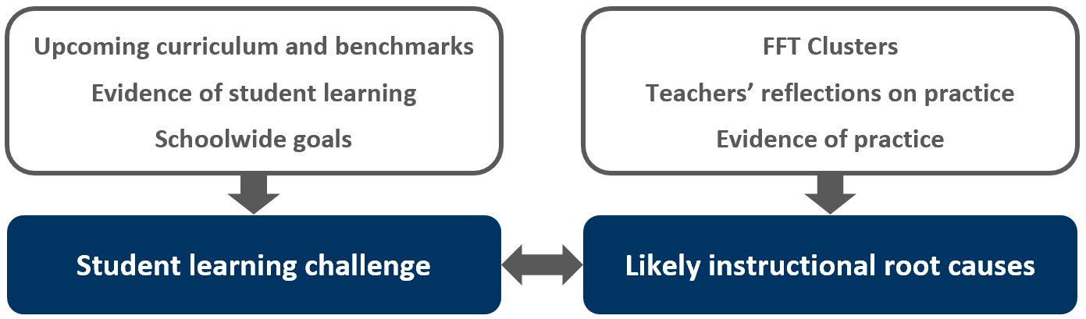
Stage 1: Analyze Data

Slide 38
Identifying Student Learning Challenges
Identifying student learning challenges has
three essential substeps:
Collect a variety of student, school, and curriculum data points.
Analyze those data points.
Summarize the analysis.

Slide 39

Identify and Collect Essential Information
Collect a variety of student data points.
Review your CASEL data points from your prework.

Slide 40
Analyze Student Learning Data
Make factual, objective observations of the data you’ve collected.
What stands out?
What surprised us?
What patterns exist?

Slide 41
Write data summary statements
Summarize the data analysis in written form.
Write concise, factual statements about the data.
Do not offer solutions or try to describe the cause.
Narrow it to one or two statements.

Slide 42

Identify Likely Instructional Root Cause
Consider patterns and trends across your team that would support a team focus in the FFT Clusters.
What cluster might align with the data that we are seeing?
What aspect of our teaching might we strengthen to address the student learning challenge?

Slide 43
Summarize Instructional Root Causes
Across all sixth-grade classes, 72% of girls are proficient in problem solving, while 64% of boys are proficient in problem solving.
One out of four fifth-grade classes achieve the district’s benchmark on the social studies 6-week benchmark last 6 weeks and they continue to struggle with the higher level thinking skills.
Less than one third of English learners demonstrated proficient academic language use during the last grading period.

Slide 44

Analyzing Data - Stage 1
In breakout rooms:
Complete as much of the Stage 1 protocol as possible, thinking through the lens of the data you will collect.
When you are finished, upload to Whetstone.

Slide 45



Homework
Record yourself explaining how you plan to get to know your students and families this year. 3-5 Minutes | Read the article on the Google Research on Effective Teams. Record some ideas for team norms that match the five characteristics of effective teams.

Slide 46

Session 2
Notes:
Introducing the “PLI” acronym
Review program, briefing figure from inside out
PLI is a product an instructional coaching model centered in the framework for teaching clusters that DG has been developing for years and the teacher learning team cycle of inquiry that LF has been developing for years
Exploring collaboratively and individually
Material that teachers and students engage with - clusters and curriculum
Collaborative process through which teachers improve - TLT and coaching
Mutually reinforcing each other
Cyclical

Slide 47
Agenda: Session 2
(3.5 hours)
Welcome and Introductions
Stage 2: Teacher and Student Goal Setting
Stage 3: KASAB and Learning Designs
1 : 1 Coaching Rounds
Wrap-Up and Debrief

Slide 48
TLT Cycle Stage 2: Set Goals

Slide 49
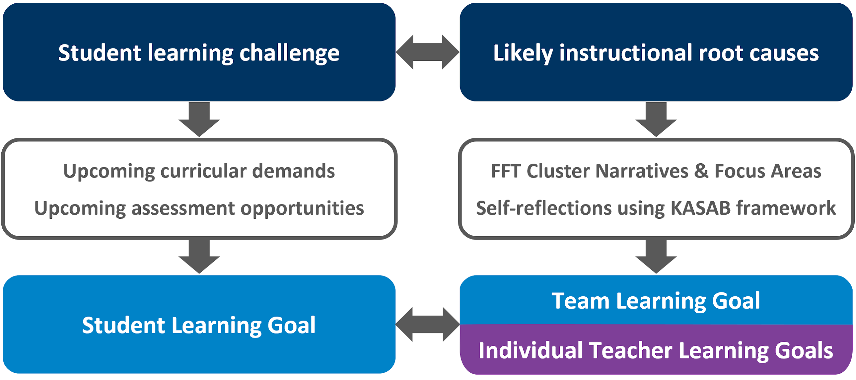
Stage 2: Set Goals

Slide 50
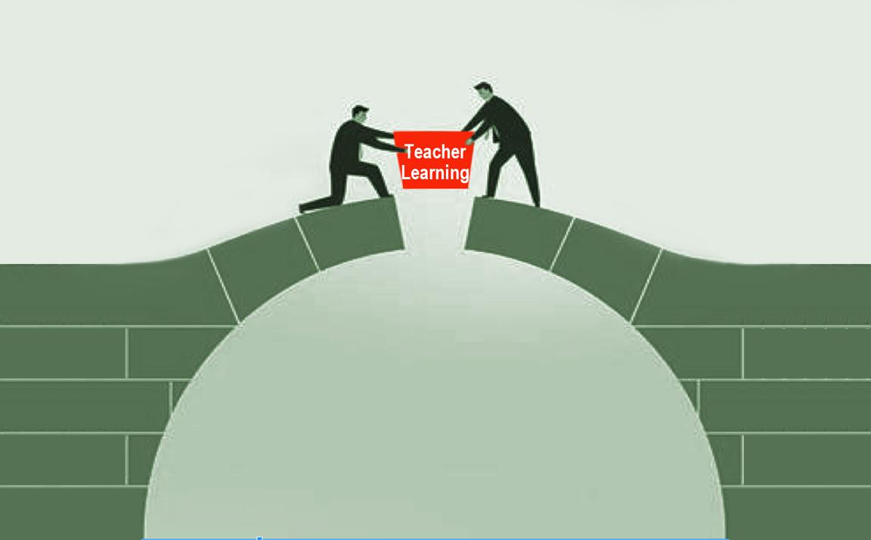
Role of Teaching and Learning
The power of this learning cycle is the embedded teacher learning.
Goal setting
Implementation
Notes:
So many times we set goals, but we need to focus on educator learning as well.

Slide 51
Where do we start?
Practice Scenario for Cluster Carousel
Student Learning Goal:
By the end of the first 6 weeks, fourth-grade students will demonstrate “social competence in social awareness by building relationships between diverse groups of people,” as measured by the number of classmates each student can name.
Notes:
FFT Cluster Roadmap, FFT Cluster Smart Card

Slide 52
Align Student Learning Goals with FFT Cluster
A Practice Example
Connecting the Student Learning Goal to a FFT Cluster Focus Area
1. Individually, read the student learning goal.
By the end of the first 6 weeks, fourth-grade students will demonstrate “social competence in social awareness by building relationships between diverse groups of people,” as measured by the number of classmates each student can name.
2. Skim and highlight statements from FTT Cluster 2 that connect to this student learning goal.
3. Select a focus area from the FFT Cluster 2.
4. Enter the focus area you selected in the chat.
Notes:
Six Clusters to Support Teacher Growth and Student Learning: Use Cluster 4 and 5

Slide 53
Crafting a Team Goal
FFT Cluster 2 Focus Area: Positive Development Relationships
If, then example.
If our team focuses on positive developmental relationships in the first 6 weeks of school, then our students will build their social competence by caring and respecting each other. We will intentionally teach classmate names by expecting students to address each other by name in conversations.

Slide 54
Crafting Educator Goals - Stage 2
6
Select one of the following crafted student learning goal (plop in Whetstone protocol):
  All students will be able to identify at least three strategies to persist and maintain motivation when working toward short- and long-term goals by the end of the first 6 weeks.
  All students will be able to work cooperatively and productively in a group to accomplish a group task as measured by the cooperation rubric by the end of the first quarter.
  All students will be able to identify cause and effect of a conflict both in grade-level literature and in classroom scenarios by the end of week 6.
  All students will be able to identify others’ need for empathy and identify respectful ways to respond to others in at least three different scenarios by the end of our first month of school.
Identify the focus area
Craft the team goal: If/then statement together in the breakout room

Slide 55
TLT Cycle Stage 3:
Learn Individually and Collaboratively

Slide 56
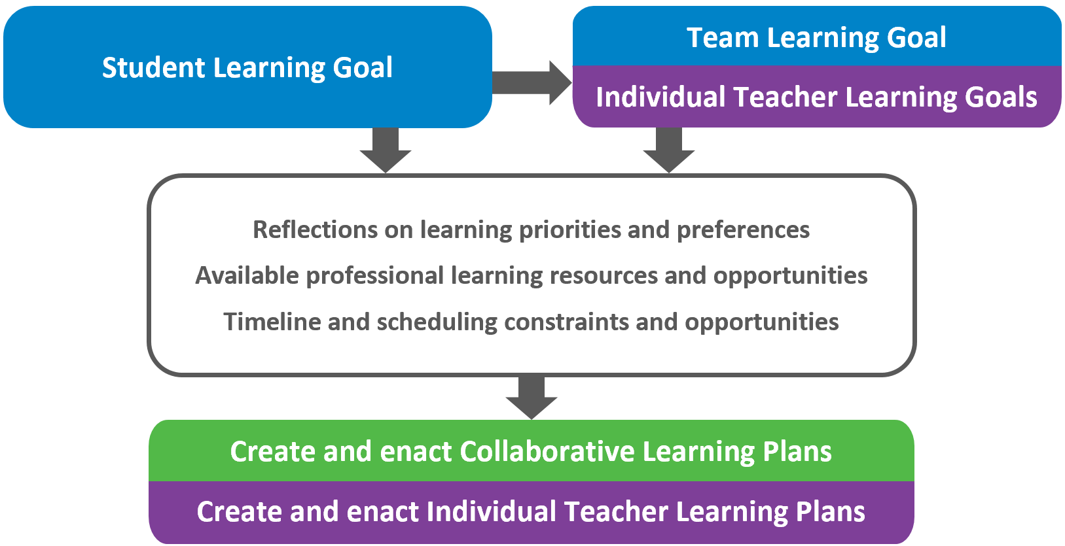
Stage 3: Learn Individually and Collaboratively

Slide 57





KASAB for Teacher Learning Goals
After teacher and team goals are written, it’s important to have a plan that details the learning needed to reach those goals.
This plan should be clear regarding the WHAT and the HOW of the learning needed.
Notes:
**animated**
unpack what is KASAB
the link is that teachers goals may not be SMART goals.
This model provides a____ way to develop teacher goals.

Slide 58
KASAB for Teacher Learning Goals
KASAB serves as a framework for outlining the WHAT part of the learning plan.
This framework allows the educator to consider multiple pathways for learning.
Notes:
**animated**
unpack what is KASAB
the link is that teachers goals may not be SMART goals.
This model provides a____ way to develop teacher goals.

Slide 59

KASAB for Teacher Learning Goals
B
A
Consistent application of knowledge and skills
Desires, or internal motivation, to engage in a particular practice
Conceptual understanding of information, theories, principles, research
Strategies and processes to apply knowledge
Beliefs about the value of particular information or strategies
A
S
K

Slide 60

KASAB for Teacher Learning Goals
Knowledge | Conceptual understanding of information, theories, principles, research
Attitude | Beliefs about the value of particular information or strategies
Skill | Strategies and processes to apply knowledge
Aspirations | Desires, or internal motivation, to engage in a particular practice
Behaviors | Consistent application of knowledge and skills
Notes:
**animated**
unpack what is KASAB
the link is that teachers goals may not be SMART goals.
This model provides a____ way to develop teacher goals.

Slide 61
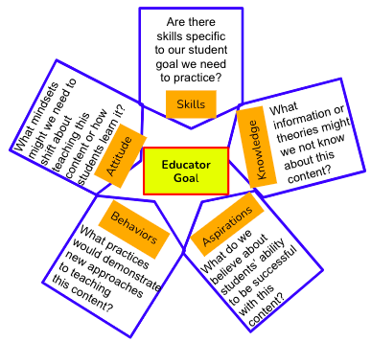
KASAB for Teacher Learning Goals
Notes:
**animated**
unpack what is KASAB
the link is that teachers goals may not be SMART goals.
This model provides a____ way to develop teacher goals.

Slide 62
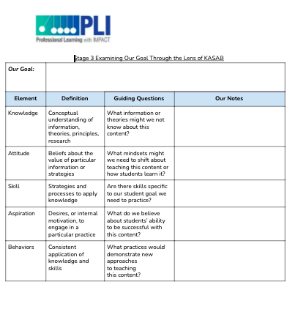
KASAB for Teacher Learning Goals
Notes:
**animated**
unpack what is KASAB
the link is that teachers goals may not be SMART goals.
This model provides a____ way to develop teacher goals.

Slide 63

Learning Designs
Selecting appropriate learning designs is the HOW part of the learning plan.
Notes:
Learning is the what distinguishes this cycle from other cycles. We’re going to take a look at the multiple forms that that team learning can take

Slide 64
Learning Designs
Refer to the handout “Powerful Learning Designs.”
Take a few minutes to read through and assess your level of familiarity with the designs.
Find a partner and talk through any that you have varying levels of experience with.
Notes:
Learning is the what distinguishes this cycle from other cycles. We’re going to take a look at the multiple forms that that team learning can take

Slide 65
Learning Designs
Thinking of your context back at school:
Which learning designs are you most familiar with?
Which one would you like to try?
Which are most feasible within your time constraints?
Notes:
Learning is the what distinguishes this cycle from other cycles. We’re going to take a look at the multiple forms that that team learning can take

Slide 66
Breakout Room to Do Stage 3
In breakout rooms:
Complete as much of the Stage 3 protocol as possible, thinking through the learning you would need to meet your educator and student learning goal.
Use this Padlet for ideas on how/what you might learn.
When you are finished, upload to Whetstone.

Slide 67
Stage 3 and One-on-One Coaching Rounds

Slide 68
Coaching Rounds Across Stages
Notes:
Three elements of the coaching rounds with example time frames

Slide 69

Video Reflections With Practice Action Steps:
Say Something
Partners:
Individually, read to the designated stopping point.
When each person is ready, stop and “say something” (e.g., an example, a connection, a significant point, or a next step).
Continue process to final stopping point.
Stopping points:
Chapter 6 Introduction and Guiding Principles: p. 45
SKIP page 46 (for now)
Steps 1 and 2: pp. 47-49
Steps 3 and 4: pp. 49-50
Step 5: p. 50
Notes:
Use post-it to put the examples, connects, points and steps.

Slide 70

Teacher Video Reflections in Whetstone
Notes:
https://docs.google.com/document/d/17k6L_Yas5ISXMKWHvzcQsXQclpXu0pTNoRi2YUQH_qc/edit

Slide 71
Video debrief: How does it look in action?
Watch the video debrief conversation:
How did the tagged video by the teacher in Whetstone and the debrief with the coach support teacher learning?
Be prepared to “debrief” with colleagues in breakout rooms.
Notes:
Use this doc while listening to the debrief: https://docs.google.com/document/d/17k6L_Yas5ISXMKWHvzcQsXQclpXu0pTNoRi2YUQH_qc/edit?usp=sharing

Slide 72
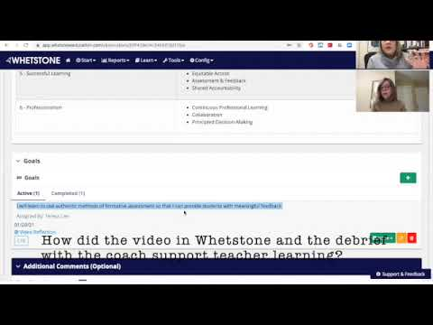
Video Debrief in Action
Teacher Goal:
I will learn to use authentic methods of formative assessment so that I can provide students with meaningful feedback.
Teacher Timestamp Notes:
0.00.14
I wanted to show all the students video responses already completed by classmates so they could see authentic examples.
0.01:31
This is the video responses I have used with students previously. I would like the students in this class to do video responses that I will use as assessment and feedback about our topic.
0.05.49
There are so many steps for the students. I worry about this. How might I simply it so the directions don't get in the way of the learning?

Slide 73

Breakout Rooms:
Round robin:
Share how the video in Whetstone and the debrief with the coach supported teacher learning.
What questions might you still have?

Slide 74
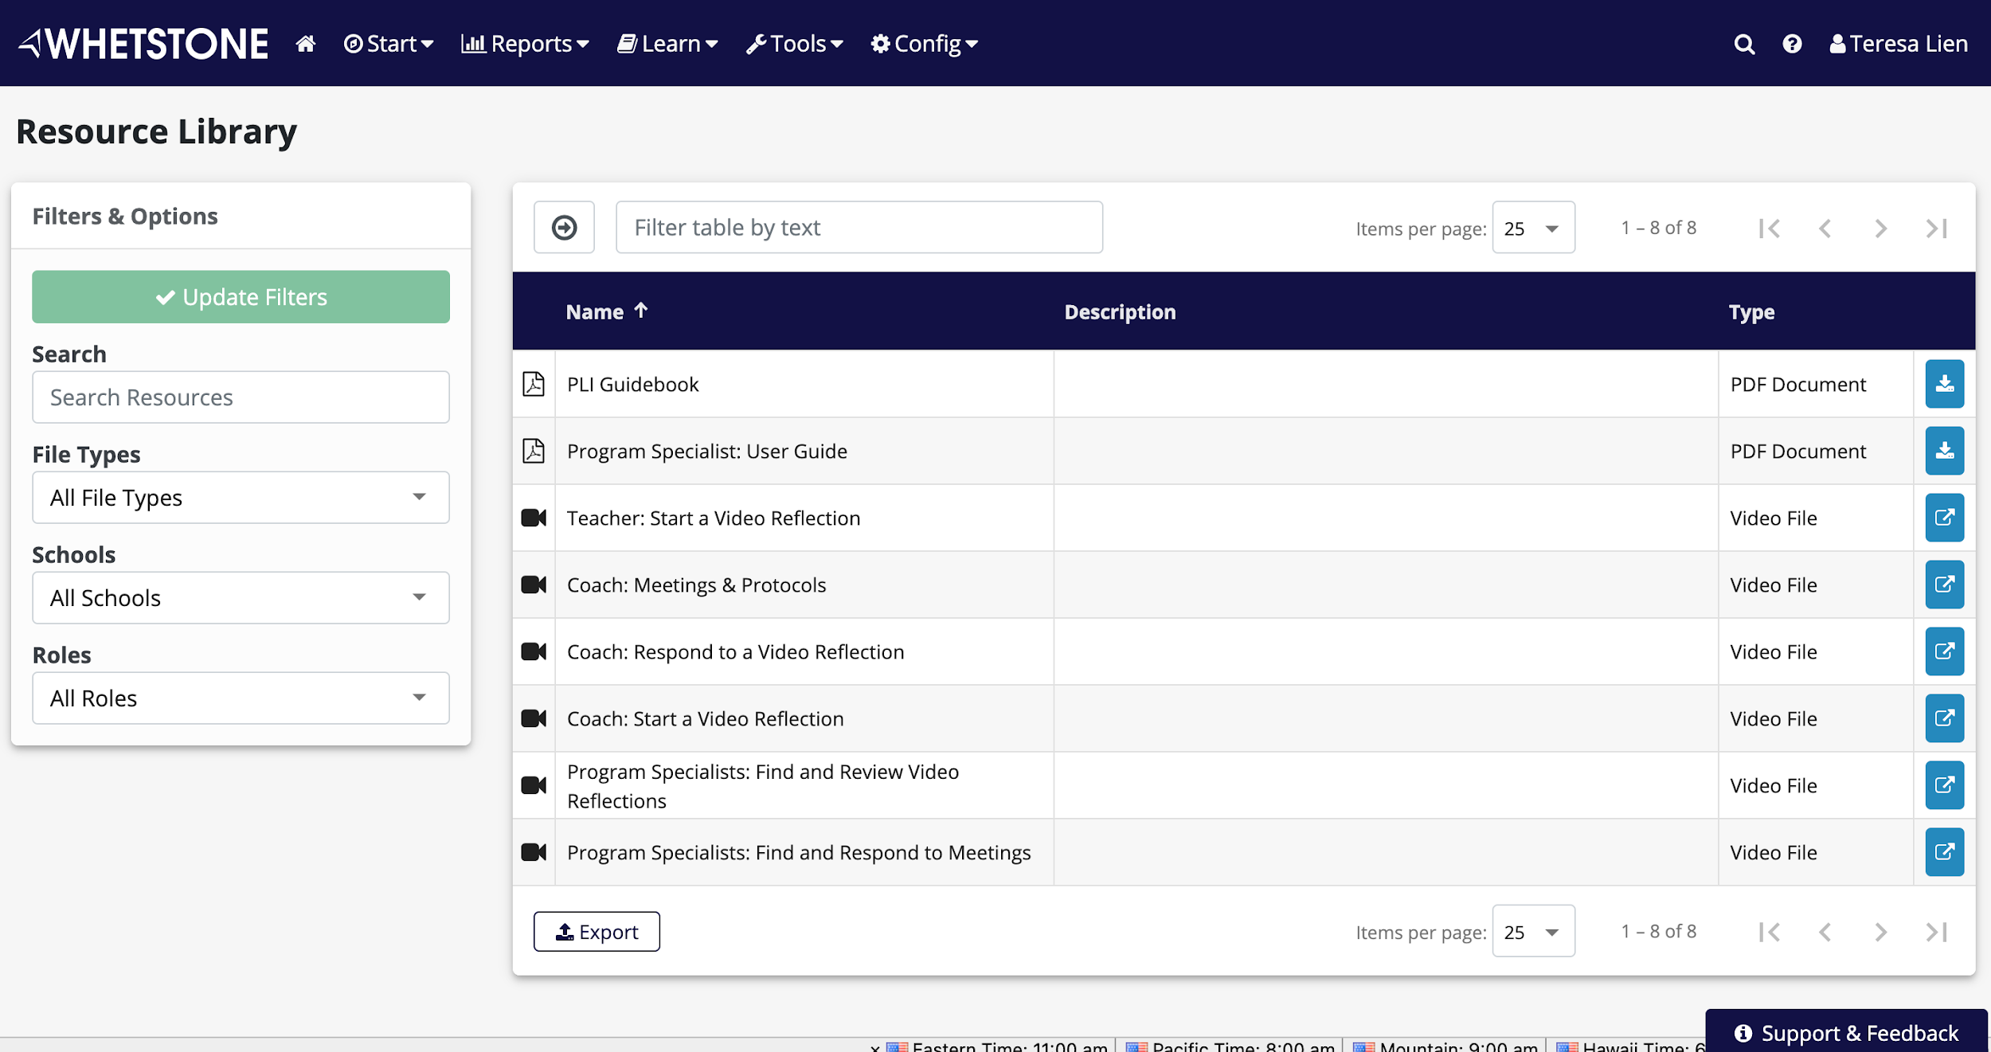
Your turn!
Watch the Whetstone video in Learn, “Teacher start a video reflection.”
Go into your Whetstone account with your HW video:
Go into the video hub.
Add your video.
Start video reflection.
Timestamp notes on your video.
Share with your coach.
Notes:
https://docs.google.com/document/d/1g1ITgKEYL5ZgDshSZbj2TCU3NOdVBUNQGeOhLYNyqwE/edit?usp=sharing

Slide 75

Kahoot Review

Slide 76
Homework
Reflect on your new learning over the last 2 days through the lens of KASAB. Make sure to share with your coach.

Slide 77

Session 3 - Coaches
Notes:
Introducing the “PLI” acronym
Review program, briefing figure from inside out
PLI is a product an instructional coaching model centered in the framework for teaching clusters that DG has been developing for years and the teacher learning team cycle of inquiry that LF has been developing for years
Exploring collaboratively and individually
Material that teachers and students engage with - clusters and curriculum
Collaborative process through which teachers improve - TLT and coaching
Mutually reinforcing each other
Cyclical

Slide 78
Agenda: Session 3
(3.5 hours)
Welcome and Reflection
Stage Expertise - Jigsaw
Troubleshooting the Stages
PLI Coach as Facilitator: Facilitator Skills and KASAB
Coaching Rounds
Wrap-Up and Debrief

Slide 79

Thoughts in the Night
Characteristics of A Collaborative Culture for Learning
As you reflected on the learning and experiences from Session 1 and 2, what thoughts came to mind?
Share your “thoughts in the night” with colleagues at your table.

Slide 80
Reflecting Back, Thinking Forward
Think about your two roles as facilitator and coach. What are some of your focus areas for today to enhance readiness to work with your team and with this process?
Notes:
An alternative for the opening
Possible Prompt:
Thinking about your two roles as facilitator and coach, what are some of your focus areas for today to enhance your readiness to work with your team and with this process?

Slide 81
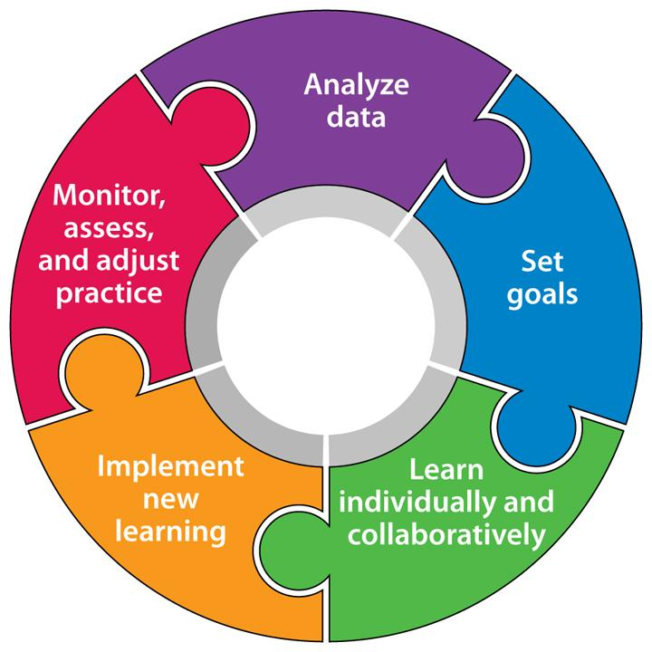
Solidifying Our Expertise of the Stages

Slide 82







Deeper Dive Into Stages 1-3
Link to Slides
Image | New Understandings | 3 Team Actions
Discussion Questions | Working Example | Virtual Learning Implications
Notes:
https://docs.google.com/presentation/d/1-IeJn3wLLZY7YvGS9oyChByb1J1sgga5dJ_tfu7cmWg/edit#slide=id.g3a8244c676_0_124

Slide 83

Troubleshooting the Stages
Round 1: Challenges
Round 2: Suggestions

Slide 84

Coach as TLT Facilitator

Slide 85

Coach as Facilitator
Access the handout titled
“Facilitator Definition”
Think of the last time you were serving as a facilitator or were in a group that had a facilitator.
Work together to record examples/“look likes” for each of the functions of a facilitator.

Slide 86
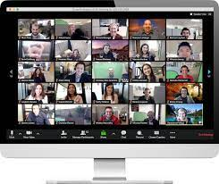
PLI Coach’s Role as Facilitator
A facilitator helps the team free itself from internal obstacles or difficulties so members may more efficiently and effectively accomplish their goals.
A facilitator guides the team’s work without directing it, helps the team discover ways to address challenges, and maintains safety and trust among members.
A facilitator brings structures and processes to help the team accomplish its goals.
A facilitator appreciates and values what each person contributes.
Share with the rest of the group what you discussed in your breakout room!

Slide 87
KASAB as a Facilitator’s Tool
Knowledge | Conceptual understanding of information, theories, principles, research
Attitude | Beliefs about the value of particular information or strategies
Skill | Strategies and processes to apply knowledge
Aspirations | Desires, or internal motivation, to engage in a particular practice
Behaviors | Consistent application of knowledge and skills
Use the KASAB Framework to organize your thinking on what it means to be a effective facilitator in the PLI process.
With a partner, share ideas and add to the Jamboard (one person adds).

Slide 88

Coach as Facilitator
Whip Around:
Which element of KASAB are you...
most confident in?
do you find most challenging and might need support?
Notes:
insert image

Slide 89
Coaching Round:
Planning and Reflective Conversations
PLI Guidebook: Chapter 6. PLI Coaching Rounds
In pairs:
Each person chooses one of the conversations to explore in the PLI Guidebook (pp. 46; 51).
Highlight key ideas, paying special attention to purposes for conversation and sample questions.
In what ways are these conversations similar to or different from planning and reflecting conversations you use?
EACH TEACH

Slide 90
What are similarities and differences?
Conversation Skills Toolkit
Card Sort
A | B
What is one thing you would change about this lesson? Could you describe the purpose of the group activity? Can you think of any reason for that behavior? Do you have any hands-on materials for this lesson?
What are some of your students’ needs that influenced this lesson?
What are some possible reasons for the behaviors that occurred in Group C?
In what ways can you interpret the results of the students’ assessments?

Slide 91
Is this A or B?
Do you think you could have done anything differently in this lesson?
Because you were concerned about the group that was less engaged, can you give some possible reasons for this lack of participation and engagement?
Do you think it would have helped if you had engaged the students more?
How might you prioritize the next steps for the unit planning?

Slide 92

Elements of Skillful Conversation
Conversation Skills Toolkit
Card Sort
PLI Guidebook, pages 12-13
Read: “Elements of Effective Conversation Skills and Practice”
Which skills are already part of your repertoire?
Which skills would you like to refine?
In breakout rooms, share.

Slide 93
Coaching Conversation Video Model
Coaching Through the Lens of KASAB
Knowledge | Conceptual understanding of teaching practices represented in the FFT Clusters
Attitude | Beliefs about the value of the good teaching found in the FFT Clusters
Skill | Strategies and processes to apply knowledge through the FFT Clusters
Aspirations | Desires, or internal motivation, to engage in a particular practice through the FFT Clusters
Behaviors | Consistent application of knowledge and skills in the FFT Clusters
“When I’m teaching my reading group, the rest of the students have to know the routines and procedures…”

Slide 94
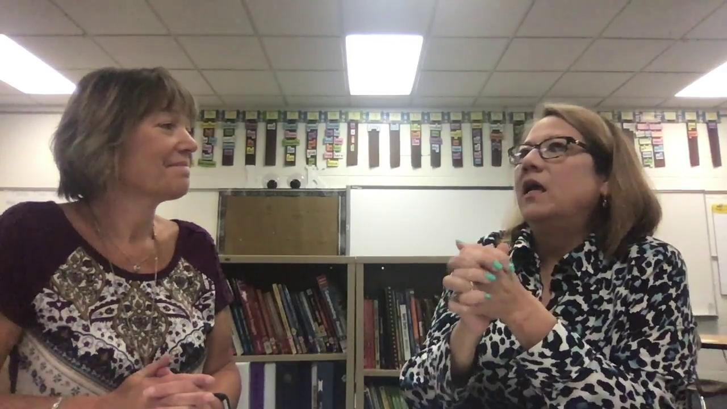
Planning Conversation

Slide 95
Coaching Conversation Video Model
Coaching Through the Lens of KASAB
Knowledge | Conceptual understanding of teaching practices represented in the FFT Clusters
Attitude | Beliefs about the value of the good teaching found in the FFT Clusters
Skill | Strategies and processes to apply knowledge through the FFT Clusters
Aspirations | Desires, or internal motivation, to engage in a particular practice through the FFT Clusters
Behaviors | Consistent application of knowledge and skills in the FFT Clusters
In breakout rooms,
share the notes related
to KASAB.
What were the similarities
between your group?
What were the differences
between your group?

Slide 96
Homework
In the guidebook, read Chapter 7, “Reflections on Team, Teacher and Coach Learning.” In the guidebook, read Chapter 8, “Illustrative Examples.” Bring your school calendar.

Slide 97
Session 4 - Coaches
Notes:
Introducing the “PLI” acronym
Review program, briefing figure from inside out
PLI is a product an instructional coaching model centered in the framework for teaching clusters that DG has been developing for years and the teacher learning team cycle of inquiry that LF has been developing for years
Exploring collaboratively and individually
Material that teachers and students engage with - clusters and curriculum
Collaborative process through which teachers improve - TLT and coaching
Mutually reinforcing each other
Cyclical

Slide 98
Agenda: Session 4
(3.5 hours)
Welcome
Teaching Thinking: Trust and Relationships
Troubleshooting the Stages
PLI Coach as Facilitator: Facilitator Skills and KASAB
Coaching Rounds
Wrap-Up and Debrief

Slide 99
A Window Into Teaching Thinking
Ability to explain own teaching practice
DON’T KNOW
KNOW
Mysterious
Unknown
Theoretical
Unable to demonstrate
CAN’T DO
Ability to teach
Miraculous
Unexplained
Intentional
Deliberate practice
CAN DO

Slide 100
Coaching With Intentionality
In breakout rooms,
Access the Jamboard.
Think about coaching strategies that would advance “teaching thinking” in each of the quadrants.
Each person writes a strategy on a sticky note and places it in the quadrant.
Be prepared to share your breakout room strategies with the whole group.

Slide 101

“The greatest effects on student learning occur when the teachers become the learners of their own teaching and when students become their own teachers.”
— John Hattie, Visible Learning (2009, p. 22)
Notes:
From mentoring

Slide 102
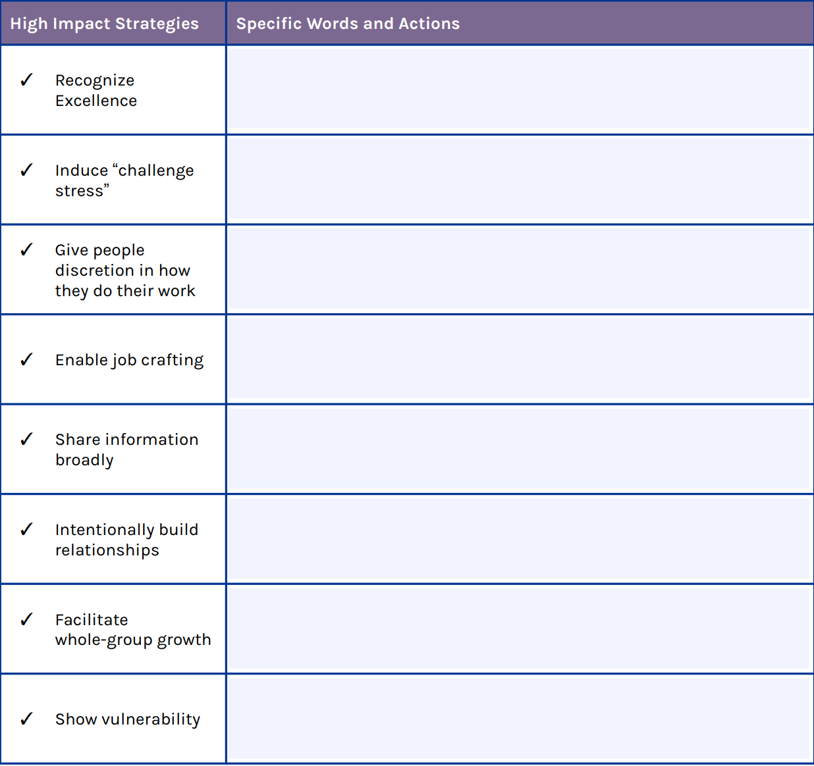
The Science of Trust
In the chat, access the URL for a module on “The Science of Trust” and complete the activity with the “Trust” workbook pages.
Return in 15 minutes with the “Science
of Trust” page filled in.
Breakout Rooms:
Share the “specific words and actions”
in your table on the “Science of Trust.”
Listen to others for any further ideas
you might consider.

Slide 103
Best Hopes and Planning for Pitfalls
Take a few moments to jot down your best hopes AND potential pitfalls as you think about implementing PLI. Be ready to share in your breakout rooms.
Round 1: Hopes
Identify a facilitator
Identify who will start: Share one hope from your list. Continue around the group until all ideas have been shared.
Facilitator synthesizes trends in your hopes. Record to share out in group.
Round 2: Potential Pitfalls
Identify who will start: Share one potential pitfall from your list. Continue around the group until all ideas have been shared.
Facilitator synthesizes trends in your pitfalls. Record to share out in group.

Slide 104

Best Hopes and Planning for Pitfalls - Debrief
What were our common hopes?
What were our common pitfalls?
Let’s identify:
Tools or support we’d need
Strategies that might help avoid the pitfalls

Slide 105

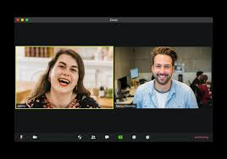
Understanding Your PLI Support System
All Coach PLC
1-1 Coaching Support
Purpose:
Structure:
Calendar:
Purpose:
Structure:
Calendar:

Slide 106



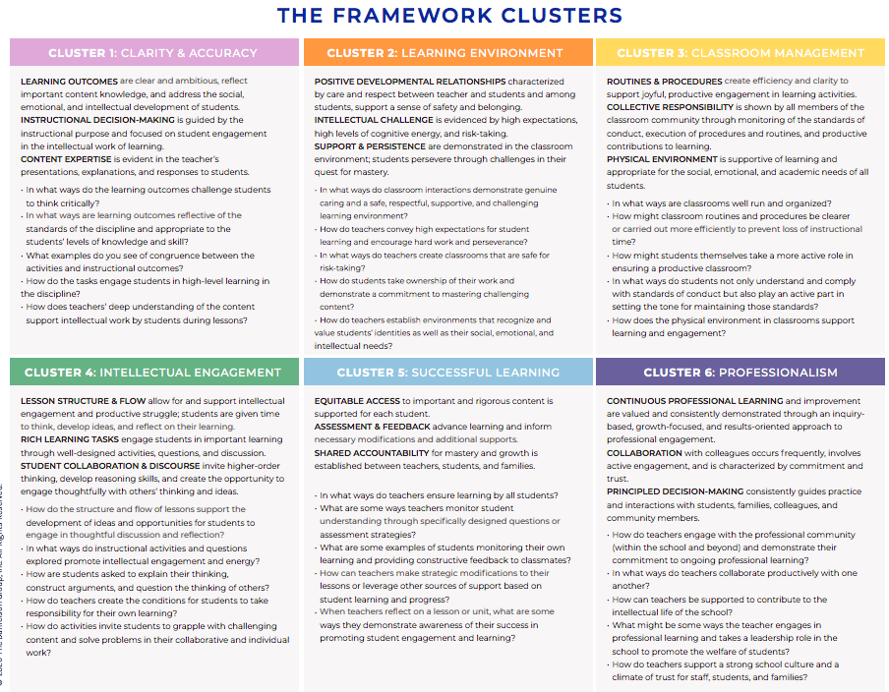

P
21
-
L
I
20
Stage 1
Stage 1:
Outcomes:
**Write data summary statements
**identify likely root cause
Protocols:
**Analyze data
**Data summary sheet
Notes:
https://docs.google.com/presentation/d/1gXqiDqXqR3ej6uD6R725QJMR5-VjfQLDT14uxMnAzBc/edit?usp=sharing

Slide 107

Preparing to Launch
Meet and Greet and PLI Specialists
Start to map out your first cycle.
Include dates for PLC and think about when 1-1 coach meetings with your specialist might work for you.
Begin thinking about induction phase: What are some coaching and TLT activities that will launch your work?
Think about structures that you might create to help guide your team through the process (Sarah’s virtual example).

Slide 108
What now?
Supports from program specialists for districts:
Immediately prior to school year (in each district):
  Preparatory refresher for PLI coaches (0.5 or 1 day)
  Preparatory workshop for teachers with assistance of PLI coach (1 day or 1.5 days)
During the school year (in each district):
  During-the-year workshops for teachers with assistance of PLI coach (two or three half-day events)
  Coach individual check-in videoconferences (monthly)
  Coaches group videoconferences (monthly)
Please leave us your feedback!

Slide 109

109

