Slide 1

Professional Learning with Impact
On-Site Teacher Preparatory Workshop
Winter 2022
The contents of this slide deck were developed under a grant from U.S. Department of Education, Office of Elementary and Secondary Education, Award No. U411B180032; However, those contents do not necessarily represent the policy of the Department of Education, and you should not assume endorsement by the Federal Government.
Professional Learning with Impact On-Site Teacher Preparatory Workshop. Winter 2022. This work is licensed under a Creative Commons Attribution-NonCommercial-ShareAlike 4.0 International (CC BY-NC-SA 4.0) License.
Notes:
Materials teachers need to bring with them the day of the training:
*Teacher guide book from first visit
*Binder from first visit https://docs.google.com/spreadsheets/d/1x8Pc8-GkzvqUbxwUI8vGULH2FpB2eMvsO3J9sG7dp1I/edit#gid=0 – Materials Spreadsheet
https://docs.google.com/document/d/19lcEyIw6vE-mOXpQP4hN6lRpYYXjr2Tq6v6aEvqYkrg/edit - Internal Agenda

Slide 2
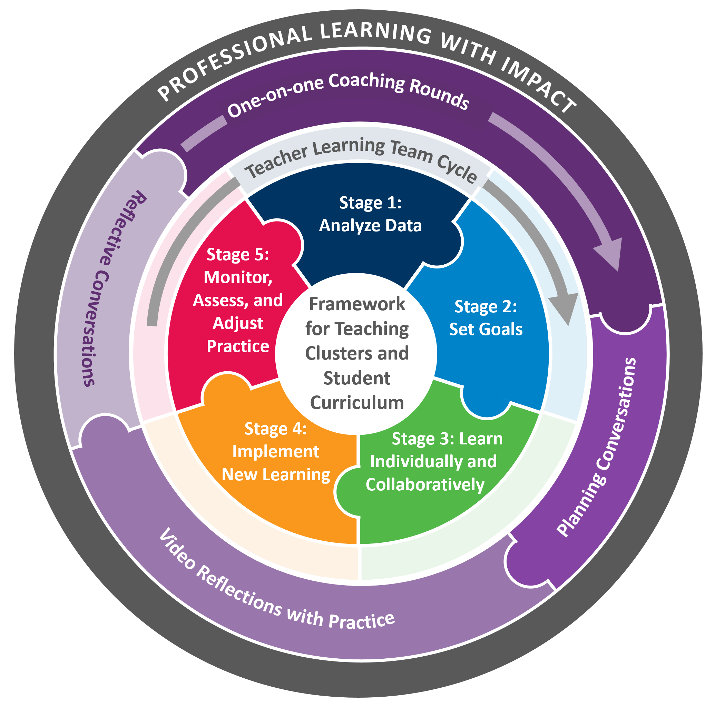
Professional Learning with Impact (PLI) Program Overview
Notes:
Introducing the “PLI” acronym
Review program, briefing figure from inside out
PLI is a product an instructional coaching model centered in the framework for teaching clusters that DG has been developing for years and the teacher learning team cycle of inquiry that LF has been developing for years
Exploring collaboratively and individually
Material that teachers and students engage with - clusters and curriculum
Collaborative process through which teachers improve - TLT and coaching
Mutually reinforcing each other
Cyclical

Slide 3
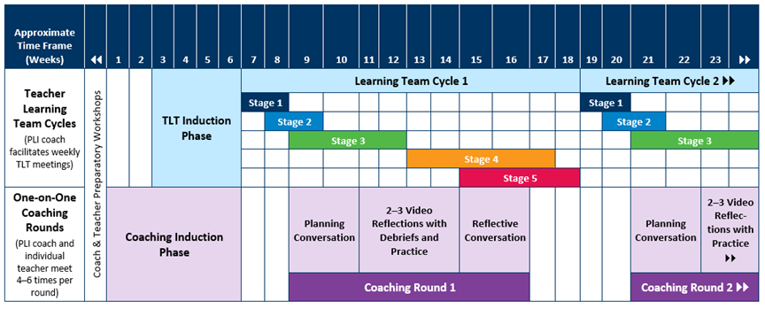
PLI activities and timeframes
Continue 1:1 Coaching
Notes:
Coaches wear multiple hats; serve as the facilitors of the TLTs and provide one-on-one coaching to participating teachers

Slide 4

Working Agreements
Approach the learning with a sense of curiosity
Ask questions—a lot of questions
Remember that we are all lead learners in this work
Be an active contributor to the thinking and learning

Slide 5
Workshop Outcomes
Reflect on the Team Learning work in first semester and explore additional tools and strategies for continuing the work
Understand the 5 steps of the Video Reflections with Debrief and Practice by reading and discussing.
Understand Video Reflection by observing the coach and teacher.
Analyze the Video Reflection for the parts.
Notes:
Compare these to the tree map

Slide 6

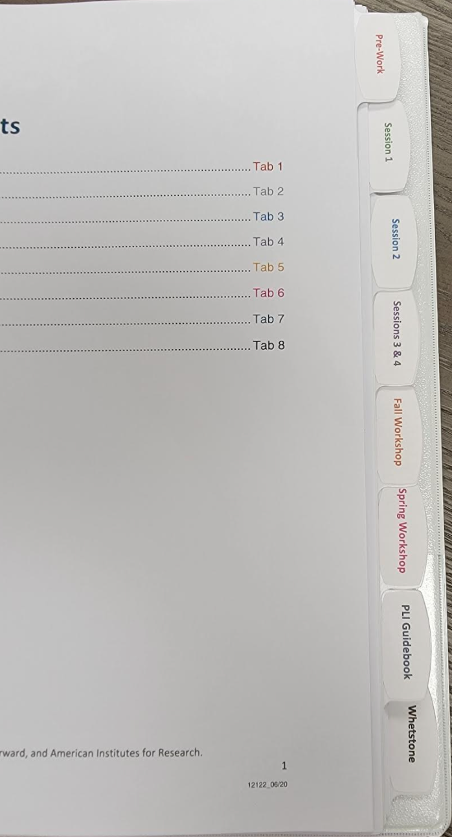
Materials by Your Side
Professional Learning with Impact (PLI) Binder
Materials provided for this workshop
Breakout Room Slide Deck
Access to Whetstone account
Highlighter
Paper and pencil/pen

Slide 7


Successes in PLI
Individually:
Write three different pluses or successes from your work with the PLI model so far.
Notes:
Breakout room
Learning partners p. 5

Slide 8


ALL on the Wall: Jamboard
Pluses/Successes
As a team, please discuss your successes, and decide on 5 successes that best represent your team.
Notes:
Participants individually list 3 successes since we last met. They put them on post it notes.

Slide 9

Sharing our successes
Pluses/Successes | Questions/Thoughts
 | Take a few minutes to view other team’s identified successes. What questions might you have for your colleagues? What trends do you notice?
Notes:
Whole Group

Slide 10
Use the PLI Guidebook
Last Tab in PLI Guidebook
Have Each protocol for each stage of the cycle at your fingertips
Stage 1​: Pages 24–25
Stage 2: Pages 28–31
Stage 3: Pages 34–35​
Stage 4: Pages 38–39
Stage 5: Pages 42–43

Slide 11

Reflect
Connect
Stage 1: Analyze Data
Notes:
Ask questions
All learning together
Be an active contributor

Slide 12
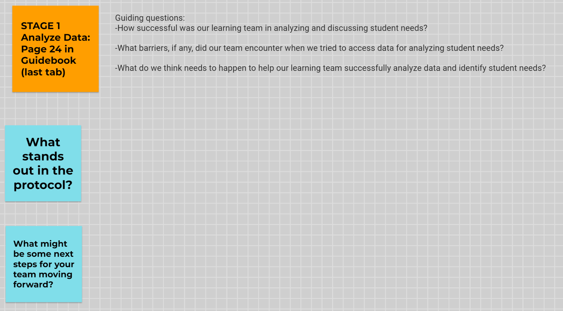
Jamboard-Reflecting on Cycle 1
When you open the jamboard link, one person on your team will need to make a copy that is just for your team. That person can then share the Jamboard with the rest of the team.
Your goal is to spend some time revisiting stage 1 (Analyze Data) and reminding yourself of the Stage 1 protocol.
What did you do well?
What might be some next steps?
Notes:
Link to Jamboard:

Slide 13

Reflect
Connect
Stage 2: Set Goals
Notes:
Ask questions
All learning together
Be an active contributor

Slide 14
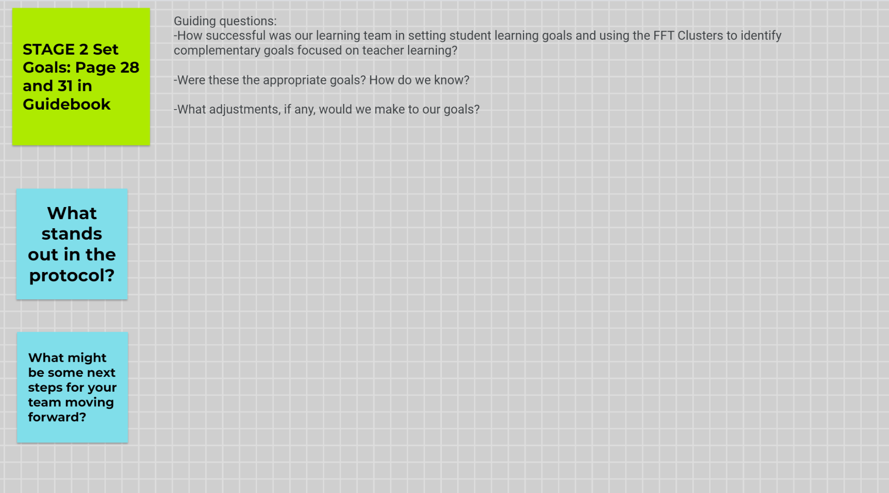
Jamboard-Reflecting on Cycle 2
Go to the second page of the Jamboard
Your goal is to spend some time revisiting stage 2 (Set Goals ) and reminding yourself of the Stage 2 protocol.
What did you do well?
What might be some next steps?
Notes:
Link to Jamboard:

Slide 15

Reflect
Connect
Stage 3:
Learn Individually and Collaboratively
Notes:
Ask questions
All learning together
Be an active contributor

Slide 16





KASAB as Framework for Teacher Learning Goals
Knowledge | What information or theories did we learn about this content that we didn't know before?
Attitude | What mindsets or attitudes did we develop about this content and how our students learned it?
Skill | Are there skills specific to our student goal that we developed?
Aspirations | What beliefs did we develop based on watching our students interact with this content?
Behaviors | What practices or new approaches did we develop?
Notes:
Each team reflect on KASAB on a chart paper to share out . Thinking about the goal you had for cycle 1. What does the mean for how you might set your goals for the next cycle?

Slide 17
What was your KASAB in Cycle 1/Semester 1
In breakout rooms, you will be using KASAB framework to reflect on their learning over this first semester in relationship to your teaching and learning goal.
One person should make the copy of the slides linked in the corner and share it with your team.
One slide per letter (K/A/S/A/B).
Feel free to add words, bullet points, pictures, etc. on the slides.
Notes:
Each team reflect on KASAB on a chart paper to share out . Thinking about the goal you had for cycle 1. What does the mean for how you might set your goals for the next cycle?

Slide 18
Reflect
Connect
Stage 4:
Implement New Learning
Notes:
Ask questions
All learning together
Be an active contributor

Slide 19

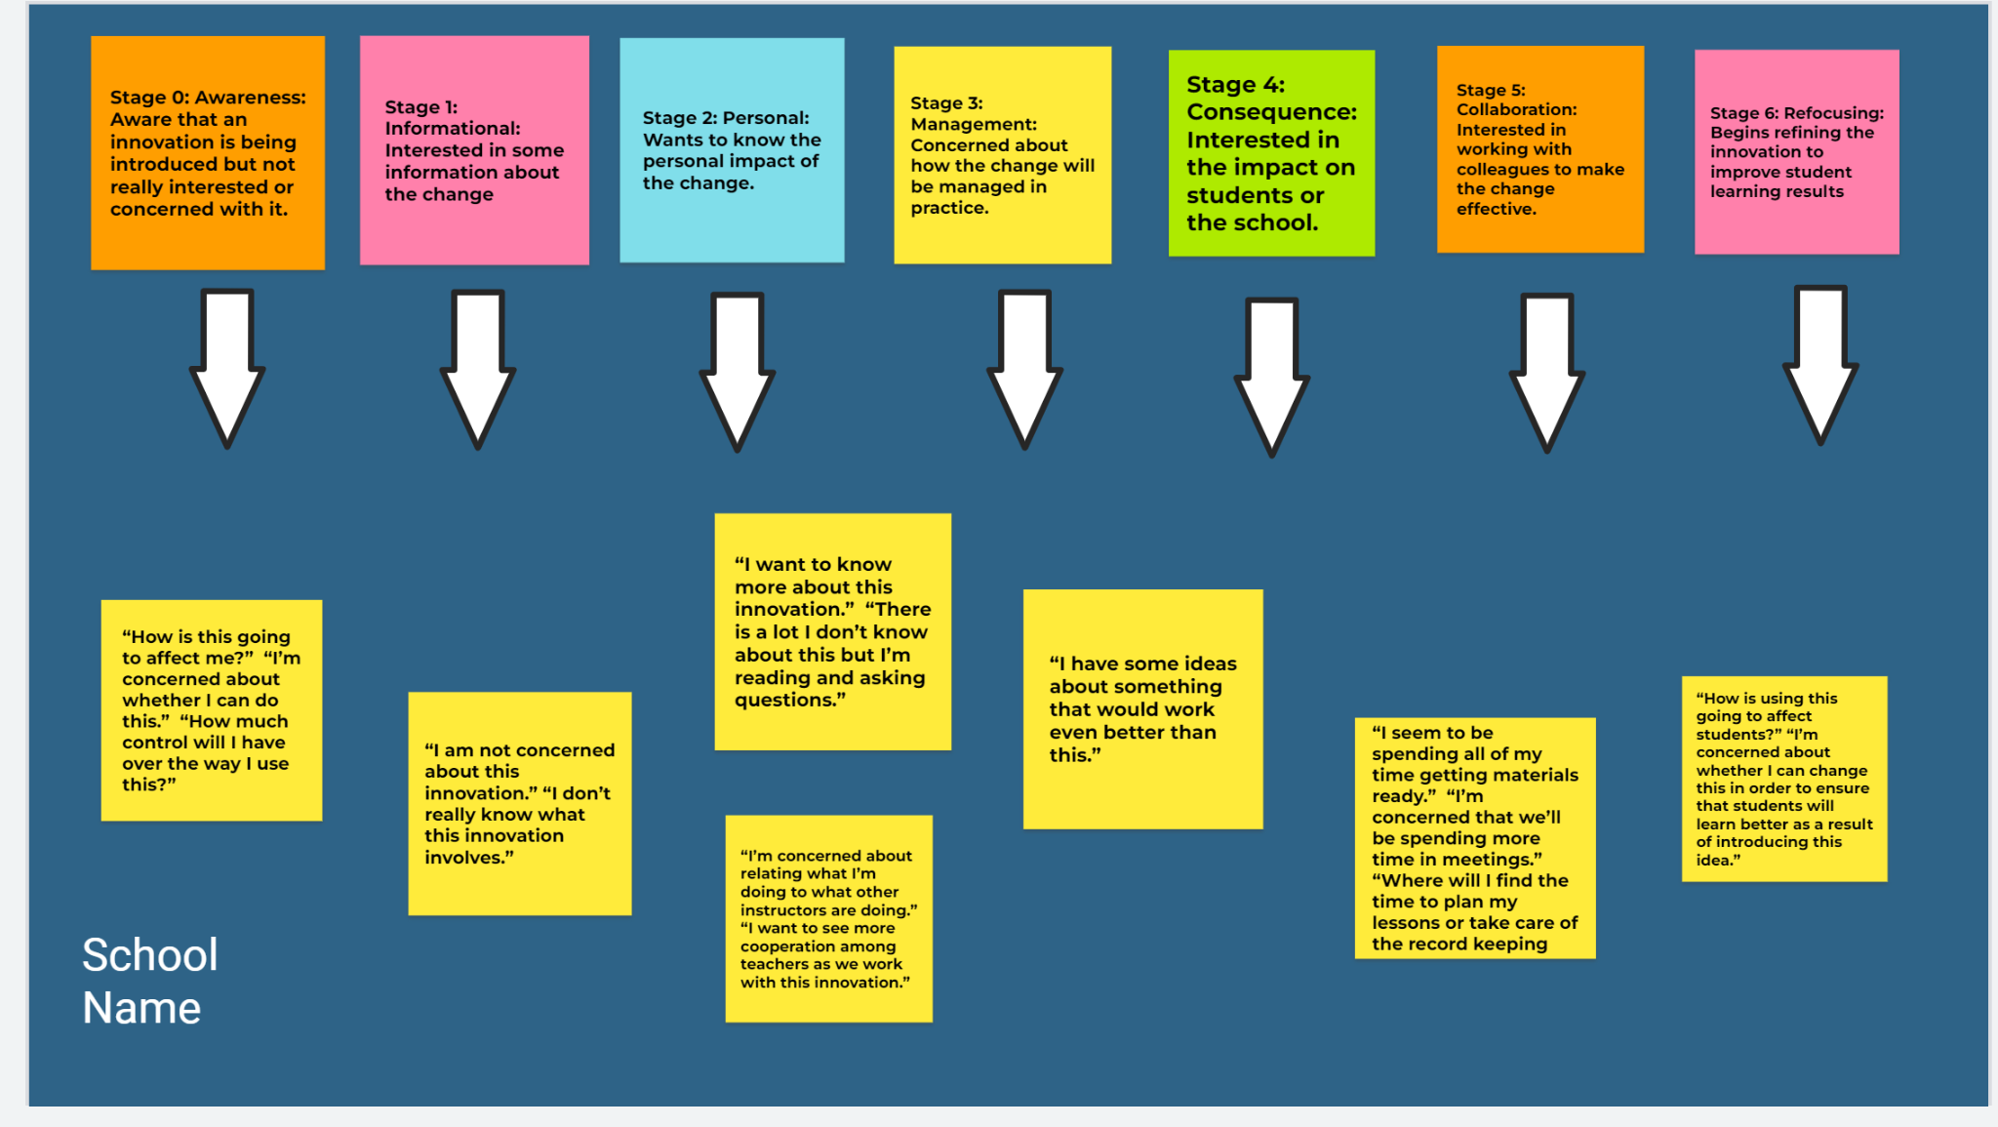
Stages of Concern - Jamboard Match UP

Slide 20
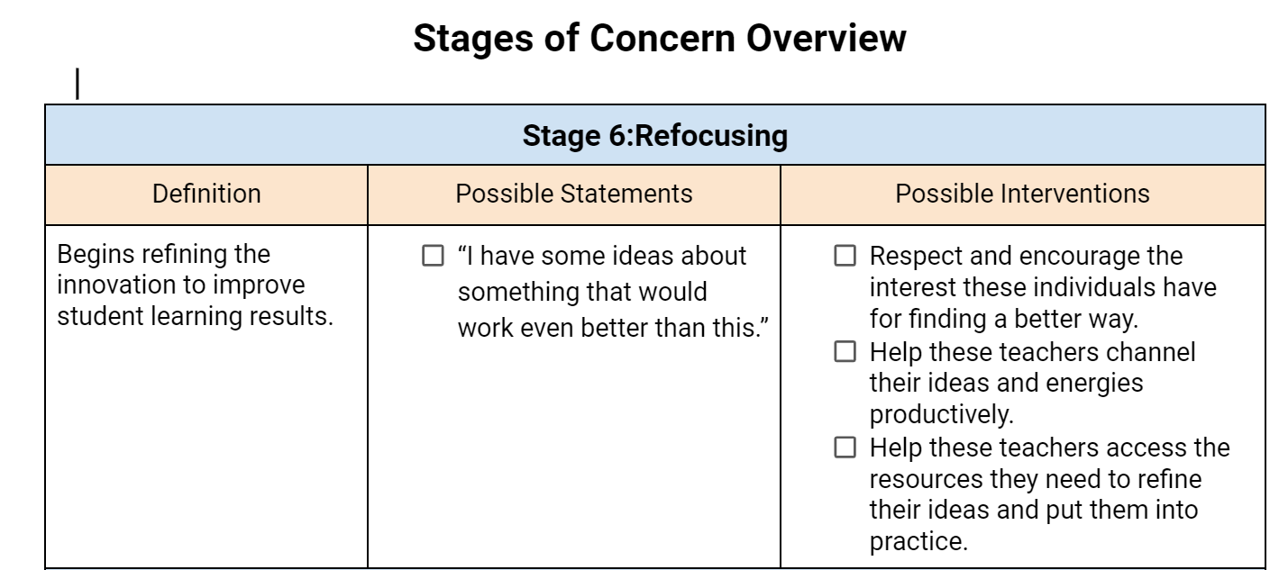
Stages of Concern - Overview

Slide 21
Stages of Concern - Team Google Doc
For the next 15 mins in breakout rooms, you are going to spend time thinking about your own SOC about any new changes you are implementing this year.
Think of examples of things you have heard or said and how that aligns with SOC overview.

Slide 22
Reflect
Connect
Stage 5:
Monitor, Assess, and Adjust
Notes:
Asych? Watch video and complete stage 5 protocol as if you were the team

Slide 23
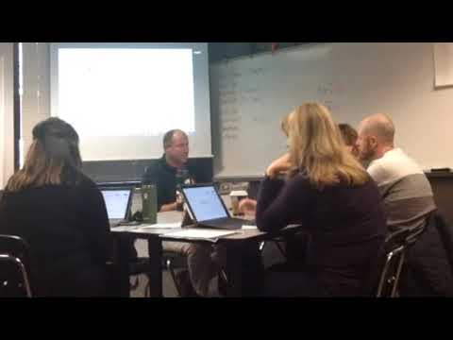
Watch a TLT in action
Listen Fors:
How the team structures the conversation
How the protocol supports the conversation
What are the team’s goals for student learning?
What is the team working on together?
As you watch the video, have the stage 5 protocol up.
Practice completing this protocol as if you were the team.
What parts of the protocol did you not hear the team talking about?
How does this inform/support your team as you think about how you monitor/assess student progress toward goals?
Notes:
https://docs.google.com/document/d/1oFGSZWeti3Wtj1eUkOdP_Z5kaqpf2bV3/edit?usp=sharing&ouid=112417244378978188239&rtpof=true&sd=true

Slide 24

Chat box: What is something you understand about the TLT cycle now that you didn’t before today?
What are you committing to in moving forward?
Notes:
Ask questions
All learning together
Be an active contributor
Breakout room/Summary/Chat

Slide 25
Asynchronous Work
Finish watching the video during our break.
As you watch the video, have the stage 5 protocol up. Practice completing this protocol as if you were the team. What parts of the protocol did you not hear the team talking about?
How does this inform/support your team as you think about how you monitor/assess student progress toward goals??

Slide 26
Video Reflections with Practice in Whetstone
To understand the steps of the Video Reflections with Practice, school teams wiil
watch a Whetstone video, “Teacher: Start a Video Reflection” and
take notes on the 3 points from this video:
Submit a video.
Timestamp a video.
Share a video.
With your teams:
One person will open up the interactive slide deck and make a copy and share with team members.
One person will share their screen and play the video (starting and stopping it at the segments indicated in the interactive slide deck.
After each video segment is played, write notes in the corresponding slide.
Notes:
https://docs.google.com/presentation/d/1szIv4IzZUaVsDNKeLqlUpdTJATWbxYFICbSiWfdvy9M/edit?usp=sharing

Slide 27
Afternoon Session (2 hours)

Slide 28
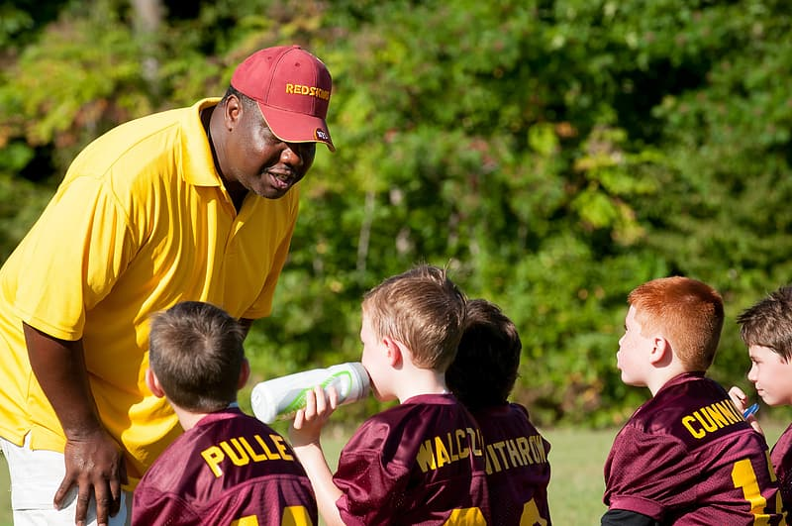
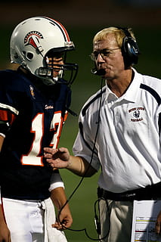
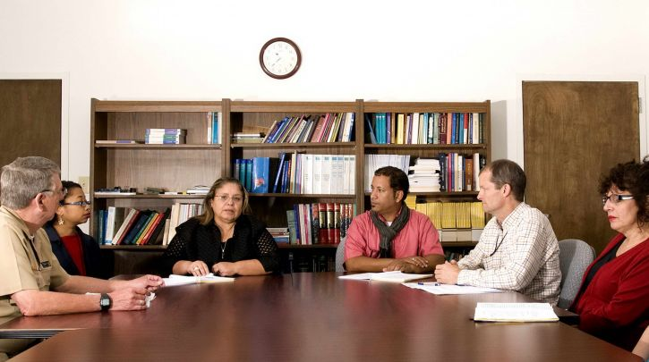
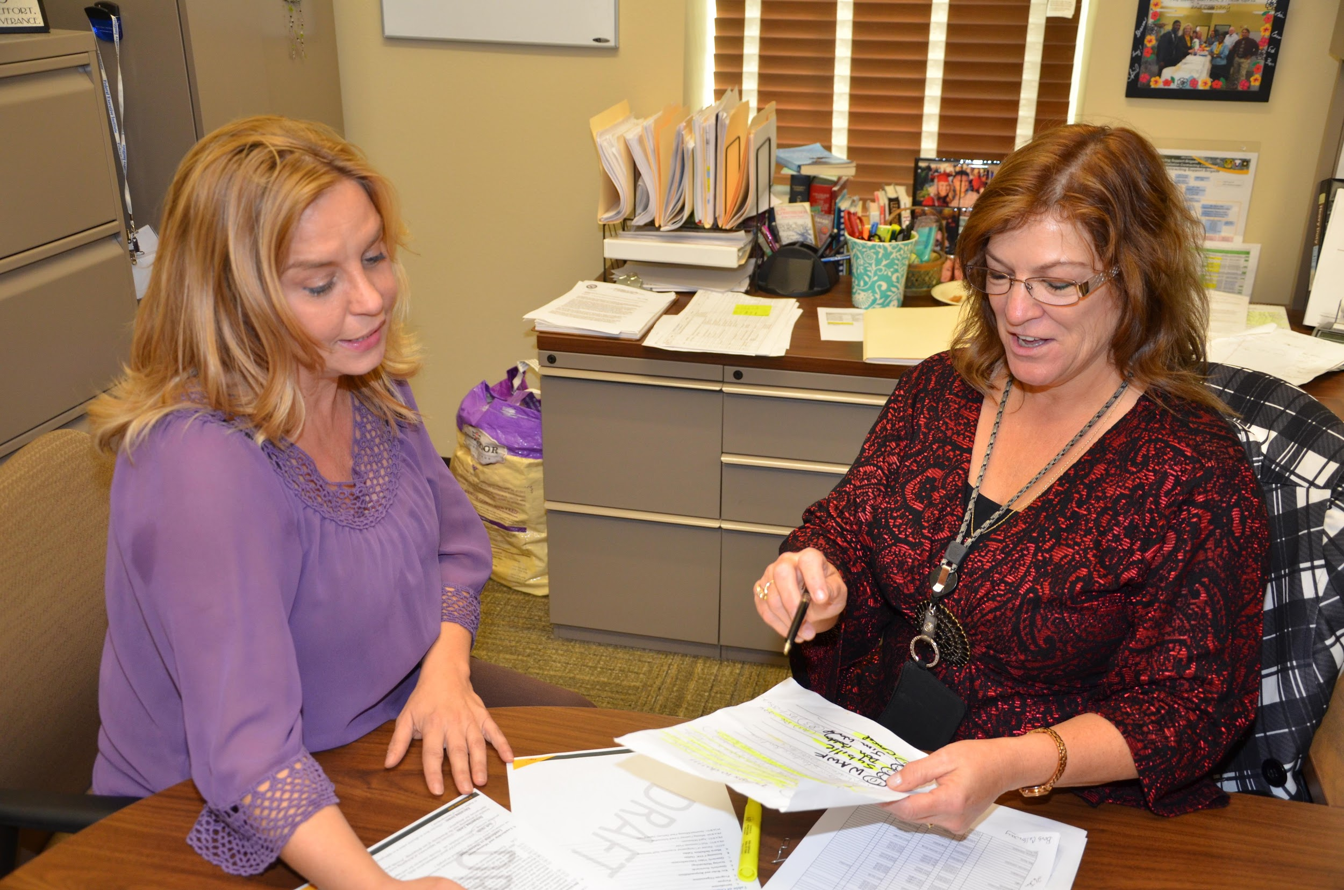
Which picture reminds you of coaching?
1
2
4
3
Why does it remind you of coaching?

Slide 29

PLI Coaching Rounds Key Features
Teacher driven
  Teacher selects the instructional segment to video.
  Teacher tags video at 1 to 2 segments explaining why this segment is important for coach to review.
Confidential
Strength based

Slide 30
1:1 Coaching Rounds: Video Reflection with Practice
Asynchronous Work: Understand the steps of the Video Reflections with Practice
in Whetstone.
Understand a Video Reflection.
Analyze the Video Reflections to understand the look fors in conversations.

Slide 31
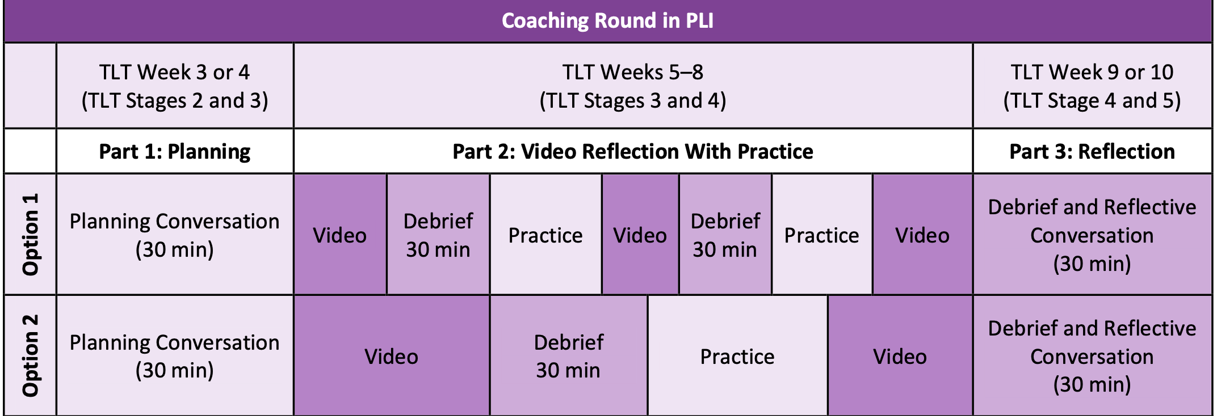
How many video reflections with practice are there?

Slide 32
Video Reflections with Practice in Action
Watch how a teacher tags her video.
“Teacher Video Reflections for Simulation”
Reflect:
What might you expect to hear in the debrief based on the teacher timestamp
notes and coach’s comments?
Debrief with team.
Notes:
Video link: https://drive.google.com/file/d/1EixQ-S2GWhgYpUxJgzNXqS9PxR3nQ2XM/view?usp=sharing

Slide 33

Teacher Video Reflections in Whetstone
Notes:
Video link: https://drive.google.com/file/d/1EixQ-S2GWhgYpUxJgzNXqS9PxR3nQ2XM/view?usp=sharing

Slide 34
Debrief!
What might you expect to hear in the debrief based on the teacher timestamp notes and coach’s comments?

Slide 35

Video Reflection for Debrief
Watch the Video Reflection Debrief Conversation:
How did the video in Whetstone and the debrief with the coach support teacher learning?
Each team will share a reflection.

Slide 36
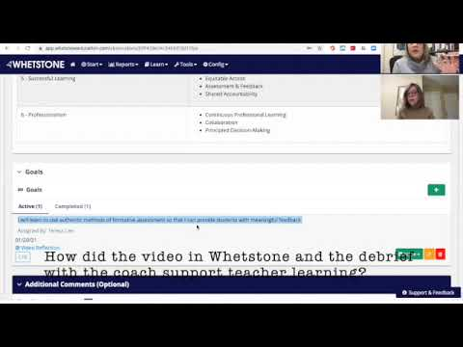
Teacher Goal:
I will learn to use authentic methods of formative assessment so that I can provide students with meaningful feedback.
Teacher Timestamp Notes:
0.00.14
I wanted to show all the students video responses already completed by classmates so they could see authentic examples.
0.01:31
This is the video responses I have used with students previously. I would like the students in this class to do video responses that I will use as assessment and feedback about our topic.
0.05.49
There are so many steps for the students. I worry about this. How might I simply it so the directions don't get in the way of the learning?

Slide 37

In the Gallery
Let’s hear from each school team!
Share how the video in Whetstone and the debrief with the coach supported teacher learning?
What questions might you still have?

Slide 38

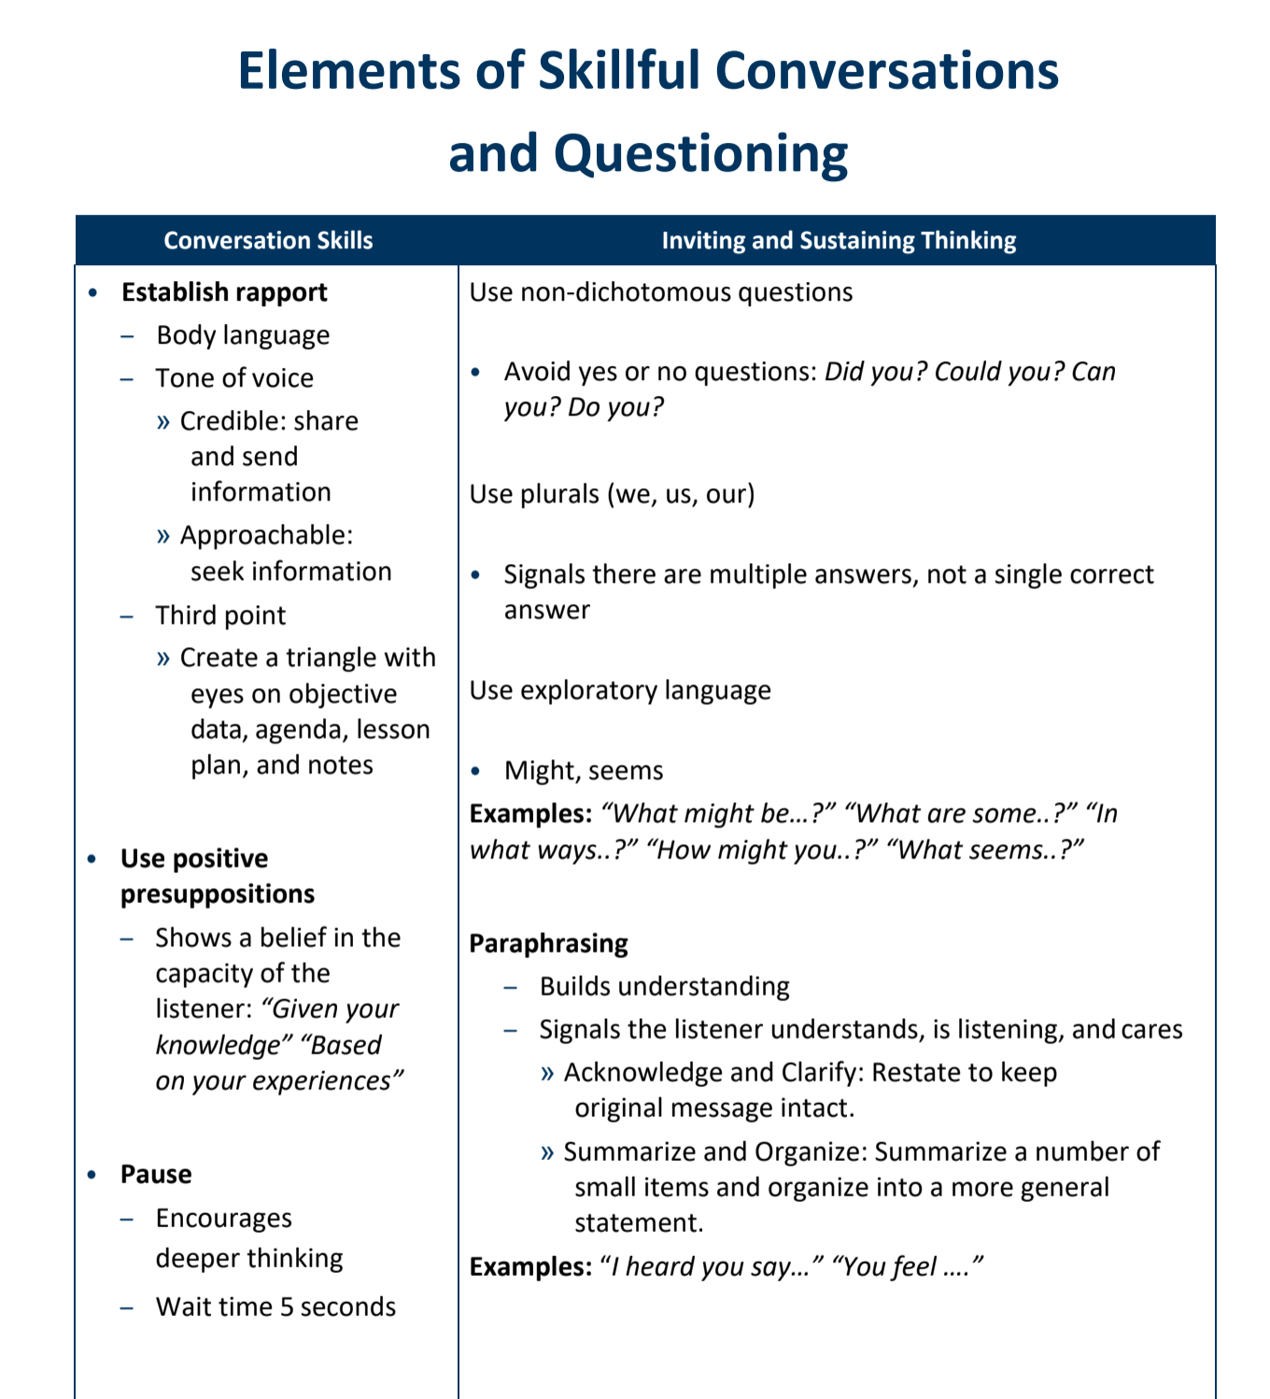

Look for:
Elements of Skillful Conversations & FFT language
In pairs, go into one of your Whetstone accounts. Share your screen and find the following:
Go into the Video hub
Submit a video (Jorie and Teresa Video Debrief Conversation)
Start Video Reflection
Add existing video
Timestamp Notes on video:
Elements of Skillful Conversations
Framework for Teaching Cluster language
Share with PLI Specialist (Jorie Ellis or Teresa Lien)
Notes:
Elements of Skillful Conversation handout is in the PLI Binder Session 3 & 4 tab.

Slide 39

Circle Up
What are you leaving here thinking about?
What do you personally want to be mindful of in coaching (as a teacher or PLI Coach)?
Now you have reviewed all the stages and learned more about 1:1 Coaching, as a team… pull out your calendars and create a tentative plan for video recording and completing cycle 1.

Slide 40
End

Slide 41
PLI activities and timeframes
Continue 1:1 Coaching

Slide 42


Axiom of Coaching
Listening To
Hear
Not
Listening To Speak

Slide 43
The Primacy of Listening
Typical speaking rate – 150-180 wpm
Listening rate – 500-800 wpm
Notes:
Attentive listening requires complete focus on the other person and noticing and managing any inner responses which may distract us from the information and meaning that the other person is trying to convey. Normal speaking rates vary from 125-150 words/min. while listening rates vary from 500-800 words/min. Most listeners fill in these gaps with their own thoughts, judgments.

Slide 44

Notes:
Chinese pictograph captures what/how/why we listen
We use our ears for hear words that might be stated more than one or emphasized, we listen for the pace/speed of the words, we watch w/our eyes non-verbal cues (facial features, breathing rates, frowns, smiles, clenching of jaw, furrowed brows, flushing of skin, shoulders hunched up, what hands/legs/feet doing)
We listen however with our hearts because we seek to understand another

Slide 45

Being Present
T
here
Emotional here and there
Mental here and there
Technological here and there
Notes:
We live in multiple time frequencies – on notepad write this word: here
You can be in the room but not present
Add one more letter “T”--- You are one consonant away from being able to be fully present
Emotional – here – there – it may relate to your role or what might be happening with others in your life (family, friends, etc)
Mental – May have a lot of “to do’s” (e.g. prepping for tomorrow’s lesson, planning for tomorrow’s meeting, etc.)
Technological – May be the most distractive - anticipate another text or email or need to send one – as soon as your mind goes there ort you hear the “ding” of your phone, you’re no longer here, but there –
There’s no away anymore in our culture – some of us remember the bulletin board with notes – we could put off things
Being here requires internal discipline to control the chatter
Being aware of how easy it is to go somewhere else – we have to constantly come back to stay engaged HERE
Physical alignment as well as mental can help

Slide 46
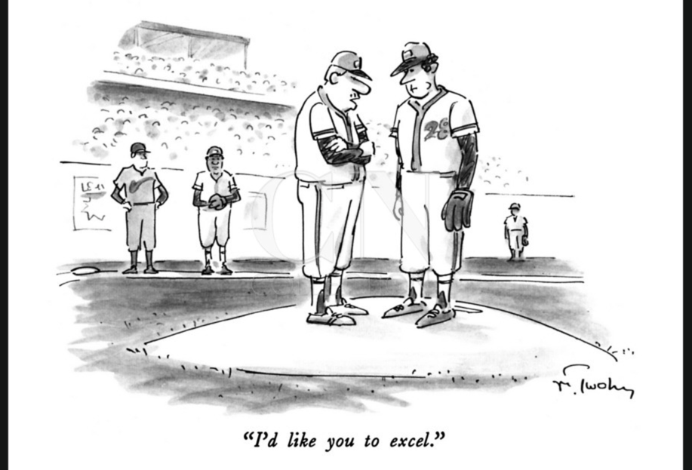
Notes:
Interpret the responses, act on it and provide feedback

Slide 47

Focused Reading-pp.12-14
Partners: both read excerpts from Talk About Teaching! Leading Professional Conversations. (Charlotte Danielson, copyright 2009, pp. 1-11)
Mark text as shown:
! Significant idea
√ I know this
? Wondering/Question
Notes:
Consider Kellie and Jorie's addition of the AB Listening Protocol
A shares their reading notes for 60 seconds
B paraphrases what they heard A say
Switch
Debrief the protocol
This is our debrief, large group after they read and teach.
In what ways do these support learning and professional growth?

Slide 48
School Teams Debrief
Compare and share your markings with your colleagues
How might professional conversations provide new opportunities for quality feedback within your school setting?
Notes:
1:20-2:00
Or say: In what ways might this learning impact the professional culture in your building?
Let’s clarify “this tool.”

Slide 49

Feedback?
Feedback is value-neutral help on worthy tasks. It describes what the learner did and did not do in relation to her goals….It is actionable information and it empowers the learner to make intelligent adjustments when she/he applies it to the next attempt to perform.
Grant Wiggins

Slide 50
You need more examples in your report.
You should have included essential questions.
Good job!
I really liked your poster!
Your use of words was more precise in this paper than in the last one.
The first sentence is confusing as your initial thesis is not supported by evidence.

Slide 51
Advice
You need more examples in your report.
You should have included essential questions.
Value Judgment/Grades
Good job!
I really liked your poster!
Useful Feedback
Your use of words was more precise in this paper than in the last one.
The first sentence is confusing as your initial thesis is not supported by evidence.

Slide 52
Feedback
Specific – refers to specific behavior or content/skill being learned, tells learner what was correct/incorrect , not focused on the learner
Timely – Immediate feedback, as often as possible
Accurate – factual, objective, safe
Constructive and Substantive – improves learning, identifies what’s done well and/or what might be some next steps
Danielson, 2009
Notes:
What does this sound like?

Slide 53
Feedback?
I really liked your opening activity.
At this point in the lesson, you might have used more examples.
Have you considered putting students into groups?
Given the question you asked about student participation, what were some things you noticed? …. What might be some ways to increase student participation? Learner, “I’m not sure”. O: Let’s brainstorm some ideas.
It would have been better if you engaged more students in the closing activity.
Your handouts outlined steps and examples for each activity. In what ways did this contribute to the learners’ success?

Slide 54
Feedback?
I really liked your opening activity.
At this point in the lesson, what might be some ways to involve students in providing input?
Have you considered putting students into groups?
Given the question you asked about student participation, what were some things you noticed? …. What might be some ways to increase student participation? Learner, “I’m not sure”. O: Let’s brainstorm some ideas.
It would have been better if you engaged more students in the closing activity.
Your handouts outlined steps and examples for each activity. In what ways did this contribute to the learners’ success?

Slide 55
Summary of Effective Feedback
  Is best initiated by the learner
  Focuses on the learning intention of the task
  Occurs as the learners are doing the learning
  Provides information on how and why the learner understands and misunderstands
  Provides strategies to help the learner to improve
  Assists the learner to understand the goals of the learning.

Slide 56
Technology: Then and Now by Ms. Karr
Ms. Karr is teaching a lesson on Technology: Then and Now. She has selected Cluster 1 and the Focus Area (learning outcomes).
Open Ms. Karr’s video in your Edthena account.
For this activity, you are Ms. Karr. Watch the first 10 minutes. Tag points that reflect your Focus Area (learning outcomes) and other points in the video that you would like to discuss with your coach. It could be a strength, a comment or a wondering.
Pair up with a participant from the other school (with your computer).
Each participant responds to their partner’s tags and questions.
Using the video reflection conversation template, each participant conducts a conference using partners’ tags and questions.
Notes:
Teresa – this is the first stab. I think once we have the directions down, the instructions should fly in.

Slide 57


LUNCH

Slide 58
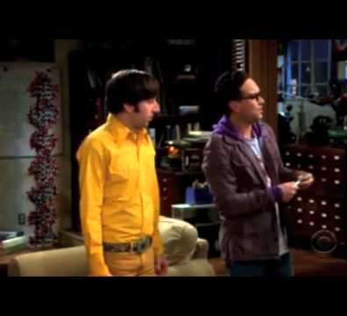
How does this represent challenges of a collaborative team?
How can you relate?

Slide 59
Take a few minutes to independently order these characteristics of an effective team based on importance for you as a team member.
DEPENDABILITY​
MEANING​
PSYCHOLOGICAL SAFETY​
STRUCTURE AND CLARITY​
IMPACT​
Notes:
About 5 minutes at first by themselves

Slide 60
Use the Google article to guide a Group Discussion around:
How did you order the characteristics?
Why and how might other members of your team rank them?
How might that impact your team dynamics?
DEPENDABILITY​
MEANING​
PSYCHOLOGICAL SAFETY​
STRUCTURE AND CLARITY​
IMPACT​
Notes:
https://docs.google.com/document/d/1RHKj5pOEKuLCTREhextp4rSo_qlOyFAyZIBSVA1COo0/edit?usp=sharing

Slide 61

Listen for the specific elements that create psychological safety.
As a team consider what norms you have that develop and support psychological safety?
What norms might you need to create?
Notes:
One of the characteristics that stands out as the most important factor in achieving the others is psychological safety…
We are going to watch a short video that talks more about this...you can think about your own connections to this as you watch and connections to your team.

Slide 62

Cycle Reflection Document
Download the Cycle Reflection Protocol from AIR Table
Share it collaboratively
Take turns facilitating the reflections for each of the stages

Slide 63

Data Summary Statements
PART 1:
Review your initial data summary statements
What is still true? What has changed?
Update your data summary statements given recent data gathered in Cycle One.
PART 2:
Review pgs 30-31 of Tool 3.4.
Circle/highlight questions you
might consider for Cycle 2
Notes:
Ask questions
All learning together
Be an active contributor

Slide 64
Connect:
How do the five characteristics of effective teams come into play in this stage?
​
Reflect:
Engage in a discussion on the guiding questions for Stage 2
Notes:
Ask questions
All learning together
Be an active contributor

Slide 65
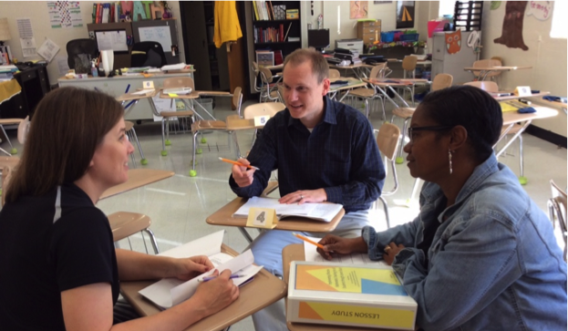
Learning Design:
Lesson Study
Review the handout on lesson study.
How might this structure support your collaborative learning?

Slide 66
Connect:
How do the five characteristics of effective teams come into play in this stage?
​
Reflect:
Engage in a discussion on the guiding questions for Stage 3
Notes:
Ask questions
All learning together
Be an active contributor

Slide 67
Stages of Concern
Tool 6.2
Consider the changes required of you as you engaged in coaching and teacher learning teamwork. Use Tool 6.2 to reflect on your own reaction at the beginning of the school year and where you are now.
How might you support one another through the change process?

Slide 68

Connect:
How do the five characteristics of effective teams come into play in this stage?
​
Reflect::
Engage in a discussion on the guiding questions for Stage 4
Notes:
Ask questions
All learning together
Be an active contributor

Slide 69
Video of data discussion
Notice and Wonder
Debrief the Process
Notes:
Watch first five minutes of video

Slide 70
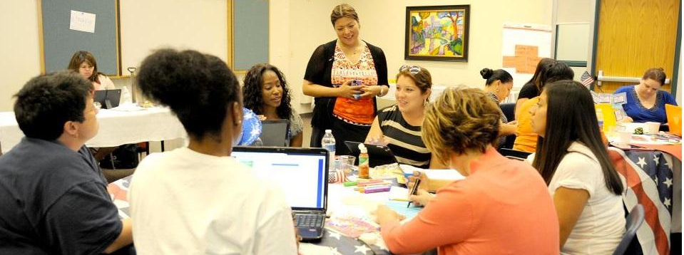
Using Student Work Protocols
This Photo by Unknown author is licensed under CC BY-NC.
Find a partner and each of you choose a protocol to review and share.
Notes:
Share the protocols – ask how they might use these next cycle

Slide 71
Connect:
How do the five characteristics of effective teams come into play in this stage?
​
Reflect:
Engage in a discussion on the guiding questions for Stage 5
Notes:
Ask questions
All learning together
Be an active contributor

