Slide 1


Professional Learning With Impact
Coach Refresher Training
Summer 2022
Professional Learning with Impact Coach Refresher Training. Fall 2022. This work is licensed under a Creative Commons Attribution-NonCommercial-ShareAlike 4.0 International (CC BY-NC-SA 4.0) License.
The contents of this slide deck were developed under a grant from U.S. Department of Education, Office of Elementary and Secondary Education, Award No. U411B180032; However, those contents do not necessarily represent the policy of the Department of Education, and you should not assume endorsement by the Federal Government.

Slide 2

Welcome Back!

Slide 3
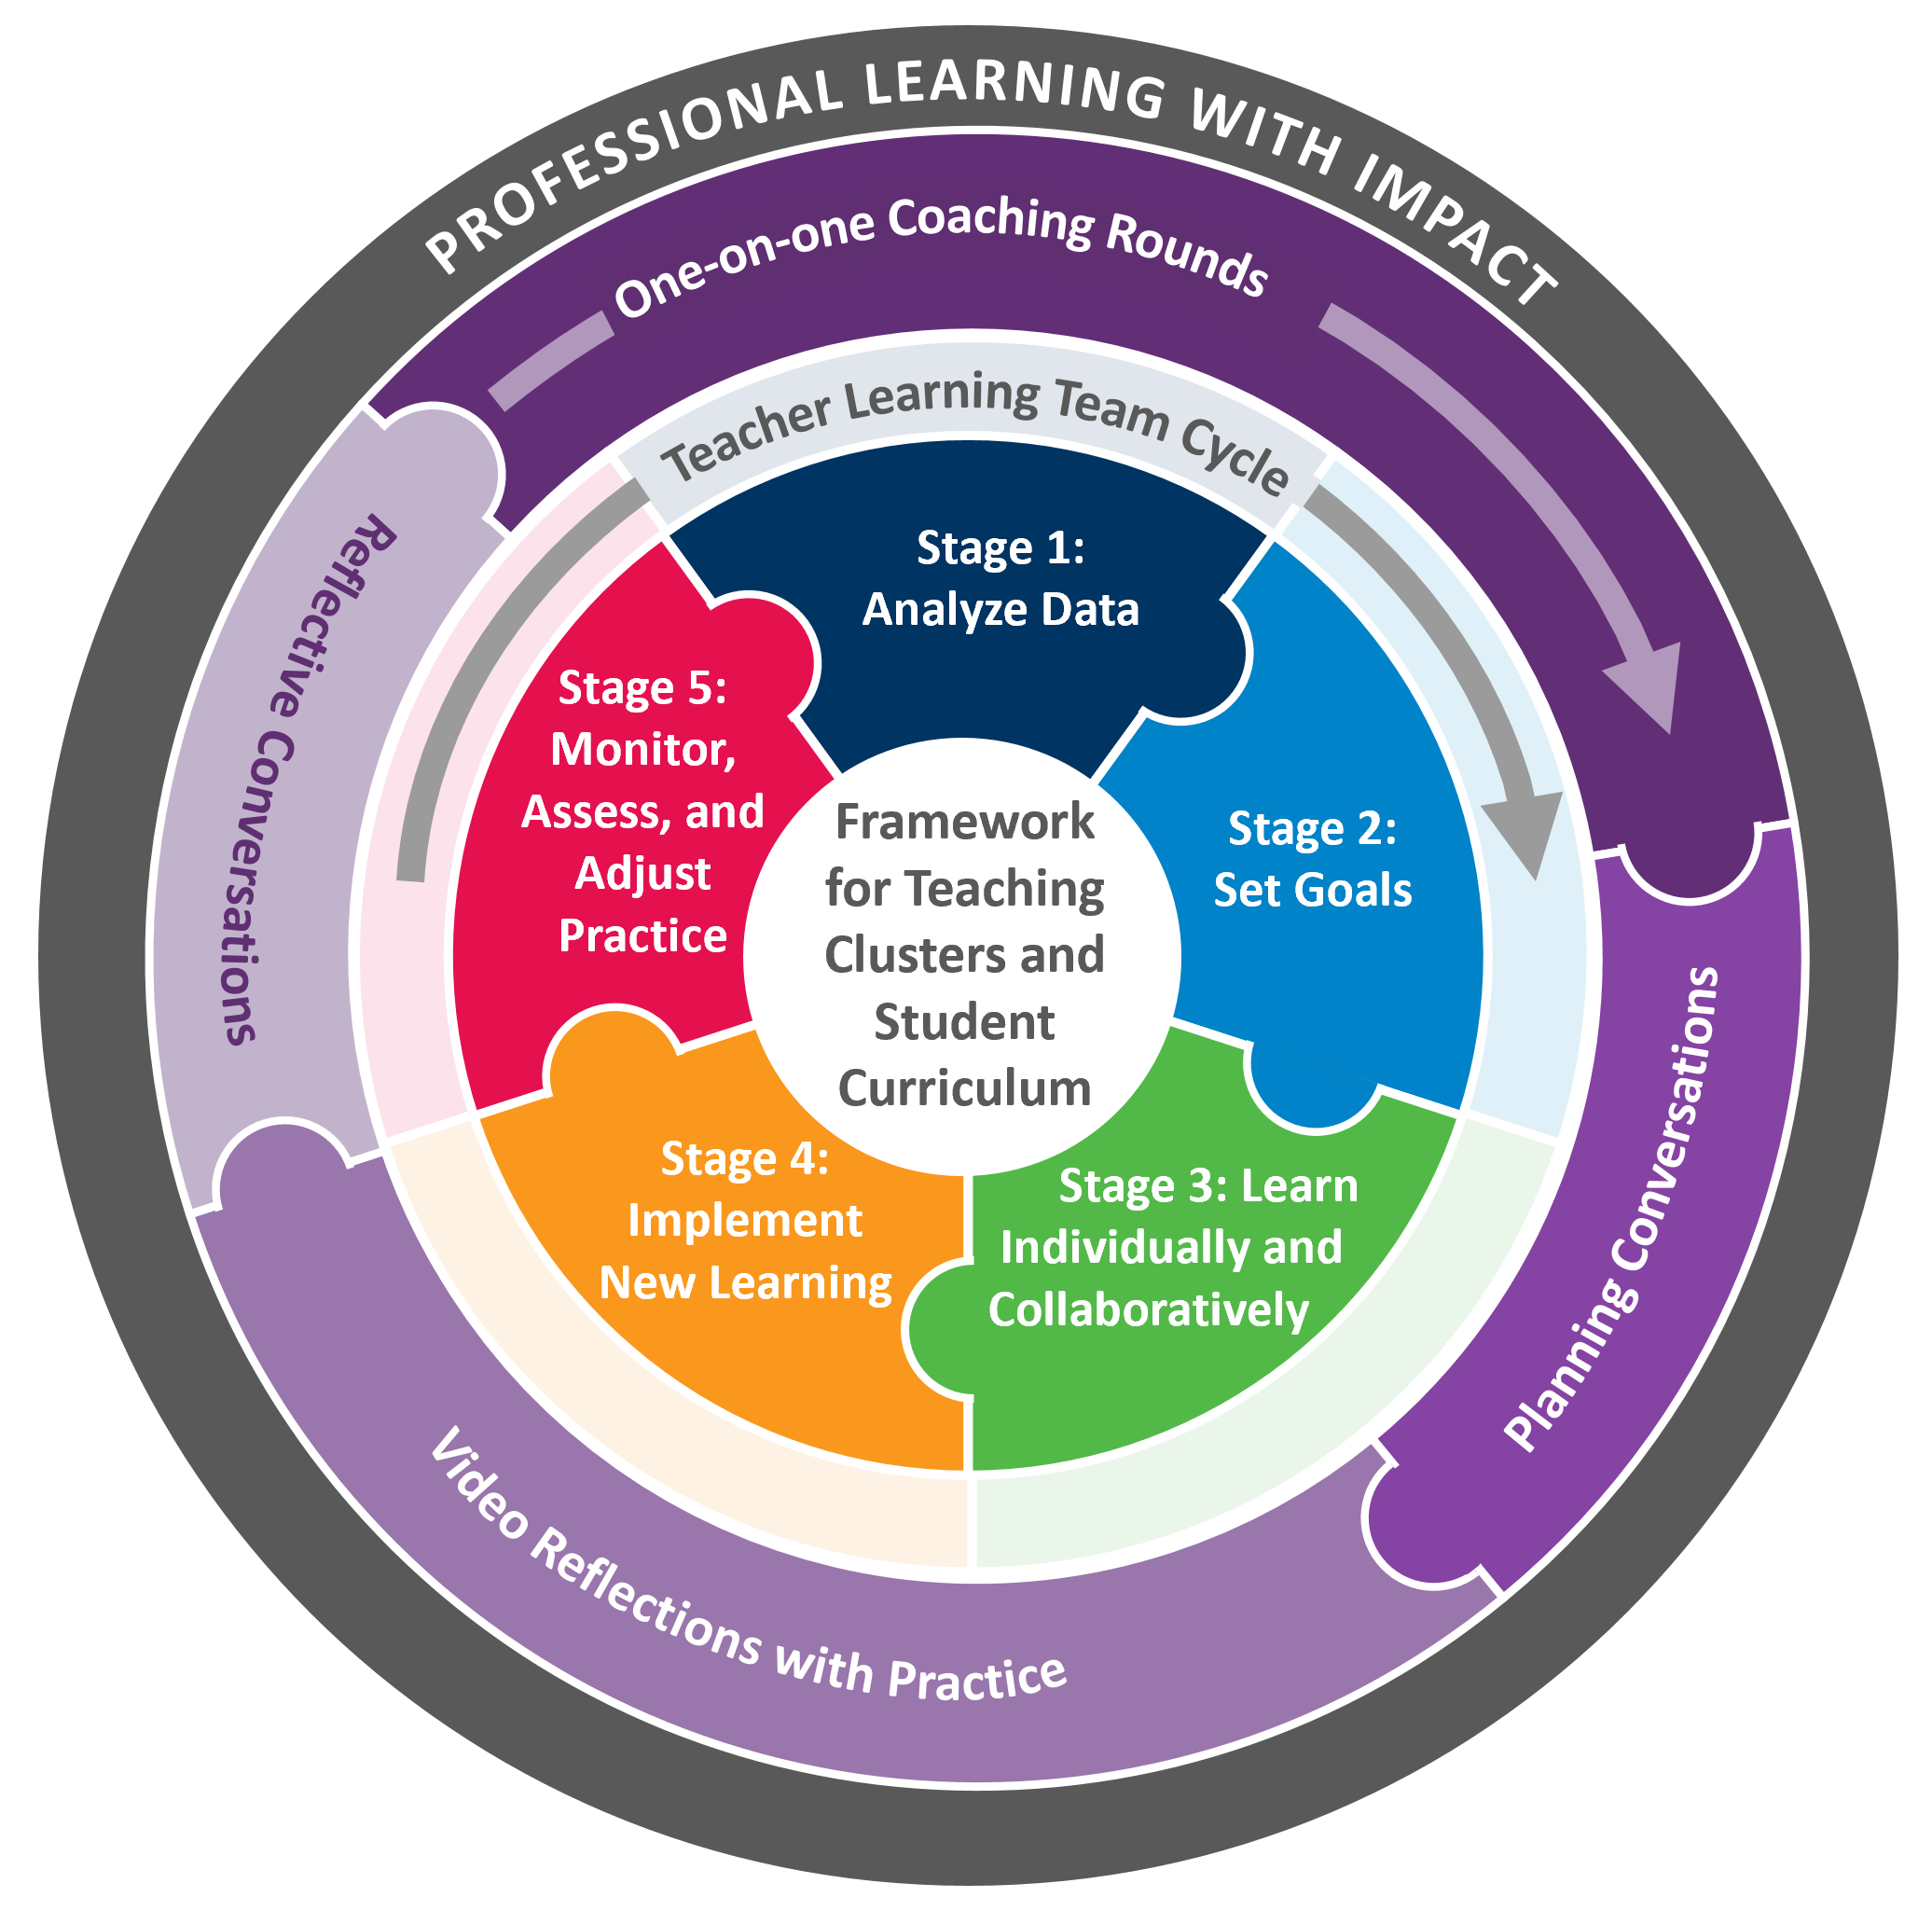
Professional Learning With Impact (PLI) Program Overview
Notes:
Introducing the PLI acronym. Review program, briefing figure from inside out:
PLI is a product of an instructional coaching model centered in the framework for teaching clusters that the Danielson Group (DG) has been developing for years and the teacher learning team cycle of inquiry that Learning Forward (LF) has been developing for years.
Exploring both collaboratively and individually.
Material that teachers and students engage with—clusters and curriculum.
Collaborative process through which teachers improve—Teacher Learning Team (TLT) and coaching.
Mutually reinforcing each other
Cyclical

Slide 4
Welcome and Voices in the Room
Since you’ve started this work, what is something you’ve discovered is a strength you bring?
Name
Role
School

Slide 5
Workshop Outcomes
Learn to automatize the coaching round process by gaining a deeper
understanding of FFT Cluster 4 and how to support teacher thinking and
propel their practice forward through the video and tagging.
Use a problem-solution lens to think through each stage in the TLT cycle
Articulate facilitator skills and steps before, during, and after a TLT meeting
Notes:
Compare these to the tree map.

Slide 6
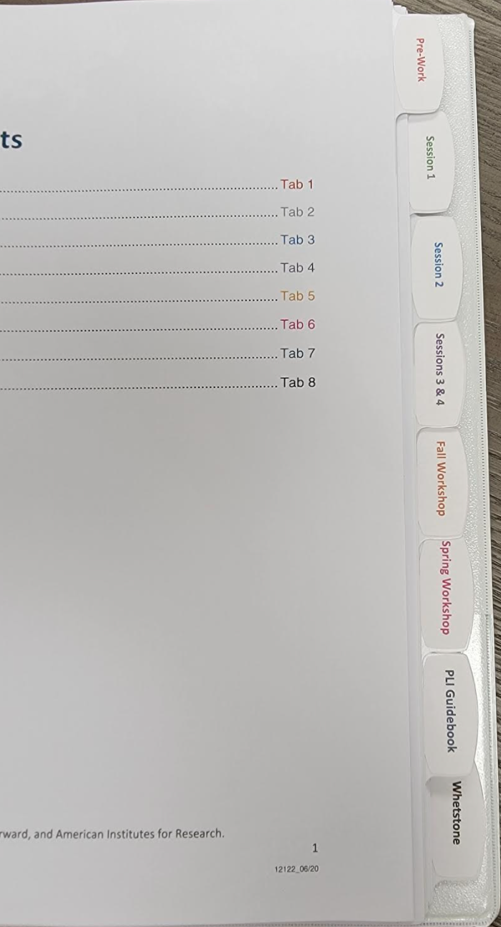
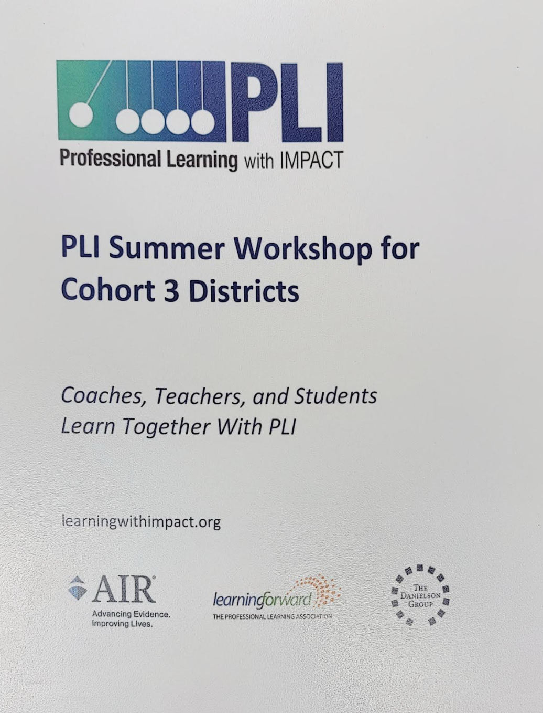
Materials by Your Side
Professional Learning with Impact binder
Collaborative Interactive Document
Access to Whetstone account
Highlighter
Paper and pencil/pen

Slide 7
Part 1: FFT Cluster 4 Review and
One-on-One Coaching Rounds

Slide 8
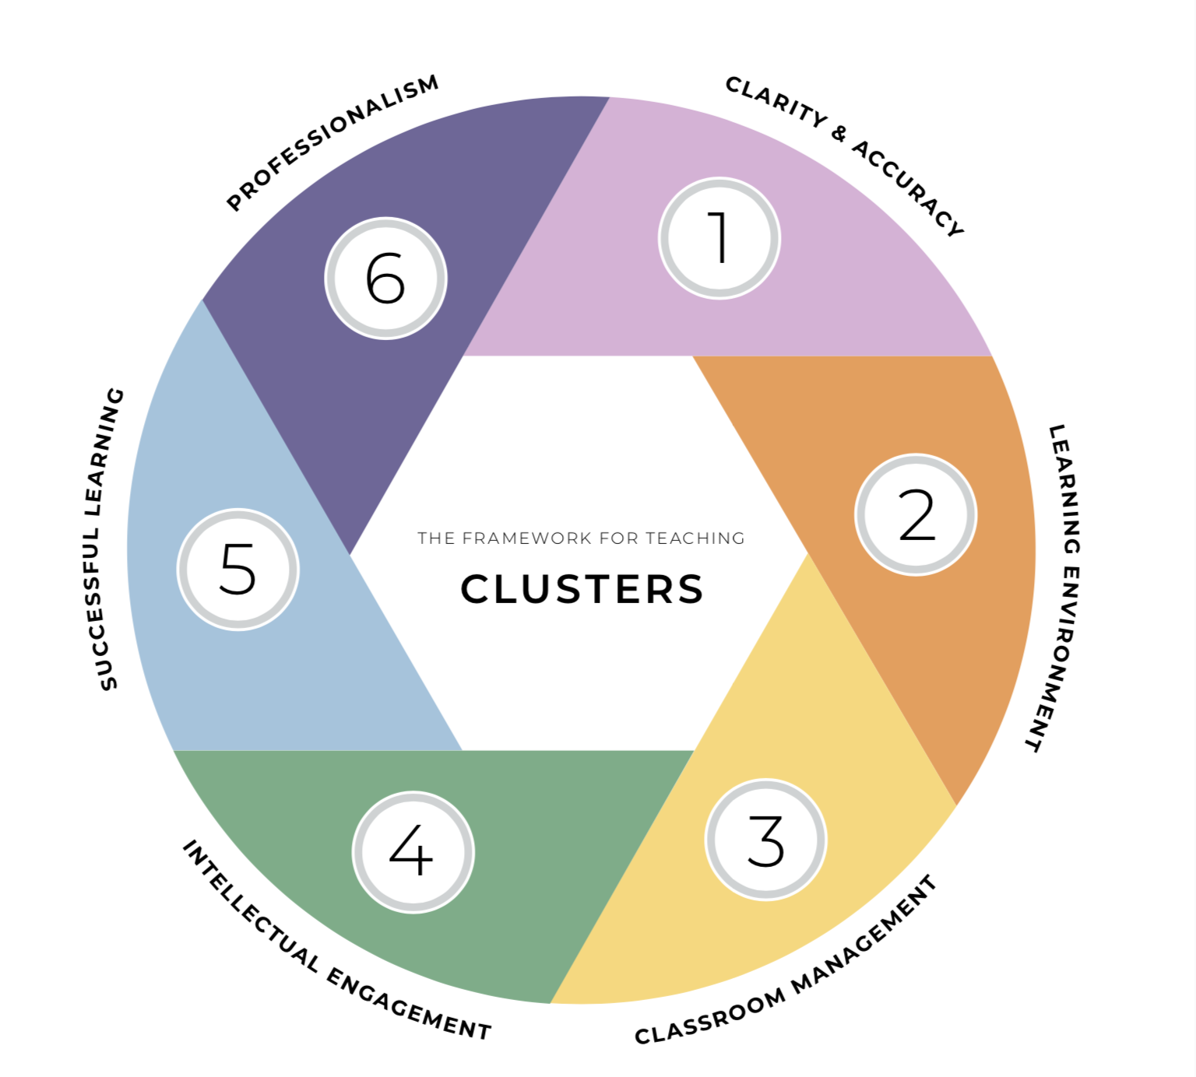


Clarity of Instructional Purpose and Accuracy of Content | Safe, Respectful, Supportive, and Challenging Learning Environment | Classroom Management
Student Intellectual Engagement
Successful Learning by All Students
Professionalism
Notes:
Explain the theory of action that is implicit in the Clusters.
The Clusters provide a roadmap for student learning.
If (1) Clarity of instructional purpose and Accuracy of content; (2) a safe, respectful, supportive, and challenging Learning Environment; and (3) Classroom Management are in place, then the conditions exist for (4) Student Intellectual Engagement with important content to occur, which is necessary to reach the ultimate goal of (5) successful Learning by all students.
These aspirations are realized upon a foundation of (6) Professionalism, and must be supported by teacher-centered professional learning systems.

Slide 9
FFT Clusters document:
Six Clusters to Support Teacher Growth and Student Learning
Each FFT Cluster contains key features, which are unpacked in various and purposeful ways to engage in analysis of practice:
a NARRATIVE description of the content of each cluster and the assumptions that underlie each;
three FOCUS AREAS for each cluster to help guide professional conversations;
a set of CONSIDERATIONS to prompt inquiry, reflection, and goal setting for each cluster;
a set of INDICATORS that deepen the understanding for analysis of each cluster; and
a CONTINUUM OF PRACTICE for each cluster that contains descriptors to guide professional conversations and teaching advancements.
Notes:
The FFT Clusters document explains the six Clusters to Support Teacher Growth and Student Learning. Using the FFT Clusters key features contributes to the common language for professional conversations on how to develop the skills of the FFT Cluster.

Slide 10
Unpacking FFT Cluster 4: Intellectual Engagement
Read each features of FFT Cluster 4 and reflect on the ways to engage in the analysis of practice:
Narrative: How might the content of this FFT Cluster and the assumptions that underlie it support teacher learning?
Focus Areas: In what ways will the focus areas be useful for guiding professional conversations?
Debrief as a Group.
Considerations: How might you leverage these as a coach?
Indicators: In what ways do these indicators deepen the understanding of the FFT Cluster?
Debrief as a Group.
Continuum of Practice: Think about how the rubric language might support your coaching conversations, or how you might be cautious about using the levels of performance in coaching.
Debrief as a Group.

Slide 11
Putting the FFT Cluster in Action
Open the “Collaborative Interactive Document for PLI Summer 2022” and find Putting the FFT Cluster in Action:
Open, make a copy and read the “Summer 2022 Coach Booster Workshop - Goals for Simulation” document.
Highlight the FFT Cluster 4 language in the team and teacher goals.
2. Open, make a copy and work in the “Tagging Simulation” table. After we watch the
video, fill out the “Your coach tag” column only.

Slide 12
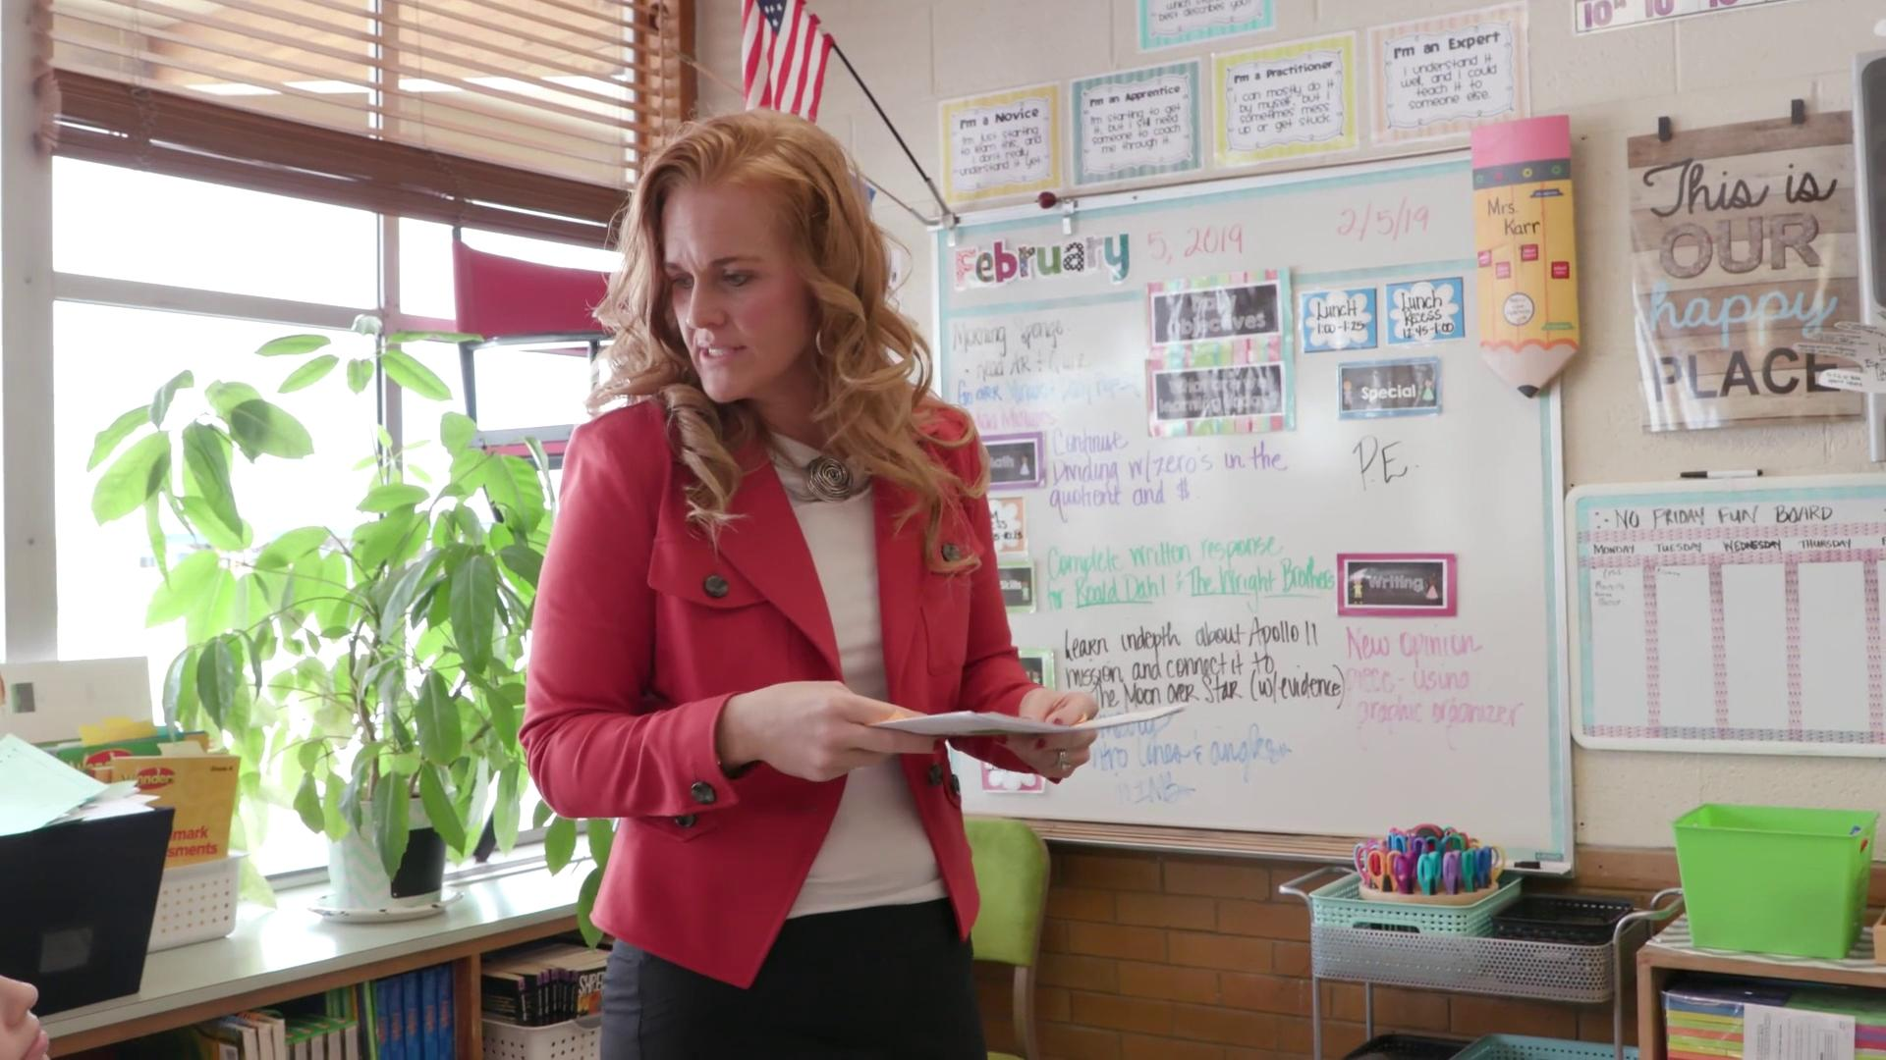
Individual Teacher Learning Goal in Action
Notes:
https://docs.google.com/document/d/1FTyCruSIIAdTNXEHpM7ucVKi-BQfH1ovTOSAoLfKGFU/edit?usp=sharing

Slide 13
PLI Guidebook: One-on-One Coaching Round
During the coaching rounds, there are several coaching conversations:
One Planning Conversation
“Coaching Rounds Part 1: The Planning Conversation” pages 44
Two to Three Debrief Video Reflections with Practice
“Coaching Rounds Part 2: Iterative Video Reflections with Practice: pages 46-48
One Reflective Conversation
“Coaching Rounds Part 3: The Reflective Conversation” pages 48-50
Directions: As you read the goal and approach to each part above, note your discoveries and questions.

Slide 14
Reflecting
Review the tagged comments you made in the collaborative document and based on the reading from the PLI Guidebook, reflect on the following:
What might be some adjustments you would make to your tags? Return to the “Tagging Simulation” table and make those modifications in the designated column.
How might these teacher and coach tags support the debrief coaching conversation?
In what ways does tagging (by teacher and coach) move teacher practice forward?

Slide 15
Possible Challenges and Solutions
How do coaches encourage teachers to record their teaching?
How to coaches engage teachers in tagging their video?
How can the coach consolidate the parts of the coaching process to maximize the use of time?
What other time tips might be useful?
Other challenges?

Slide 16
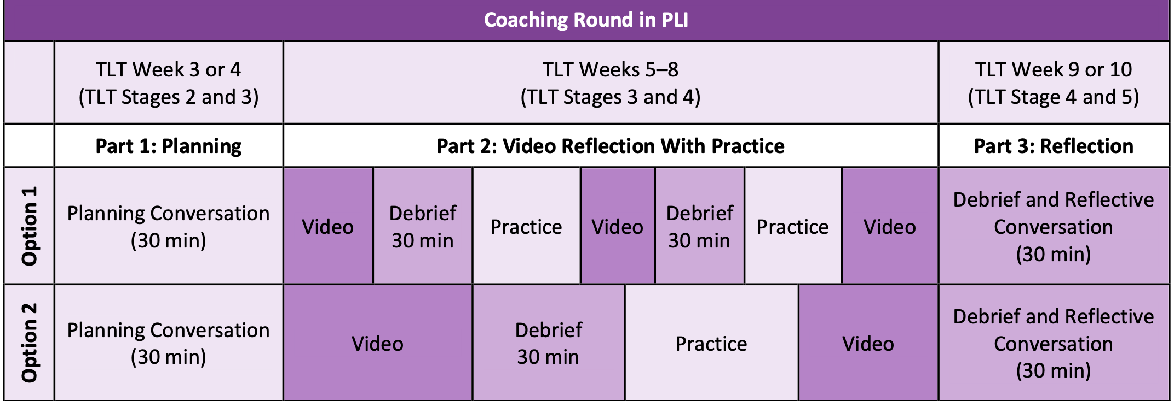
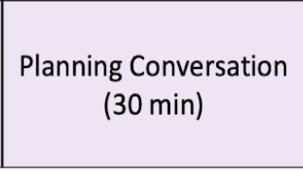
Possible Places to Consolidate to Maximize Time
If appropriate, a coach could conduct
a planning conversation during a TLT
to demonstrate a planning conversation
to the team.
Reflective and
the next planning
conversation.

Slide 17
Part 2: TLT Review and Revisit

Slide 18



Reviewing and Troubleshooting the Stages
Review and Recall
Challenges
Suggestions
Notes:
https://docs.google.com/presentation/d/1aePSTY9Vvc6-7mymIev4Hzr-RXKLNXbQyQvDZAvhrlY/edit?usp=sharing

Slide 19
Facilitating a TLT
BEFORE:
What do you do to prepare for TLTs?
DURING:
What are some facilitator “moves” that support your team during a TLT?
AFTER:
What do you to wrap up or follow up after the TLT?
Notes:
https://docs.google.com/presentation/d/1aePSTY9Vvc6-7mymIev4Hzr-RXKLNXbQyQvDZAvhrlY/edit?usp=sharing

Slide 20
Part 3: Getting Ready for 2022-2023

Slide 21

Consultancy Protocol for Anticipated Challenges
One person shares thinking around a challenge they anticipate in implementing the PLI model this year. (2 min)
Listeners ask clarifying questions.
(2 min)
Listeners then discuss possible strategies, solutions, and ideas to address the challenge. (4 min)
Presenter rejoins the conversation to share new thinking generated by the discussion. (2 min)

Slide 22
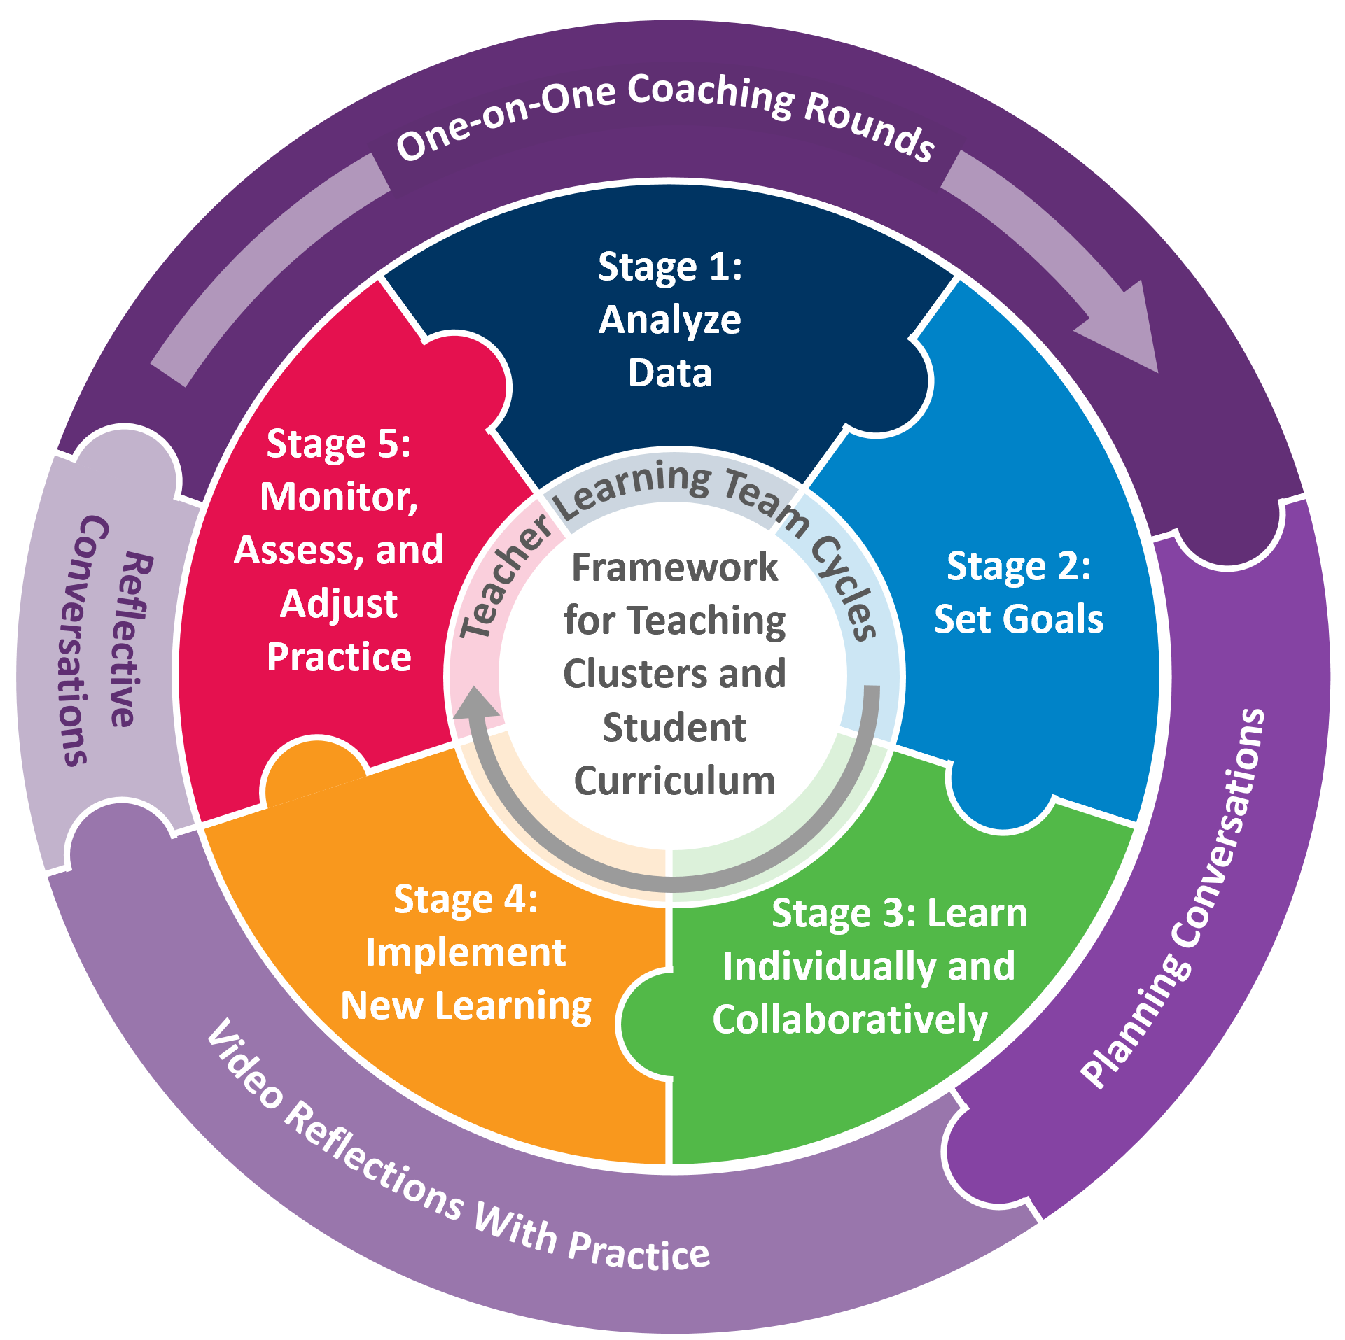
Anticipated Timeline for Coaching and TLTS
What will your timeline for restablishing TLTs and starting the coaching cycles look like this year as compared to last year?
Notes:
DAVID DOUGLAS EXAMPLE https://docs.google.com/document/d/15n3YDO157JIrw8o13io2D80ZD3VoithtYC_z61-Njjo/edit
PLAINFIELD EXAMPLE https://docs.google.com/document/d/1d2bpQkcYAiLLYYiNvinz8dUr5dMJc7Wzcf58vOjq-qM/edit
LINK TO BLANK TEMPLATE: https://docs.google.com/document/d/11Q0ymP6TeCRTztGM8p-_27plHnj7bazq33yBGXUhScY/copy

Slide 23
PLI Coach Community Connections
PLI Coach Community Connections will happen monthly, starting in September
What conversations, tools, or support might our monthly community meetings offer coaches?
Topics, ideas for how we spend our time
Notes:
Jamboard
Refresher on stages
Strategies for working with teams
FFT clusters
Group coaching
Alike challenges
Focus on equity

Slide 24

Closure
What is your greatest hope for the year ahead?
How can you nurture that hope throughout the year?

