Slide 1


Sensemaking
Meeting
[Month Year]

Slide 2
Agenda
1
Welcome and Overview
2
ICA Self-Assessment Sensemaking Conversation
3
Next Steps and Learnings
2
Notes:
Welcome team to the meeting
Provide an overview of the agenda

Slide 3
Today’s Objectives
1
Increase staff’s understanding and perceptions
of current organizational capabilities.
2
Determine an overall organizational self-rating for prioritized capabilities and elements.
3
Notes:
Provide an overview of the objectives for the meeting

Slide 4



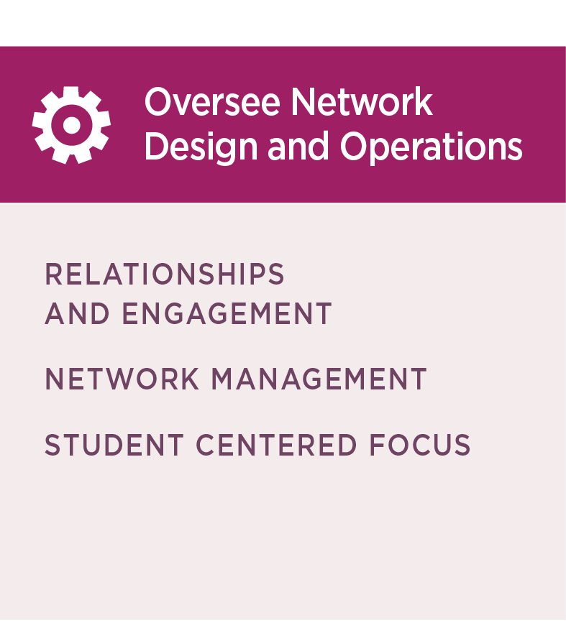
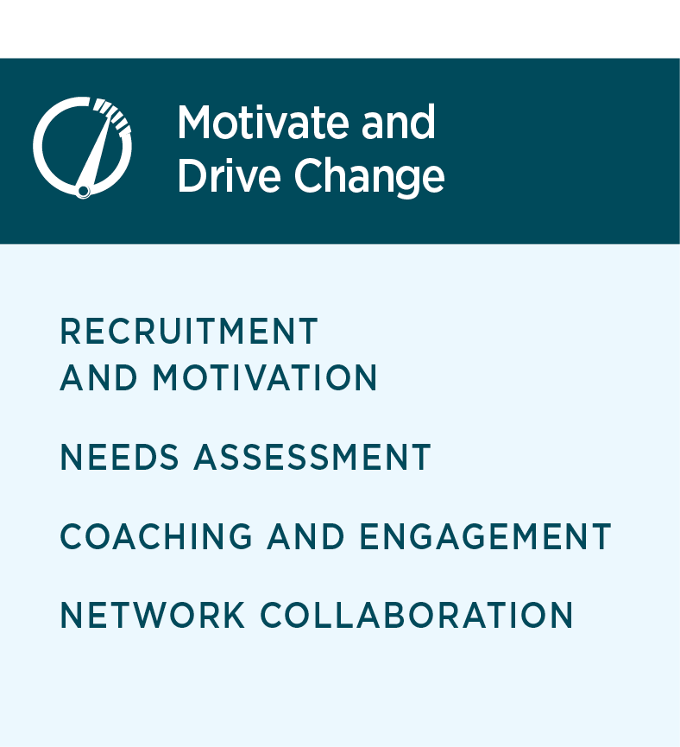
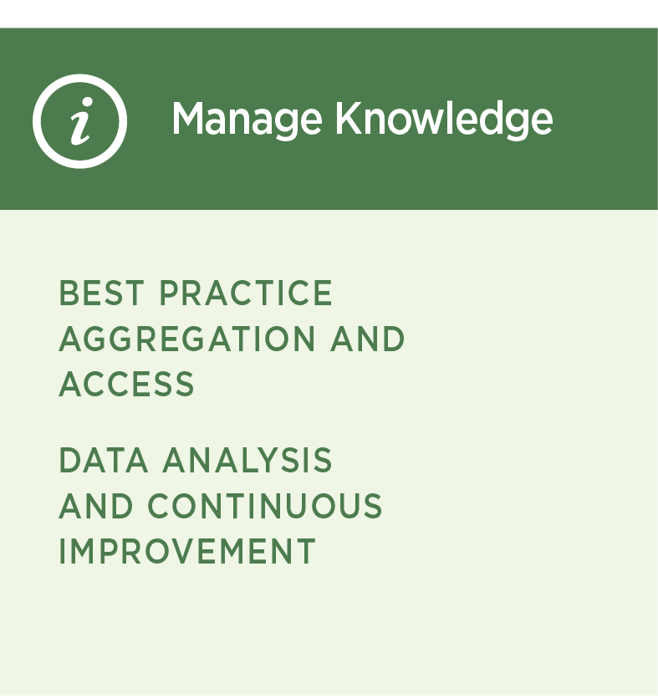
Intermediary Capability Assessment
The Intermediary Capability Assessment Framework is comprised
of three Roles.
Each role has an associated set of Intermediary Capabilities that reflect key Intermediary activities or capacities.
Each Intermediary Capability is measured by one or more Elements.
Tori Cirks
Senior TA Consultant
Billie Jo Day
Researcher
Daniyal Rahim
Research Associate
4
Notes:
Provide high-level overview of structure of the ICA

Slide 5
Purpose of ICA Self-Assessment
The ICA Self-Assessment gathers information about organizational strengths and areas for growth on each Element of the ICA Framework.
1
The conceptual framework of the ICA posits that Intermediaries performing at higher levels across these Elements will be able to more effectively support institutional change.
2
5
Notes:
Share the purpose of the ICA
Make the connection between the purpose and how your organization plans to use it.
Suggested Talking Points:
The ICA framework prioritizes self-assessment and self-reflection.
The sensemaking conversation is a structured opportunity for self-reflection; to take an honest look at our organizational capabilities. ​​
Through this process we can better understand our current capacity to function as an Intermediary.
The process provides valuable information on areas of strength and opportunity to serve as a jumping-off point for internal planning conversations.

Slide 6
ICA Framework Structure
High-level Overview
Oversee Network Design and Operations | Motivate and Drive Change | Manage Knowledge
Relationships and Engagement | Recruitment and Motivation | Best Practice Access and Aggregation
Network Membership Member Engagement Shared Vision and Common Goals | Message Development Communication Methods Change Agent Engagement Motivation for Action Commitment to Action | Network Information Learning Synthesis
Network Management | Needs Assessment | Data Analysis and Continuous Improvement
Network Operations Strategic Talent Recruitment Talent Development Financial Management Financial Stability | Resource and Service Needs Readiness Assessment Need Articulation | Data Administration Network Needs and Performance Monitoring Network Continuous Improvement
Student Centered Focus | Coaching and Engagement
9. Respectful Working Environment Practices 10. Student-Centered Expertise 11. Programmatic Focus Based on Student Needs 12. Network Partnerships Based on Student Needs 13. Student Voice 14. Student-Centered Language | Theory of Action Evidence-based Practices Knowledge and Skills to Manage Change Structures and Processes to Support Change Sustainability of Institutional Change
 | Network Collaboration
 | Network Interaction and Connections Co-Generation Within the Network Value of Network Participation
6
Notes:
Review the overall structure of the ICA Framework and remind participants that for each Element there was a corresponding survey item.

Slide 7
Example ICA Self-Assessment Survey Item
Network Operations | Does your team (with support from your organization as needed) manage the day-to-day operations of the network (e.g., project management, technology, and communication systems)?
We do not yet have systems to manage the day-to-day operations of the network.
We consistently use our systems to manage the day-to-day operations of the network.
We are beginning to develop systems to manage the day-to-day operations of the network.
We consistently use our systems to manage the day-to-day operations of the network and regularly assess our systems to improve effectiveness.
We have developed some systems to manage the day-to-day operations of the network, but use of them is limited or inconsistent.
7
Notes:
Share example item from the survey to help make the connection between the Elements on the previous slide and the survey items themselves
​
Suggested Talking Points
This should look familiar. It is from the ICA self-assessment survey. ​
The self-assessment is designed to collect information about the current status of work or capacity around each Element of the evaluation framework. ​

Slide 8

Self-Assessment Rating Scales
In general, the response options align to a developmental continuum for which numeric values were assigned.
1
NO ACTIVITY: Organization is not currently engaged in the activity.
2
EMERGING: Organization is planning to engage in the activity.
3
DEVELOPING: Organization is engaged in the activity but is limited or inconsistent in its engagement.
4
ACHIEVED: Organization is consistently engaged in the activity with demonstrated effectiveness.
5
EXEMPLARY: Organization is consistently engaged in the activity and proactively incorporates continuous improvement and capacity-building objectives into their work.
8
Notes:
Review self-assessment rating scale and developmental continuum
Suggested Talking Points
As a reminder, here is the self-assessment rating scale. Each rating has a numerical value attached to it with 1 being no activity and 5 being exemplary. ​
​​The rating reflects the current status of work or capacity.
This means in order to rate ourselves exemplary on an element, all components of the rubric description must be present: for example, we are consistently engaged in the activity AND proactively incorporates continuous improvement and capacity-building objectives into their work.
You need all elements of a rating present in order to score yourself at that rating. ​

Slide 9

2
ICA Consensus Conversation
9

Slide 10
The Consensus Conversation
What is consensus decision making?
A decision that everyone can support or can live with.
What is expected during consensus conversation?
Active cooperation
Disciplined speaking and listening
Respect for the contributions of every member
10
Notes:
Set the context and expectations for the sensemaking and consensus conversation
Suggested Talking Points:
As we move onto the consensus conversation, let’s talk about what we mean by consensus. When we say that we will reach consensus on a particular element, we mean that this is a decision that everyone in the group actively supports or can at least live with. ​
Why do we do this? We believe that the conversation that occurs during this process improves the understanding of the strengths and opportunities available to our organization. The “creative interplay of ideas” that occurs during this process encourages an improved understanding of the strengths and opportunities available. ​
​So, what does this mean for you? To make this an engaging process, we need active cooperation, intentional speaking and listening, and respect for the contributions of every team member.
While the survey required staff to make a determination that translated to a 1-5, during our conversation today, we as a group can select half scores. This means that we may not be engaged in each component of the rating category, but we are well on the way to doing so.

Slide 11
The Consensus Conversation
How do we reach consensus?
Present the Element and the diversity of scores
Open the discussion
Take stock of organizational rating after discussion
Revisit 1 and 2 as needed
What if we do not reach consensus?
If consensus is not reached, take the rating most people can live with and include notes about the dissent.
What about the ratings for the elements not covered?
The average rating from the ICA Self-Assessment Summary will stand.
11
Notes:
Provide overview of the process that will be used to discuss and come to consensus on ratings
Suggested Talking Points:
To reach consensus, we will follow the following process: ​
​We will review the element and the spread of ratings.​
We will open the ‘floor’ for discussion.​
We will take stock of the organizational rating after discussion; and​
Revisit as needed until everyone can live with the organizational rating. ​
​If we cannot reach consensus, we will take the rating with the most agreement and include notes about the dissent. ​
​And so that we are all on the same page, for the elements that we do not discuss during our time together, the average rating from the ICA Self-Assessment Survey will stand.

Slide 12
Capability Ratings Across Roles
Slide Instructions: Replace this slide with the corresponding slide from the Survey Summary Report.
Notes:
Ground conversation in high-level results
Begin to engage participants in reflections
Suggested Talking Points
This is a snapshot of our survey results – the averages for each role is along the top and the averages for each capability within each role are underneath. ​
What resonates? Any surprises?

Slide 13
ICA Framework Structure
Slide Instructions: Highlight the Elements on which the sensemaking conversation will focus (e.g., Elements with the most spread, low-rated Elements)
Oversee Network Design and Operations | Motivate and Drive Transformation | Manage Knowledge
Relationships and Engagement | Recruitment and Motivation | Best Practice Access and Aggregation
Network Membership Member Engagement Shared Vision and Common Goals | Message Development Communication Methods Change Agent Engagement Motivation for Action Commitment to Action | Network Information Learning Synthesis
Network Management | Needs Assessment | Data Analysis and Continuous Improvement
Network Operations Strategic Talent Recruitment Talent Development Financial Management Financial Stability | Resource and Service Needs Readiness Assessment Need Articulation | Data Administration Network Needs and Performance Monitoring Network Continuous Improvement
Student Centered Focus | Coaching and Engagement
Respectful Working Environment Practices Student-Centered Expertise Programmatic Focus Based on Student Needs Network Partnerships Based on Student Needs Student Voice Student-Centered Language | Theory of Action Evidence-based Practices Knowledge and Skills to Manage Change Structures and Processes to Support Change Sustainability of Institutional Change
 | Network Collaboration
 | Network Interaction and Connections Co-generation within the Network Value of Network Participation
13
Notes:
Identify prioritized elements for discussion
Suggested Talking Points:
At the end of the Survey Summary Report, you may have noticed some Elements that were pulled out for specific notice.
These included Elements that were the lowest-rated or where there was a lot of divergent responses.
The highlighted Elements on this slide are the ones that we will discuss during our time together.
Are there any others you think we should discuss?

Slide 14
Oversee Network Design
and Operations
Motivate and Drive Change
Manage Knowledge
Slide Instructions: Replace this slide with the corresponding slide from the Survey Summary Report.
RELATIONSHIPS AND ENGAGEMENT
AVERAGE
Oversee Network Design and Operations
4.4
4.4
4.0
4.4
4.1
RELATIONSHIPS
AND ENGAGEMENT
Notes:
Review the overall breakdown of survey results for this Capability
Identify which Element(s) (if any) will be part of the conversation.
Ask staff to share any high-level reflections (e.g., questions or comments) related to this Capability
For example, “It looks like fewer people answered the question about [Element]. I wonder why that is?”
Then shift conversation to the specific Element(s) you have identified for discussion. Probe for understanding:
Why might this Element have been rated lowest?
What might contribute to the spread?

Slide 15
Oversee Network Design
and Operations
Motivate and Drive Change
Manage Knowledge
Slide Instructions: Replace this slide with the corresponding slide from the Survey Summary Report.
NETWORK MANAGEMENT
AVERAGE
4.4
Oversee Network Design and Operations
4.4
4.4
4.4
4.0
4.4
4.1
NETWORK MANAGEMENT
Notes:
Review the overall breakdown of survey results for this Capability
Identify which Element(s) (if any) will be part of the conversation.
Ask staff to share any high-level reflections (e.g., questions or comments) related to this Capability
For example, “It looks like fewer people answered the question about [Element]. I wonder why that is?”
Then shift conversation to the specific Element(s) you have identified for discussion. Probe for understanding:
Why might this Element have been rated lowest?
What might contribute to the spread?

Slide 16
Oversee Network Design
and Operations
Motivate and Drive Change
Manage Knowledge
Slide Instructions: Replace this slide with the corresponding slide from the Survey Summary Report.
STUDENT CENTERED FOCUS
AVERAGE
4.4
Oversee Network Design and Operations
4.4
4.4
4.4
4.4
4.0
4.4
4.1
STUDENT CENTERED FOCUS
Notes:
Review the overall breakdown of survey results for this Capability
Identify which Element(s) (if any) will be part of the conversation.
Ask staff to share any high-level reflections (e.g., questions or comments) related to this Capability
For example, “It looks like fewer people answered the question about [Element]. I wonder why that is?”
Then shift conversation to the specific Element(s) you have identified for discussion. Probe for understanding:
Why might this Element have been rated lowest?
What might contribute to the spread?

Slide 17
Oversee Network Design
and Operations
Motivate and Drive Change
Manage Knowledge
Slide Instructions: Replace this slide with the corresponding slide from the Survey Summary Report.
RECRUITMENT AND MOTIVATION
AVERAGE
4.4
Motivate
and Drive
Change
4.4
4.4
4.4
3.9
4.4
3.4
RECRUITMENT AND MOTIVATION
Notes:
Review the overall breakdown of survey results for this Capability
Identify which Element(s) (if any) will be part of the conversation.
Ask staff to share any high-level reflections (e.g., questions or comments) related to this Capability
For example, “It looks like fewer people answered the question about [Element]. I wonder why that is?”
Then shift conversation to the specific Element(s) you have identified for discussion. Probe for understanding:
Why might this Element have been rated lowest?
What might contribute to the spread?

Slide 18
Oversee Network Design
and Operations
Motivate and Drive Change
Manage Knowledge
Slide Instructions: Replace this slide with the corresponding slide from the Survey Summary Report.
NEEDS ASSESSMENT
AVERAGE
4.4
Motivate
and Drive
Change
4.4
3.9
4.4
3.4
NEEDS ASSESSMENT
Notes:
Review the overall breakdown of survey results for this Capability
Identify which Element(s) (if any) will be part of the conversation.
Ask staff to share any high-level reflections (e.g., questions or comments) related to this Capability
For example, “It looks like fewer people answered the question about [Element]. I wonder why that is?”
Then shift conversation to the specific Element(s) you have identified for discussion. Probe for understanding:
Why might this Element have been rated lowest?
What might contribute to the spread?

Slide 19
Oversee Network Design
and Operations
Motivate and Drive Change
Manage Knowledge
Slide Instructions: Replace this slide with the corresponding slide from the Survey Summary Report.
COACHING AND ENGAGEMENT
AVERAGE
4.4
Motivate
and Drive
Change
4.4
4.4
4.4
3.9
4.4
3.4
COACHING AND ENGAGEMENT
Notes:
Review the overall breakdown of survey results for this Capability
Identify which Element(s) (if any) will be part of the conversation.
Ask staff to share any high-level reflections (e.g., questions or comments) related to this Capability
For example, “It looks like fewer people answered the question about [Element]. I wonder why that is?”
Then shift conversation to the specific Element(s) you have identified for discussion. Probe for understanding:
Why might this Element have been rated lowest?
What might contribute to the spread?

Slide 20
Oversee Network Design
and Operations
Motivate and Drive Change
Manage Knowledge
Slide Instructions: Replace this slide with the corresponding slide from the Survey Summary Report.
NETWORK COLLABORATION
AVERAGE
4.4
Motivate
and Drive
Change
4.4
3.9
4.4
3.4
NETWORK COLLABORATION
Notes:
Review the overall breakdown of survey results for this Capability
Identify which Element(s) (if any) will be part of the conversation.
Ask staff to share any high-level reflections (e.g., questions or comments) related to this Capability
For example, “It looks like fewer people answered the question about [Element]. I wonder why that is?”
Then shift conversation to the specific Element(s) you have identified for discussion. Probe for understanding:
Why might this Element have been rated lowest?
What might contribute to the spread?

Slide 21
Oversee Network Design
and Operations
Motivate and Drive Change
Manage Knowledge
Slide Instructions: Replace this slide with the corresponding slide from the Survey Summary Report.
BEST PRACTICE AGGREGATION AND ACCESS
AVERAGE
4.4
Manage
Knowledge
4.4
DATA ANALYSIS AND CONTINUOUS IMPROVEMENT
3.7
AVERAGE
4.4
3.2
4.4
BEST PRACTICE AGGREGATION
AND ACCESS
4.4
COLLABOATIVE AND ADAPTIVE LEARNING
4.1
DATA ANALYSIS AND CONTINUOUS IMPROVEMENT
Notes:
Review the overall breakdown of survey results for this Capability
Identify which Element(s) (if any) will be part of the conversation.
Ask staff to share any high-level reflections (e.g., questions or comments) related to this Capability
For example, “It looks like fewer people answered the question about [Element]. I wonder why that is?”
Then shift conversation to the specific Element(s) you have identified for discussion. Probe for understanding:
Why might this Element have been rated lowest?
What might contribute to the spread?

Slide 22
Oversee Network Design
and Operations
Motivate and Drive Change
Manage Knowledge
ROLE: OVERSEE NETWORK DESIGN AND OPERATIONS
NO ACTIVITY
EMERGING
DEVELOPING
ACHIEVED
EXEMPLARY
RELATIONSHIPS AND ENGAGEMENT
Network Membership
There is no evidence that the intermediary has developed criteria for network membership that prioritize student-centered outcomes for all student populations.
The intermediary is
beginning to develop criteria for network membership that prioritize student-centered outcomes for all student
populations.
The intermediary has
developed criteria for
network membership that prioritize all student-centered outcomes for all student populations, but use of the criteria in its recruitment strategy is limited or inconsistent.
The intermediary
consistently uses criteria for network membership that prioritize all student-centered outcomes for all student populations in their recruitment efforts.
The intermediary consistently applies its criteria for network membership, regularly assesses the effectiveness of its overall recruitment strategy, and monitors the composition of network members to ensure alignment to the criteria.
Define and use criteria for network membership that prioritize student-centered outcomes for all students, including any prioritized student populations [as identified by the organization]
3.6
Slide Instructions: Update this marker with the Element average and reposition it under the correct developmental category (e.g., developing)
22

Slide 23
Oversee Network Design
and Operations
Motivate and Drive Change
Manage Knowledge
ROLE: OVERSEE NETWORK DESIGN AND OPERATIONS
NO ACTIVITY
EMERGING
DEVELOPING
ACHIEVED
EXEMPLARY
RELATIONSHIPS AND ENGAGEMENT
Member Engagement
There is no evidence that the intermediary has developed expectations for participation or provides opportunities for meaningful engagement in network activities.
The intermediary has developed expectations for participation in network activities.
The intermediary has communicated expectations for participation but provides limited or inconsistent opportunities for meaningful engagement in network activities.
The intermediary clearly communicates expectations for participation and consistently provides opportunities for meaningful engagement in the network.
The intermediary consistently provides meaningful opportunities for member engagement in network activities and regularly assesses the opportunities to ensure their effectiveness.
Provide opportunities for meaningful engagement in network activities and communicate expectations for participation.
3.6
Slide Instructions: Update this marker with the Element average and reposition it under the correct developmental category (e.g., developing)
23

Slide 24
Oversee Network Design
and Operations
Motivate and Drive Change
Manage Knowledge
ROLE: OVERSEE NETWORK DESIGN AND OPERATIONS
NO ACTIVITY
EMERGING
DEVELOPING
ACHIEVED
EXEMPLARY
RELATIONSHIPS AND ENGAGEMENT
Shared Vision and Common Goals
There is no evidence that the intermediary has developed a shared vision and common goals to guide network collaboration and achieve positive student outcomes.
The intermediary is working with network members to develop or refine a shared vision and common goals to achieve positive student outcomes.
The intermediary has developed a shared vision and common goals to achieve positive student outcomes but does not yet use them consistently to guide collaboration within the network.
The intermediary has developed a shared vision and common goals with network members to achieve positive student outcomes and guide collaboration within the network.
The intermediary has a shared vision and common goals to achieve positive student outcomes and guide collaboration within the network and regularly assesses alignment and adjusts activities or vision and goals based on assessment.
Guide network collaboration with a shared vision and common goals to achieve positive student outcomes.
3.6
Slide Instructions: Update this marker with the Element average and reposition it under the correct developmental category (e.g., developing)
24

Slide 25
Oversee Network Design
and Operations
Motivate and Drive Change
Manage Knowledge
ROLE: OVERSEE NETWORK DESIGN AND OPERATIONS
NO ACTIVITY
EMERGING
DEVELOPING
ACHIEVED
EXEMPLARY
NETWORK MANAGEMENT
Network Operations
There is no evidence
that the intermediary has systems to manage the
day-to-day operations of the network.
The intermediary is beginning to develop systems to manage the day-to-day operations of the network.
The intermediary has developed some systems to manage the day-to-day operations of the network, but use of them is limited or inconsistent.
The intermediary
consistently uses its systems to manage day-to-day operations of the network.
The intermediary
consistently uses systems to manage day-to-day operations of the network and regularly assesses its systems to improve effectiveness.
Manage the day-to-day operations of the network (e.g., project management, technology, and communication systems).
3.6
Slide Instructions: Update this marker with the Element average and reposition it under the correct developmental category (e.g., developing)
25

Slide 26
Oversee Network Design
and Operations
Motivate and Drive Change
Manage Knowledge
ROLE: OVERSEE NETWORK DESIGN AND OPERATIONS
NO ACTIVITY
EMERGING
DEVELOPING
ACHIEVED
EXEMPLARY
NETWORK MANAGEMENT
Strategic Talent Recruitment
There is no evidence that the intermediary identifies necessary skills, knowledge, or experience to build, support, and grow the network through intermediary staff.
The intermediary is beginning to identify necessary skills, knowledge, or experience to build, support, and grow the network through intermediary staff.
The intermediary identifies necessary skills, knowledge, or experience needed to build, support, and grow the network through intermediary staff, but use of this information for recruitment is limited or inconsistent.
The intermediary consistently uses the identified skills, knowledge, or experience in its recruitment strategies to address intermediary capacity needs.
The intermediary
consistently uses the identified skills, knowledge, or experience in its recruitment strategies, regularly evaluates intermediary staffing capacity, and implements short- and long-term recruitment strategies.
Determine skills, knowledge, or experience required, and recruit qualified candidates to build, support, and grow the network through intermediary staff.
3.6
Slide Instructions: Update this marker with the Element average and reposition it under the correct developmental category (e.g., developing)
26

Slide 27
Oversee Network Design
and Operations
Motivate and Drive Change
Manage Knowledge
ROLE: OVERSEE NETWORK DESIGN AND OPERATIONS
NO ACTIVITY
EMERGING
DEVELOPING
ACHIEVED
EXEMPLARY
NETWORK MANAGEMENT
Talent Development
There is no evidence that the intermediary trains, develops, and retains talent through formal processes.
The intermediary is
beginning to train, develop, and retain talent through formal processes.
The intermediary trains, develops, and retains talent, but use of formal processes to do this is limited or inconsistent.
The intermediary consistently trains, develops, and retains talent through formal processes.
The intermediary consistently uses as well as evaluates its talent development processes.
Train, develop, and retain intermediary talent through formal processes.
3.6
Slide Instructions: Update this marker with the Element average and reposition it under the correct developmental category (e.g., developing)
27

Slide 28
Oversee Network Design
and Operations
Motivate and Drive Change
Manage Knowledge
ROLE: OVERSEE NETWORK DESIGN AND OPERATIONS
NO ACTIVITY
EMERGING
DEVELOPING
ACHIEVED
EXEMPLARY
NETWORK MANAGEMENT
Financial Management
There is no evidence that the intermediary has systems to manage network funds or monitor budget decisions.
The intermediary is
beginning to develop systems to manage network funds and monitor budget decisions.
The intermediary has developed systems to manage network funds and monitor budget decisions, but their use is limited or inconsistent.
The intermediary consistently uses systems to manage network funds and monitor budget decisions.
The intermediary proactively manages network funds and monitors budget decisions to include financial considerations in programmatic decision making.
Manage network funds and monitor budget decisions.
3.6
Slide Instructions: Update this marker with the Element average and reposition it under the correct developmental category (e.g., developing)
28

Slide 29
Oversee Network Design
and Operations
Motivate and Drive Change
Manage Knowledge
ROLE: OVERSEE NETWORK DESIGN AND OPERATIONS
NO ACTIVITY
EMERGING
DEVELOPING
ACHIEVED
EXEMPLARY
NETWORK MANAGEMENT
Financial Stability
There is no evidence that the intermediary has developed a business/revenue plan.
The intermediary is
beginning to develop a business/revenue plan.
The intermediary has developed a business/revenue plan, but it does not provide for long-term sustainability.
The intermediary
has a business/revenue plan that includes a plan for sustainability.
The intermediary has a business/revenue plan that includes a plan for sustainability and regularly reviews and revises plans for improvement.
Develop business/revenue plan that provides for long-term sustainability.
3.6
Slide Instructions: Update this marker with the Element average and reposition it under the correct developmental category (e.g., developing)
29

Slide 30
Oversee Network Design
and Operations
Motivate and Drive Change
Manage Knowledge
ROLE: OVERSEE NETWORK DESIGN AND OPERATIONS
NO ACTIVITY
EMERGING
DEVELOPING
ACHIEVED
EXEMPLARY
STUDENT CENTERED FOCUS
Respectful Working Environment Practices
There is no evidence that the intermediary has policies, procedures, and professional
development opportunities that result in more respectful
working environment
practices.
The intermediary is
beginning to design
policies, procedures, and professional development opportunities aimed to develop more respectful working environment practices.
The intermediary has
designed some policies,
procedures, and
professional development opportunities but application of them is inconsistent.
The intermediary consistently applies policies, procedures, and professional development opportunities that result in a more respectful working environment practices.
The intermediary has processes in place to assess the effectiveness of its policies, procedures, and professional development opportunities and to adjust as needed to increase their effectiveness.
Design and apply policies, procedures, and professional development opportunities that result in more respectful
working environment practices.
3.6
Slide Instructions: Update this marker with the Element average and reposition it under the correct developmental category (e.g., developing)
30

Slide 31
Oversee Network Design
and Operations
Motivate and Drive Change
Manage Knowledge
ROLE: OVERSEE NETWORK DESIGN AND OPERATIONS
NO ACTIVITY
EMERGING
DEVELOPING
ACHIEVED
EXEMPLARY
STUDENT CENTERED FOCUS
Student-Centered Expertise
There is no evidence that the intermediary understands or applies the use of student-centered experts.
The intermediary is developing an understanding of the balanced use of student-centered experts.
The intermediary understands and has a plan to apply the balanced use of student-centered experts, but efforts are limited or inconsistent.
The intermediary consistently applies a balanced use of student-centered experts.
The intermediary regularly reviews application of their balanced use of student-centered experts to identify areas for improvement.
Understand and apply the balanced use of student-centered experts, including students, researchers, and practitioners who understand and have experience supporting all students, including any prioritized student populations [as identified by the intermediary].
3.6
Slide Instructions: Update this marker with the Element average and reposition it under the correct developmental category (e.g., developing)
31

Slide 32
Oversee Network Design
and Operations
Motivate and Drive Change
Manage Knowledge
ROLE: OVERSEE NETWORK DESIGN AND OPERATIONS
NO ACTIVITY
EMERGING
DEVELOPING
ACHIEVED
EXEMPLARY
STUDENT CENTERED FOCUS
Programmatic Focus Based on Student Needs
There is no evidence that the intermediary prioritizes efforts that advance positive student needs for all student populations.
The intermediary is beginning to articulate its focus on advancing positive student outcomes for all student populations, in one or more programs or initiatives.
The intermediary’s focus on advancing positive student outcomes for all student populations, is limited or inconsistent.
The intermediary prioritizes efforts focused on advancing positive student outcomes for all student populations.
The intermediary prioritizes efforts focused on advancing positive student outcomes for all student populations and has key performance objectives related to how well it serves students.
Prioritize efforts (e.g., services and supports) that advance positive student outcomes for all students, including efforts for prioritized student populations [as identified by the intermediary].
3.6
Slide Instructions: Update this marker with the Element average and reposition it under the correct developmental category (e.g., developing)
32

Slide 33
Oversee Network Design
and Operations
Motivate and Drive Change
Manage Knowledge
ROLE: OVERSEE NETWORK DESIGN AND OPERATIONS
NO ACTIVITY
EMERGING
DEVELOPING
ACHIEVED
EXEMPLARY
STUDENT CENTERED FOCUS
Network Partnerships Based on Student Needs
There is no evidence that the intermediary collaborates with organizations that address the needs of all student populations.
The intermediary is beginning to identify organizations that address the needs of all student populations, for future collaborations.
The intermediary has been collaborating with one or more organizations that address the needs of all student populations, but in a limited or inconsistent way.
The intermediary now routinely collaborates with multiple organizations that address the needs of all student populations.
The intermediary has a history of multiyear collaborative relationships with multiple organizations that address the needs of all student populations. Relationships have led to productive collaborative endeavors and greater awareness of student-centered issues within the network.
Demonstrate student-centered focus through partnerships with organizations that provide content expertise focused on addressing the needs of all students, including any student populations [as identified by the intermediary].
3.6
Slide Instructions: Update this marker with the Element average and reposition it under the correct developmental category (e.g., developing)
33

Slide 34
Oversee Network Design
and Operations
Motivate and Drive Change
Manage Knowledge
ROLE: OVERSEE NETWORK DESIGN AND OPERATIONS
NO ACTIVITY
EMERGING
DEVELOPING
ACHIEVED
EXEMPLARY
STUDENT CENTERED FOCUS
Student Voice
There is no evidence that the intermediary understands the aspirations, challenges, and life contexts of our student populations.
The intermediary is beginning to develop an approach to learning about the aspirations, challenges, and life contexts of our student populations, from an antideficit lens.
The intermediary has an approach to learning about the aspirations, challenges, and life contexts of our student populations, from an antideficit lens, but application of that understanding to the design and delivery of resources and services is limited or inconsistent.
The intermediary understands the aspirations, challenges, and life contexts of our student populations, from an antideficit lens and consistently applies that understanding to the design and delivery of resources and services.
The intermediary understands the aspirations, challenges, and life contexts of our student populations, from an antideficit lens, consistently applies that understanding to the design and delivery of resources and services, and regularly revisits its understanding to improve service design and delivery.
Develop an understanding of the aspirations, challenges, and life contexts of all students, including any prioritized student populations [as identified by the intermediary], and apply that understanding to the resources and services provided to institutions.
3.6
Slide Instructions: Update this marker with the Element average and reposition it under the correct developmental category (e.g., developing)
34

Slide 35
Oversee Network Design
and Operations
Motivate and Drive Change
Manage Knowledge
ROLE: OVERSEE NETWORK DESIGN AND OPERATIONS
NO ACTIVITY
EMERGING
DEVELOPING
ACHIEVED
EXEMPLARY
STUDENT CENTERED FOCUS
Student-Centered Language
There is no evidence that the intermediary uses student-centered language to communicate the experiences of all student populations.
The intermediary is beginning to articulate its expectations around the use of student-centered language to communicate the experiences of all student populations but is not yet applying them.
The intermediary is developing processes aligned to the expectations for use of student-centered language to communicate the experiences of all student populations and is beginning to apply them.
The intermediary consistently uses student-centered language to communicate the experiences of all student populations.
The intermediary uses student-centered language to communicate the experiences of all student populations, and shares tools and resources for student-centered language use with network members.
Use student-centered language to communicate the experiences of all students, including any prioritized student populations [as identified by the intermediary].
3.6
Slide Instructions: Update this marker with the Element average and reposition it under the correct developmental category (e.g., developing)
35

Slide 36
Oversee Network Design
and Operations
Motivate and Drive Change
Manage Knowledge
ROLE: MOTIVATE AND DRIVE CHANGE
NO ACTIVITY
EMERGING
DEVELOPING
ACHIEVED
EXEMPLARY
RECRUITMENT AND MOTIVATION
Message Development
There is no evidence
that the intermediary has developed targeted messages about institutional change.
The intermediary is beginning to develop targeted messages about institutional change.
The intermediary is developing targeted messages about institutional change, but its efforts are limited or inconsistent.
The intermediary consistently develops targeted messages about institutional change.
The intermediary develops targeted messages and establishes processes for future message development.
Develop targeted messages about institutional change. .
3.6
Slide Instructions: Update this marker with the Element average and reposition it under the correct developmental category (e.g., developing)
36

Slide 37
Oversee Network Design
and Operations
Motivate and Drive Change
Manage Knowledge
ROLE: MOTIVATE AND DRIVE CHANGE
NO ACTIVITY
EMERGING
DEVELOPING
ACHIEVED
EXEMPLARY
RECRUITMENT AND MOTIVATION
Communication Methods
There is no evidence that the intermediary is identifying and using multiple communication methods to disseminate messages about institutional change.
The intermediary is beginning to identify multiple communication methods to disseminate messages about institutional change.
The intermediary is
limited or inconsistent in its use of multiple communication methods to disseminate messages about institutional change.
The intermediary consistently uses multiple communication methods to disseminate messages about institutional change.
The intermediary uses multiple communication methods and establishes guidelines for use of methods for specific audiences.
Identify and use multiple communication methods to disseminate messages about institutional change. .
3.6
Slide Instructions: Update this marker with the Element average and reposition it under the correct developmental category (e.g., developing)
37

Slide 38
Oversee Network Design
and Operations
Motivate and Drive Change
Manage Knowledge
ROLE: MOTIVATE AND DRIVE CHANGE
NO ACTIVITY
EMERGING
DEVELOPING
ACHIEVED
EXEMPLARY
RECRUITMENT AND MOTIVATION
Change Agent Engagement
There is no evidence that the intermediary has identified or is engaging potential change agents.
The intermediary is beginning to identify potential change agents.
The intermediary has identified potential change agents, but engagement with them is limited or inconsistent.
The intermediary is consistently engaging identified change agents within institutions or organizations who are positioned to effect institutional change.
The intermediary is engaging change agents, including identifying additional change agents, and regularly reviews processes for change agent engagement for improvement.
Engage stakeholders within institutions and organizations who are positioned as change agents for institutional change.
3.6
Slide Instructions: Update this marker with the Element average and reposition it under the correct developmental category (e.g., developing)
38

Slide 39
Oversee Network Design
and Operations
Motivate and Drive Change
Manage Knowledge
ROLE: MOTIVATE AND DRIVE CHANGE
NO ACTIVITY
EMERGING
DEVELOPING
ACHIEVED
EXEMPLARY
RECRUITMENT AND MOTIVATION
Motivation for Action
There is no evidence that the intermediary has articulated or used value propositions with institutions.
The intermediary is
beginning to articulate how institutional change will meet institutional needs.
The intermediary is developing value propositions for institutional change.
The intermediary routinely uses value propositions to articulate how institutional change will meet institutional needs.
The intermediary regularly assesses the relevance of value propositions and adjusts them to ensure their relevance.
Articulate how institutional change will meet institutional needs (e.g., value proposition).
3.6
Slide Instructions: Update this marker with the Element average and reposition it under the correct developmental category (e.g., developing)
39

Slide 40
Oversee Network Design
and Operations
Motivate and Drive Change
Manage Knowledge
ROLE: MOTIVATE AND DRIVE CHANGE
NO ACTIVITY
EMERGING
DEVELOPING
ACHIEVED
EXEMPLARY
RECRUITMENT AND MOTIVATION
Commitment
to Action
There is no evidence that the intermediary has developed agreements (e.g., MOU) with institutions.
The intermediary is
beginning to develop a process for entering into agreements (e.g., MOU) with institutions to work toward institutional change.
The intermediary has a process for entering into agreements (e.g., MOU) with institutions to work toward institutional change, but use is limited or inconsistent.
The intermediary consistently uses its process for entering into agreements (e.g., MOU) with institutions to work toward institutional change.
The intermediary regularly assesses their agreements (e.g., MOU) with institutions to ensure commitments are being upheld and their process to improve effectiveness.
Develop agreements (e.g., MOU) with institutions to work toward institutional change.
3.6
Slide Instructions: Update this marker with the Element average and reposition it under the correct developmental category (e.g., developing)
40

Slide 41
Oversee Network Design
and Operations
Motivate and Drive Change
Manage Knowledge
ROLE: MOTIVATE AND DRIVE CHANGE
NO ACTIVITY
EMERGING
DEVELOPING
ACHIEVED
EXEMPLARY
NEEDS ASSESSMENT
Resource and Service Needs
There is no evidence that the intermediary has assessed institutional resource and service needs related to supporting institutional change.
The intermediary is beginning to assess institutional resource and service needs related to supporting institutional change.
The intermediary’s assessment of institutional resource and service needs to support institutional change includes multiple sources of data (e.g., institutional assessment data, student outcome data, and institutional context), but collection and use of the data is limited or inconsistent.
The intermediary consistently collects multiple forms of data (e.g., institutional assessment data, student outcome data, institutional context) to assess institutional resource and service needs to support institutional change. The data collected are consistently used to inform resource and service development and implementation.
The intermediary consistently uses a process to assess institutional resource and service needs related to institutional change and regularly reviews its processes for improvement.
Assess needs of institutions related to resources and services to support institutional change, including use of disaggregated student-level data.
3.6
Slide Instructions: Update this marker with the Element average and reposition it under the correct developmental category (e.g., developing)
41

Slide 42
Oversee Network Design
and Operations
Motivate and Drive Change
Manage Knowledge
ROLE: MOTIVATE AND DRIVE CHANGE
NO ACTIVITY
EMERGING
DEVELOPING
ACHIEVED
EXEMPLARY
NEEDS ASSESSMENT
Readiness Assessment
There is no evidence
that the intermediary is assessing institutional readiness to engage in services related to institutional change.
The intermediary is beginning to develop an approach to assess institutional readiness to engage in services related to institutional change.
The intermediary has developed an approach to assess institutional readiness to engage in services related to institutional change, but use of the approach is limited or inconsistent.
The intermediary consistently uses its approach to assess institutional readiness to engage in services related to institutional change.
The intermediary uses its approach to assess institutional readiness to engage in services related to institutional change and collects and uses feedback to improve its approach.
Assess institutional readiness to engage in services related to institutional change.
3.6
Slide Instructions: Update this marker with the Element average and reposition it under the correct developmental category (e.g., developing)
42

Slide 43
Oversee Network Design
and Operations
Motivate and Drive Change
Manage Knowledge
ROLE: MOTIVATE AND DRIVE CHANGE
NO ACTIVITY
EMERGING
DEVELOPING
ACHIEVED
EXEMPLARY
NEEDS ASSESSMENT
Need Articulation
There is no evidence that the intermediary is articulating needs to reflect an understanding of institutional assessment data, student outcome data, institutional context, and the integration of services selected to
advance change.
The intermediary is
beginning to develop an approach to articulate needs to reflect an understanding of institutional assessment data, student outcome data, institutional context, and the integration of services selected to
advance change.
The intermediary has developed an approach to articulate needs to reflect an understanding of institutional assessment data, student outcome data, institutional context, and the integration of services selected to
advance change, but use of the approach is limited or inconsistent.
The intermediary consistently uses its approach to articulate needs to reflect an understanding of institutional assessment data, student outcome data, institutional context, and the integration of services selected to advance change.
The intermediary uses its approach to articulate needs to reflect an understanding of institutional assessment data, student outcome data, institutional context, and the integration of services selected to advance change and collects and uses feedback to improve its approach.
Articulate needs to reflect an understanding of institutional assessment data, student outcome data, institutional context, and the integration of services selected to advance change.
3.6
Slide Instructions: Update this marker with the Element average and reposition it under the correct developmental category (e.g., developing)
43

Slide 44
Oversee Network Design
and Operations
Motivate and Drive Change
Manage Knowledge
ROLE: MOTIVATE AND DRIVE CHANGE
NO ACTIVITY
EMERGING
DEVELOPING
ACHIEVED
EXEMPLARY
COACHING AND ENGAGEMENT
Theory of Action
There is no evidence that the intermediary has a theory of action.
The intermediary has a theory of action, but it is not used to drive programmatic decisions.
The intermediary’s use of its theory of action to drive programmatic activities is limited or inconsistent.
The intermediary consistently uses its theory of action as a driver of programmatic decisions.
The intermediary has a well-defined theory of action and has a process for evaluating and modifying that theory of action to respond to emerging knowledge or changing field conditions.
Develop and apply a well-defined theory of action to drive programmatic decisions.
3.6
Slide Instructions: Update this marker with the Element average and reposition it under the correct developmental category (e.g., developing)
44

Slide 45
Oversee Network Design
and Operations
Motivate and Drive Change
Manage Knowledge
ROLE: MOTIVATE AND DRIVE CHANGE
NO ACTIVITY
EMERGING
DEVELOPING
ACHIEVED
EXEMPLARY
COACHING AND ENGAGEMENT
Evidence-Based Practices
There is no evidence that the intermediary activities are informed by evidence-based interventions or practices.
The intermediary is
beginning to review the evidence base to determine its relevance to programmatic goals, but current activities lack rigorous evidence.
The intermediary reviews evidence-based interventions or practices with a willingness to design and deliver services based on findings, but the process is limited or inconsistent.
The intermediary is knowledgeable about evidence-based interventions or practices and consistently uses this knowledge to design and deliver an integrated suite of evidence-based services.
The intermediary uses evidence-based interventions or practices to design and deliver services and builds institutions’ capacity to identify and use evidence-based practices in program design.
Use evidence-based interventions or practices that support institutional change.
3.6
Slide Instructions: Update this marker with the Element average and reposition it under the correct developmental category (e.g., developing)
45

Slide 46
Oversee Network Design
and Operations
Motivate and Drive Change
Manage Knowledge
ROLE: MOTIVATE AND DRIVE CHANGE
NO ACTIVITY
EMERGING
DEVELOPING
ACHIEVED
EXEMPLARY
COACHING AND ENGAGEMENT
Knowledge and Skills to Manage Change
There is no evidence that the intermediary develops or delivers services that build knowledge and skills to support and manage institutional change.
The intermediary is beginning to develop services that build knowledge and skills to support and manage institutional change.
The intermediary is delivering limited services that build knowledge and skills to support and manage institutional change.
The intermediary consistently develops and delivers services that build knowledge and skills to support and manage institutional change.
The intermediary develops and delivers services that build knowledge and skills to support and manage institutional transformation and assesses institutional capacity building using the data to revise ongoing services.
Develop and deliver services that build knowledge and skills to support and manage institutional change.
3.6
Slide Instructions: Update this marker with the Element average and reposition it under the correct developmental category (e.g., developing)
46

Slide 47
Oversee Network Design
and Operations
Motivate and Drive Change
Manage Knowledge
ROLE: MOTIVATE AND DRIVE CHANGE
NO ACTIVITY
EMERGING
DEVELOPING
ACHIEVED
EXEMPLARY
COACHING AND ENGAGEMENT
Structures and Processes to Support Change
There is no evidence that the intermediary develops or delivers services that support behaviors, structures, and processes that facilitate institutional change.
The intermediary is
beginning to develop services that support behaviors, structures, and processes that facilitate institutional change.
The intermediary is developing and delivering limited services that support behaviors, structures, and processes that facilitate institutional change.
The intermediary consistently develops and delivers services that support behaviors, structures, and processes that facilitate institutional change.
The intermediary develops and delivers services that support behaviors, structures, and processes that support institutional change and assesses institutional capacity building using the data to revise ongoing services.
Develop and deliver services that support behaviors, structures, and processes that facilitate institutional change.
3.6
Slide Instructions: Update this marker with the Element average and reposition it under the correct developmental category (e.g., developing)
47

Slide 48
Oversee Network Design
and Operations
Motivate and Drive Change
Manage Knowledge
ROLE: MOTIVATE AND DRIVE CHANGE
NO ACTIVITY
EMERGING
DEVELOPING
ACHIEVED
EXEMPLARY
COACHING AND ENGAGEMENT
Sustainability of Institutional Change
There is no evidence that the intermediary develops or delivers services that support sustainability of institutional change.
The intermediary is beginning to develop services that support sustainability of institutional change.
The intermediary is delivering limited services that support sustainability of institutional change.
The intermediary consistently develops and delivers services that support sustainability of institutional change.
The intermediary develops and delivers services that support sustainability of institutional change and assesses the extent to which institutions sustain institutional change without intermediary services using the data to revise ongoing services.
Develop and deliver services that support sustainability of institutional change.
3.6
Slide Instructions: Update this marker with the Element average and reposition it under the correct developmental category (e.g., developing)
48

Slide 49
Oversee Network Design
and Operations
Motivate and Drive Change
Manage Knowledge
ROLE: MOTIVATE AND DRIVE CHANGE
NO ACTIVITY
EMERGING
DEVELOPING
ACHIEVED
EXEMPLARY
NETWORK COLLABORATION
Network Interaction and Connections
There is no evidence that the intermediary has built connection and collaboration among network members and itself.
The intermediary is beginning to develop processes to build connection and collaboration among network members and itself.
The intermediary has a formalized process in place to build connection and collaboration among network members and itself, but the application of the process is limited.
The intermediary consistently applies a formalized process for building connection and collaboration among network members and itself.
The intermediary’s process for building connection and collaboration has resulted in robust interaction among network members.
Build connection and collaboration among network members and the intermediary.
3.6
Slide Instructions: Update this marker with the Element average and reposition it under the correct developmental category (e.g., developing)
49

Slide 50
Oversee Network Design
and Operations
Motivate and Drive Change
Manage Knowledge
ROLE: MOTIVATE AND DRIVE CHANGE
NO ACTIVITY
EMERGING
DEVELOPING
ACHIEVED
EXEMPLARY
NETWORK COLLABORATION
Co-Generation Within the Network
There is no evidence that the intermediary supports the development of activities (e.g., resources, learning opportunities) within the network that accelerate institutional change.
The intermediary is beginning to engage network members in planning for the development of network activities (e.g., resources, learning opportunities).
The intermediary is supporting the development of activities (e.g., resources, learning opportunities), and there is indication that network participants are taking more of a co-generation role.
The intermediary and network members consistently share responsibility for identifying and developing activities (e.g., resources, learning opportunities) to accelerate institutional change with members taking primary responsibility for providing feedback about design and deployment.
The intermediary fulfills a largely advisory role in developing activities (e.g., resources, learning opportunities) to accelerate institutional change; network members take primary responsibility for development, improvement, and quality of activities.
Support development of activities (e.g., resources, learning opportunities) within the network that accelerate institutional change.
3.6
Slide Instructions: Update this marker with the Element average and reposition it under the correct developmental category (e.g., developing)
50

Slide 51
Oversee Network Design
and Operations
Motivate and Drive Change
Manage Knowledge
ROLE: MOTIVATE AND DRIVE CHANGE
NO ACTIVITY
EMERGING
DEVELOPING
ACHIEVED
EXEMPLARY
NETWORK COLLABORATION
Value of Network Participation
There is no evidence that the intermediary has created value for network members from active participation in the network.
The intermediary is beginning to articulate the value of active participation in the network.
The intermediary has articulated the value of active participation in the network and is beginning to create opportunities for members to gain value.
Network members can articulate the value they gain through active participation in the network, and intermediary activities consistently result in interactions through which members are able to simultaneously contribute their expertise to the network and yield value.
Network members can articulate the value they gain through active participation in the network. In addition, the intermediary has formalized opportunities for network members to shape network participation, structures, and functions as needed to enhance opportunities for success.
Create value for network members from active participation in the network.
3.6
Slide Instructions: Update this marker with the Element average and reposition it under the correct developmental category (e.g., developing)
51

Slide 52
Oversee Network Design
and Operations
Motivate and Drive Transformation
Manage Knowledge
ROLE: MANAGE KNOWLEDGE
NO ACTIVITY
EMERGING
DEVELOPING
ACHIEVED
EXEMPLARY
BEST PRACTICE AGGREGATION AND ACCESS
Network Information
There is no evidence that the intermediary synthesizes and communicates information about promising practices that drive institutional change.
The intermediary is beginning to synthesize promising practices to drive institutional change.
The intermediary synthesizes promising practices to drive institutional change, but the synthesis and distribution of best practice information is limited or not coordinated.
The intermediary consistently synthesizes institutions’ best practices in a coordinated manner and communicates the practices among network members and ecosystem partners.
The intermediary disseminates best practices information to a wide audience that not only includes network members and ecosystem partners but also external stakeholders and policymakers.
Synthesize and communicate promising practices derived from the network to drive institutional change .
3.6
Slide Instructions: Update this marker with the Element average and reposition it under the correct developmental category (e.g., developing)
52

Slide 53
Oversee Network Design
and Operations
Motivate and Drive Transformation
Manage Knowledge
ROLE: MANAGE KNOWLEDGE
NO ACTIVITY
EMERGING
DEVELOPING
ACHIEVED
EXEMPLARY
BEST PRACTICE AGGREGATION AND ACCESS
Learning Synthesis
There is no evidence that the intermediary is developing or curating resources that synthesize learning from the field to support network members advance/implement institutional change.
The intermediary is
beginning to develop or curate resources that synthesize learning from the field to support network members advance/implement institutional change.
The intermediary’s efforts to develop or curate resources that synthesize learning from the field to support network members advance/implement institutional change are limited or inconsistent.
The intermediary
consistently develops or curates and disseminates resources that synthesize learning from the field to support network members advance/implement institutional change.
Intermediary resources provided to network members are continuously reviewed and tailored when possible to align with institutions' individual contexts, including capacity strengths and challenges related to institutional change.
Develop or curate resources that synthesize learning from the field to support network members advance/implement institutional change.
3.6
Slide Instructions: Update this marker with the Element average and reposition it under the correct developmental category (e.g., developing)
53

Slide 54
Oversee Network Design
and Operations
Motivate and Drive Transformation
Manage Knowledge
ROLE: MANAGE KNOWLEDGE
NO ACTIVITY
EMERGING
DEVELOPING
ACHIEVED
EXEMPLARY
DATA ANALYSIS AND CONTINUOUS IMPROVEMENT
Data Administration
There is no evidence that the intermediary is knowledgeable about best practices related to data administration.
The intermediary is beginning to understand best practices related to data administration.
The intermediary is developing procedures for effective data administration, but use of them with its network institutions is limited or inconsistent.
The intermediary has procedures for effective data administration and consistently applies them.
The intermediary has documented its procedures for effective data administration and regularly reviews them for effectiveness.
Understand and apply best practices related to data administration, including data-sharing agreements, data storage and privacy, and transparent communications about data usage with its network institutions.
3.6
Slide Instructions: Update this marker with the Element average and reposition it under the correct developmental category (e.g., developing)
54

Slide 55
Oversee Network Design
and Operations
Motivate and Drive Transformation
Manage Knowledge
ROLE: MANAGE KNOWLEDGE
NO ACTIVITY
EMERGING
DEVELOPING
ACHIEVED
EXEMPLARY
DATA ANALYSIS AND CONTINUOUS IMPROVEMENT
Network Needs
and Performance Monitoring
There is no evidence
that the intermediary collects data on network needs and performance or intermediary effectiveness.
The intermediary is beginning to collect data on network needs and performance and intermediary effectiveness.
The intermediary is collecting network needs and performance data and intermediary effectiveness but in a limited or inconsistent way.
The intermediary routinely collects network needs and performance and intermediary effectiveness data.
The intermediary collects network needs and performance data and intermediary effectiveness data and regularly assesses its processes for collecting data to improve effectiveness.
Collect data on network needs and performance as well as the
effectiveness of its own activities.
3.6
Slide Instructions: Update this marker with the Element average and reposition it under the correct developmental category (e.g., developing)
55

Slide 56
Oversee Network Design
and Operations
Motivate and Drive Transformation
Manage Knowledge
ROLE: MANAGE KNOWLEDGE
NO ACTIVITY
EMERGING
DEVELOPING
ACHIEVED
EXEMPLARY
DATA ANALYSIS AND CONTINUOUS IMPROVEMENT
Network Continuous Improvement
There is no evidence
that the intermediary is using network needs and performance data to guide the health and growth of the network.
The intermediary is
beginning to use network needs and performance data to guide the health and growth of the network.
The intermediary is using network needs and performance data to guide the health and growth of the network, but the use of data is limited or inconsistent.
The intermediary is consistently using network needs and performance data to guide the health and growth of the network.
The intermediary has integrated into its operations the use of network needs and performance data to improve the health and growth of the network, and how to do so is clearly documented.
Use network needs and performance data to guide improvement in the health and growth of the network.
3.6
Slide Instructions: Update this marker with the Element average and reposition it under the correct developmental category (e.g., developing)
56

Slide 57
3
Learnings and Next Steps
57

Slide 58
Learnings
What is one take-away you have had from today’s session?
Any other thoughts?
58

Slide 59
Next Steps
Identify staff
Self-assessment window opens
Summary report of individual team ratings
Sensemaking conversation
ICA Action Plan
Use data for continuous improvement
Meeting notes summarizing team decisions will be shared back to Team for review.
Team develops Action Plan to address prioritized Elements.
​
59

Slide 60

Questions?
60

