Slide 1


ICA Self-Assessment Summary
Month Year

Slide 2


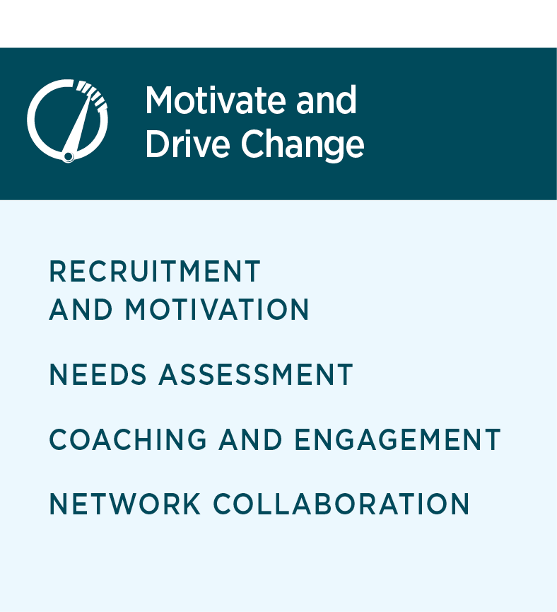
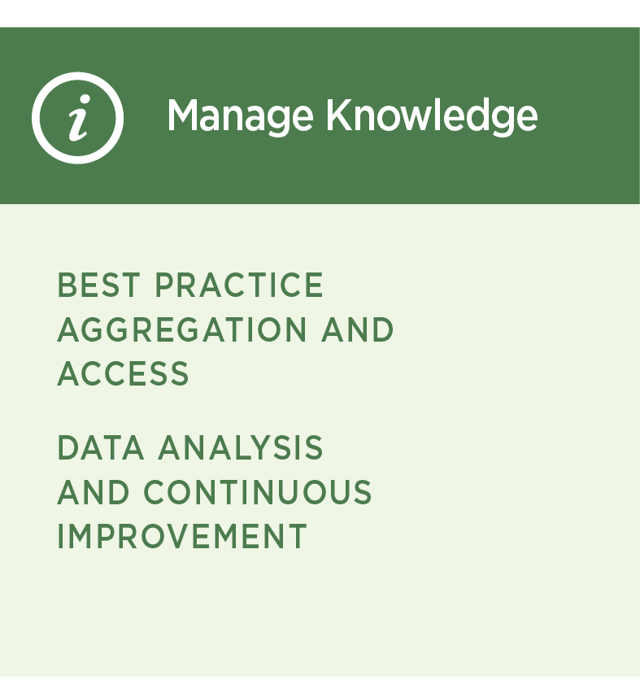
Introduction
This report provides a graphic snapshot of how your team members responded to the questions in the ICA Self-Assessment survey. The report is structured around the three Roles of the ICA Framework.
As you read through this report, please refer to the ICA Framework for more detailed information on each Role, Intermediary Capability, and Element and their associated evaluation criteria.
To support transformational change, there are three Roles that intermediaries must fulfill that are aligned with key performance indicators:
Oversee Network Design and Operation
Motivate and Drive Change
Manage Knowledge
Each Role has associated Capabilities that reflect key intermediary activities or capacities. While an intermediary does not need to be proficient in all Capabilities, they should be willing to engage in each Capability as appropriate to meet their goals as well as the needs of the institutions they support.

Slide 3

Self-Assessment Rating Scales
In general, the response options align to a developmental continuum for which numeric values were assigned.
1
NO ACTIVITY: Intermediary is not currently engaged in the activity.
2
EMERGING: Intermediary is planning to engage in the activity.
3
DEVELOPING: Intermediary is engaged in
the activity but is limited or inconsistent in its engagement.
4
ACHIEVED: Intermediary is consistently engaged in the activity with demonstrated effectiveness.
5
EXEMPLARY: Intermediary is consistently engaged in the activity and proactively incorporates continuous improvement and capacity building objectives into their work.

Slide 4
How to Read This Report
As you review this report,
you will see that each Role
has its own page that shows:
(a) the number of individuals selecting each rating, (b) the average score per Element,
(c) the average score per Intermediary Capability,
and (d) the Role average.
Oversee Network Design
and Operations
Motivate and Drive Change
a) Number of individuals selecting each rating
Manage Knowledge
RELATIONSHIPS AND ENGAGEMENT
AVERAGE
Oversee Network Design and Operations
4.4
4.4
4.0
4.4
d) Role average
c) Intermediary Capability average
4.1
RELATIONSHIPS
AND ENGAGEMENT
b) Element average
4

Slide 5
Capability Ratings Across Roles

Slide 6
Oversee Network Design
and Operations
Motivate and Drive Change
Manage Knowledge
RELATIONSHIPS AND ENGAGEMENT
AVERAGE
Oversee Network Design and Operations
4.4
4.4
4.0
4.4
4.1
RELATIONSHIPS
AND ENGAGEMENT

Slide 7
Oversee Network Design
and Operations
Motivate and Drive Change
Manage Knowledge
NETWORK MANAGEMENT
AVERAGE
4.4
Oversee Network Design and Operations
4.4
4.4
4.4
4.0
4.4
4.1
NETWORK MANAGEMENT

Slide 8
Oversee Network Design
and Operations
Motivate and Drive Change
Manage Knowledge
NETWORK MANAGEMENT
AVERAGE
4.4
Oversee Network Design and Operations
4.4
4.4
4.4
4.4
4.0
4.4
4.1
NETWORK MANAGEMENT

Slide 9
Oversee Network Design
and Operations
Motivate and Drive Change
Manage Knowledge
RECRUITMENT AND MOTIVATION
AVERAGE
4.4
Motivate
and Drive
Change
4.4
4.4
4.4
3.9
4.4
3.4
RECRUITMENT AND MOTIVATION

Slide 10
Oversee Network Design
and Operations
Motivate and Drive Change
Manage Knowledge
NEEDS ASSESSMENT
AVERAGE
4.4
Motivate
and Drive
Change
4.4
3.9
4.4
3.4
NEEDS ASSESSMENT

Slide 11
Oversee Network Design
and Operations
Motivate and Drive Change
Manage Knowledge
COACHING AND ENGAGEMENT
AVERAGE
4.4
Motivate
and Drive
Change
4.4
4.4
4.4
3.9
4.4
3.4
COACHING AND ENGAGEMENT

Slide 12
Oversee Network Design
and Operations
Motivate and Drive Change
Manage Knowledge
NETWORK COLLABORATION
AVERAGE
4.4
Motivate
and Drive
Change
4.4
3.9
4.4
3.4
NETWORK COLLABORATION

Slide 13
Oversee Network Design
and Operations
Motivate and Drive Change
Manage Knowledge
BEST PRACTICE AGGREGATION AND ACCESS
AVERAGE
4.4
Manage
Knowledge
4.4
DATA ANALYSIS AND CONTINUOUS IMPROVEMENT
3.7
AVERAGE
4.4
3.2
4.4
BEST PRACTICE AGGREGATION
AND ACCESS
4.4
COLLABOATIVE AND ADAPTIVE LEARNING
4.1
DATA ANALYSIS AND CONTINUOUS IMPROVEMENT

Slide 14
Snapshot of Elements from Different Angles
GROUPING​ | ELEMENTS​
Elements with the most spread​ | [Add]
Lowest-scored elements​ | [Add]
Elements that many abstained from answering​ | [Add]
Other Notes | [Add]

