Slide 1
A Beginner's Guide to Systematic Evidence Reviews
AIR Pipeline Partnership Program (P3)
Quantitative Evidence Synthesis Training (QuEST) Virtual Learning Event
David Miller, PhD| Megan Iacocca, MS
QuEST@air.org
February 2026
Copyright © 2026 American Institutes for Research®. All rights reserved.

Slide 2
Virtual Meeting/Conference Recording Notice
The American Institutes for Research (AIR®) allows for the recording of audio, visuals, participants, and other information sent, verbalized, or utilized during business-related meetings.
This meeting is scheduled to be recorded by AIR. Your consent to the recording is requested. Participation in the meeting without expressing an objection to recording will be treated as consent. Any participant who prefers to participate via audio only should disable their video camera so only their audio will be captured. External AI bots are prohibited unless specifically authorized.

Slide 3
AIR Inclusive Meeting Guidelines

Slide 4
Specific Guidelines for Today
Let’s focus on the speakers! Please remain muted until the live Q&A session.
Ask away! Please submit questions electronically through the Q&A chat feature; QuEST team members will be answering throughout the session.
Tell us what you think! Please complete the feedback survey to let us know your thoughts on today’s event.

Slide 5
Today’s Agenda
Introduction to QuEST
A Beginner’s Guide to Systematic Evidence Reviews
Q&A
Student Panel Discussion

Slide 6

About QuEST
Quantitative Evidence Synthesis Training
Established in 2024 by the AIR Pipeline Partnership Program to help graduate students build successful careers in behavioral and social science research
  Georgia State University
  Howard University
  The University of Texas at San Antonio
More training opportunities available for students:
  https://air.org/project/air-pipeline-partnership-program-p3
  https://www.air.org/quest-for-p3

Slide 7




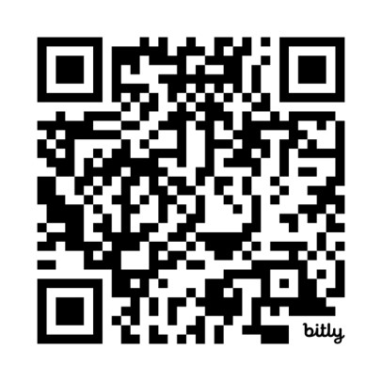


Come Train With Us in Chicago!
Conducting a Meta-Analysis: From Search to Synthesis
AIR Office, downtown Chicago, IL
Apply now through April 10!
QR code and link to application:
https://bit.ly/QuEST_IT_2026
August 3–7, 2026
Open to doctoral students at US P3 institutions
Travel, hotel, meals fully covered by the AIR Pipeline Partnership Program
Up to one year of project planning support following the training

Slide 8


Today’s Instructors
David Miller
Megan Iacocca
Senior Researcher
dmiller@air.org
Researcher
miacocca@air.org

Slide 9
Objectives
Understand
…what systematic reviews can and cannot address, when they are appropriate, basic process steps.
Identify
…the difference between traditional vs. systematic literature reviews.
Develop
…research questions that can be answered with systematic review methods.
Scope
…your own systematic review using tips covered today and recommended steps for afterwards.

Slide 10
Laying the Groundwork
Or Perhaps a Quick Refresher

Slide 11

Traditional Literature Reviews
For your graduate program:
  Course papers
  Dissertation proposals
  Literature reviews in dissertations
More broadly:
  Theory papers
  Overviews of a topic
Broad scope
Provide general understanding
Identify major themes/trends
May be subjective in nature
May not synthesize findings

Slide 12

A Systematic Review Is…
For your graduate program:
  Course papers
  Dissertation proposals
  Literature reviews in dissertations
More broadly:
  Theory papers
  Overviews of a topic
A structured research methodology (and output!) involving systematic searching for, evaluation of, and synthesis of findings from at least two independent primary sources addressing the same research question or topic.
  Synthesis may or may not involve quantitative analyses (i.e., meta-analysis)

Slide 13
…and Results in a Product/Process That Is:
Comprehensive
Reproducible
Transparent

Slide 14
Traditional vs. Systematic: Highlighting Key Differences
 | Traditional | Systematic
PURPOSE | Provide broad narrative overview | Answer a specific well-defined question
SEARCH STRATEGY | Not explicitly defined | Comprehensive, transparent, and pre-defined
STUDY SELECTION | May be subjective | Follow explicit inclusion/exclusion criteria
OUTPUT | Narrative, qualitative | Can also include a statistical synthesis (meta-analysis)
REPRODUCIBILITY | Low, due to lack of transparency | High, due to systematic and documented approach

Slide 15
Traditional vs. Systematic: Highlighting Key Differences
 | Traditional | Systematic
PURPOSE | Provide broad narrative overview | Answer a specific well-defined question
SEARCH STRATEGY | Not explicitly defined | Comprehensive, transparent, and pre-defined
STUDY SELECTION | May be subjective | Follow explicit inclusion/exclusion criteria
OUTPUT | Narrative, qualitative | Can also include a statistical synthesis (meta-analysis)
REPRODUCIBILITY | Low, due to lack of transparency | High, due to systematic and documented approach

Slide 16
Traditional vs. Systematic: Highlighting Key Differences
 | Traditional | Systematic
PURPOSE | Provide broad narrative overview | Answer a specific well-defined question
SEARCH STRATEGY | Not explicitly defined | Comprehensive, transparent, and pre-defined
STUDY SELECTION | May be subjective | Follow explicit inclusion/exclusion criteria
OUTPUT | Narrative, qualitative | Can also include a statistical synthesis (meta-analysis)
REPRODUCIBILITY | Low, due to lack of transparency | High, due to systematic and documented approach

Slide 17
Traditional vs. Systematic: Highlighting Key Differences
 | Traditional | Systematic
PURPOSE | Provide broad narrative overview | Answer a specific well-defined question
SEARCH STRATEGY | Not explicitly defined | Comprehensive, transparent, and pre-defined
STUDY SELECTION | May be subjective | Follow explicit inclusion/exclusion criteria
OUTPUT | Narrative, qualitative | Can also include a statistical synthesis (meta-analysis)
REPRODUCIBILITY | Low, due to lack of transparency | High, due to systematic and documented approach

Slide 18
Traditional vs. Systematic: Highlighting Key Differences
 | Traditional | Systematic
PURPOSE | Provide broad narrative overview | Answer a specific well-defined question
SEARCH STRATEGY | Not explicitly defined | Comprehensive, transparent, and pre-defined
STUDY SELECTION | May be subjective | Follow explicit inclusion/exclusion criteria
OUTPUT | Narrative, qualitative | Can also include a statistical synthesis (meta-analysis)
REPRODUCIBILITY | Low, due to lack of transparency | High, due to systematic and documented approach

Slide 19
Primary Goal of Systematic Reviews
Combine information from multiple studies investigating the same topic to comprehensively understand findings utilizing transparent, pre-defined methods
Search
Screen
code
analyze
Lasserson TJ, Thomas J, Higgins JP. Chapter 1: Starting a review [last updated August 2021]. In: Higgins JP, Thomas J, Chandler J, Cumpston M, Li T, Page MJ, et al, editor(s). Cochrane Handbook for Systematic Reviews of Interventions version 6.5. Cochrane, 2024. Available from cochrane.org/handbook.

Slide 20

Utility of Systematic Reviews
Summarize existing research to address a specific question
Inform policy or practice
  Clinical guidelines, educational practice
Identify knowledge gaps
  What is known, what remains unknown (or non-reported?)
Does the ABC tutoring program increase math scores in kindergarten students?

Slide 21
To ensure your review project meets systematic review standards and achieves its intended goals…

Slide 22

Nothing Can Be Fuzzy!
Fuzziness = lack of defining (and adherence to) a structured, transparent process
Potential sources of fuzziness:
  Vague conceptual definitions, unclear research questions, ambiguous eligibility criteria, inconsistent coding procedures
Why fuzziness is problematic:
  May introduce bias and subjectivity, lead to gaps in assessment of evidence base, results may be non-reproducible

Slide 23

Definition
Distinction
Goals
Utility
Clarity

Slide 24
Key Steps of a Comprehensive Systematic Review

Slide 25
What Does Each of These Steps Entail?
Search
Screen
code
analyze
Let's dive deeper, while contrasting traditional vs. systematic reviews.

Slide 26
1. Literature search: Finding potential studies
Traditional: Not explicitly stated, but often informal searching in Google Scholar, asking your advisor, etc.
Systematic: At minimum, a keyword search string in literature databases, while saving *all* results for later decisions on eligibility.
A simple example: What interventions can improve algebra instruction in ninth grade?
You can answer with both approaches. But what would a systematic approach look like? (next slide)

Slide 27
1. Literature search: Finding potential studies
Traditional: Not explicitly stated, but often informal searching in Google Scholar, asking your advisor, etc.
Systematic: At minimum, a keyword search string in literature databases, while saving *all* results for later decisions on eligibility.
Literature databases
Search results
Next steps
Search string (simplified):
ERIC
319 hits
Combine, deduplicate, and keep records of later decisions of eligibility for the review
“algebra” AND (“ninth grade” OR “grade 9”)
Education Source
103 hits
PsycInfo
151 hits

Slide 28
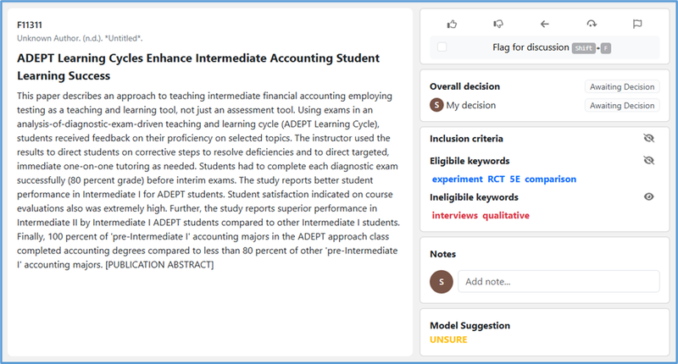
2. Screening: Deciding what’s eligible
Traditional: Not explicitly stated, but might save relevant PDFs into subfolders as you encounter them, then decide later what to cite in review
Systematic: Assess every record against precise inclusion criteria, usually with two or more people to assess reliability/repeatability
From the freely available platform MetaReviewer: metareviewer.org

Slide 29
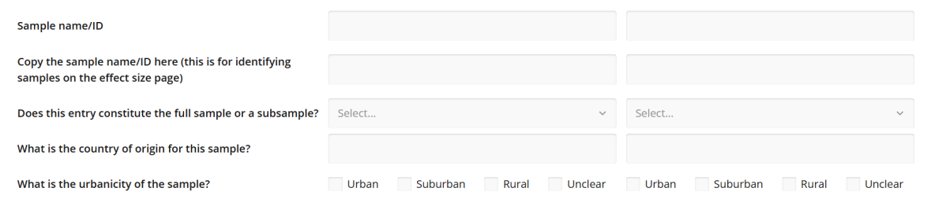
3. Coding: Extracting information from studies
Traditional: Not explicitly stated, but might be taking notes as you read each study, highlighting notable sections in the PDF, etc.
Systematic: Structured forms to extract specific study characteristics (e.g., outcome type, % women) and quantitative results (e.g., means, SDs)

Slide 30
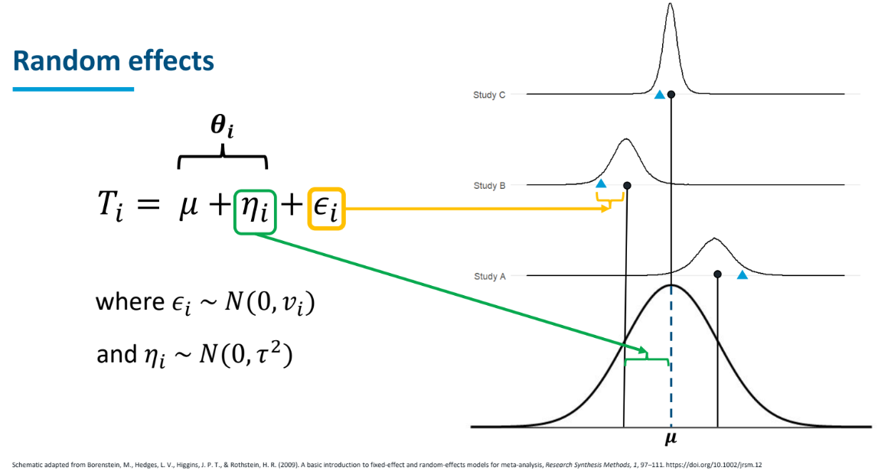
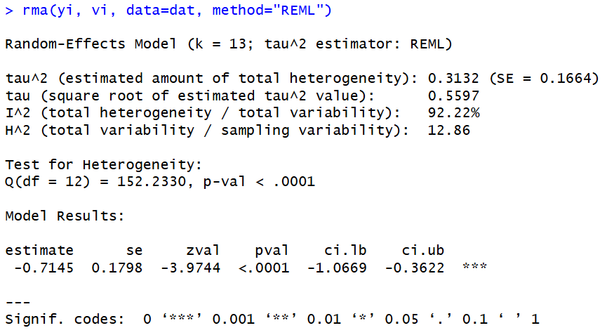
4. Analysis: Making sense of study findings
Traditional: Not explicitly stated, but often co-occurs when writing the review
Systematic: If paired with meta-analysis, then detailed statistical analysis of how the quantitative study results vary

Slide 31
Forming Your Problem and Defining Your Review Scope

Slide 32

Why You Should Consider a Systematic Review
You have to do a dissertation proposal anyway: Systematic review practices can be helpful even for more "traditional" reviews.
  Rigorous search and screening, confidence in assessing full scope of eligible literature.
Could become a dissertation study: Systematic reviews can be seen as an empirical contribution or "study" in their own right.

Slide 33
Problem formulation: The crucial first step of any high-quality systematic review
And it’s not easy!
Articulating your research questions
Establishing the scope of your review
Identifying inclusion/exclusion criteria
(Sometimes) distinguishing confirmatory versus exploratory hypotheses
Image credit: https://imgflip.com/i/a2038m. Created 8/2/2025 5:20PM MT
33

Slide 34
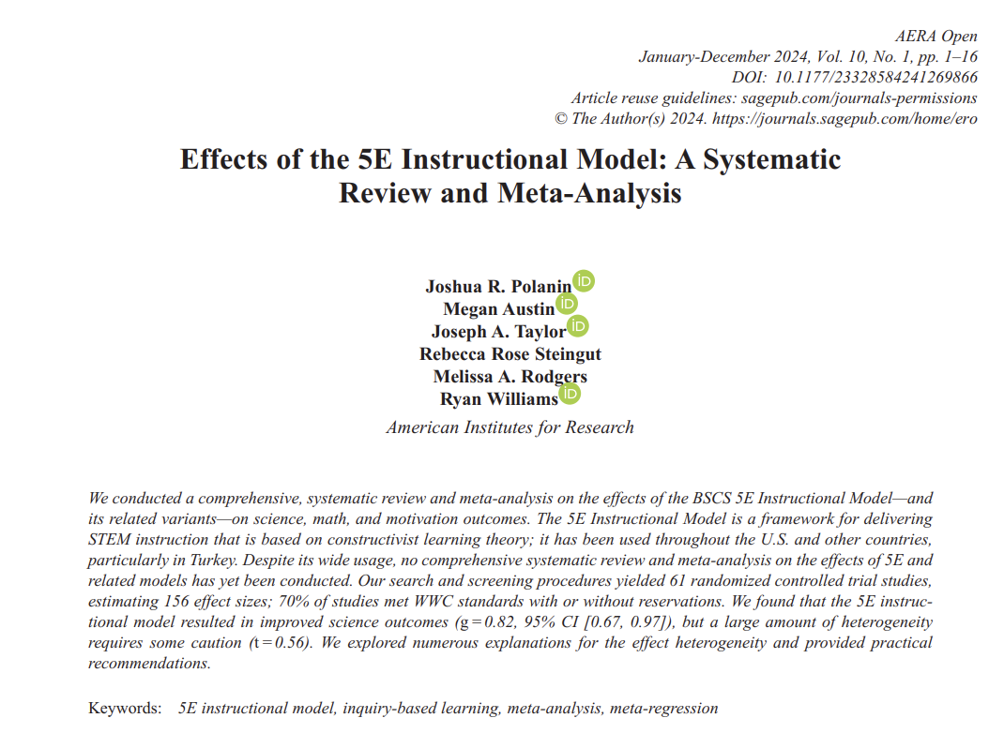
Using a Completed Example: 5E Review​ (STEM Education)
5E: Engage, Explore, Explain, Elaborate, Evaluate
(widely-used instructional framework in STEM education)
Research question: What are the impacts of the 5E intervention model on science, math, and motivation among K-12 students?
STEM = Science, Technology, Engineering, Math
34

Slide 35
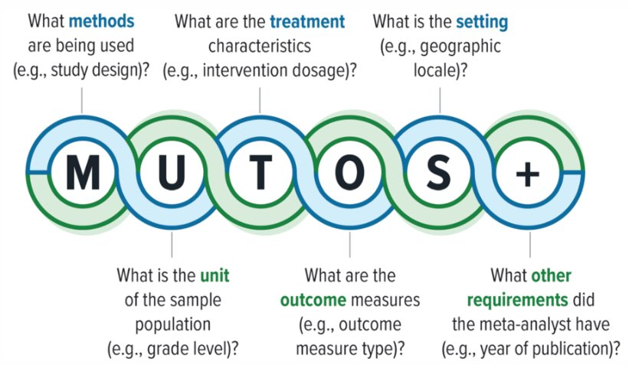
MUTOS: A Framework for Problem Formulation
35

Slide 36
MUTOS Framework in 5E Review
M = RCTs and QEDs with a comparator group
U = PK-12 grade students in schools in any country
T = 5E (or 3E or 7E) STEM intervention; minimum 5 class periods or 4 hours
O = Science achievement, math achievement, or motivation
S = Classroom or school-based
36

Slide 37
How Do I Get There?
Four key questions for defining your problem:
  What questions interest me (for a systematic review)?
  Is this an answerable question?
  What is known (and remains unknown) about this topic?
  Is the scope aligned with my budget and/or timeline?
37

Slide 38
Problem Formulation
Picking your question:
Strongly recommend aligning with what you’re already studying.
Do you need to do a narrative review for something else already (e.g., dissertation proposal)?
The review can help sharpen where you can fill research gaps.
Could start as simple as: “Is the 5E model effective?”
  What questions interest me?
  Is this an answerable question?
  What is known (and remains unknown) about this topic?
  Is the scope aligned with my budget and/or timeline?
38

Slide 39
Problem Formulation
Write in the chat (3 minutes)
Put in the chat a potential research question that you'd want to answer with a systematic review.
Start with an area you're familiar with. Anything your field disagrees on? Uncertainty about a specific intervention or program?
  What questions interest me?
  Is this an answerable question?
  What is known (and remains unknown) about this topic?
  Is the scope aligned with my budget and/or timeline?
39

Slide 40
Problem Formulation
Answerable questions:
Have definitive responses
That are (ideally) widely accepted
Using available information
Answerable:
“What is the speed of sound?”
Unanswerable:
“What is the meaning of life?”
“Who was the first human?”
“What is the best album of all time?”
  What questions interest me?
  Is this an answerable question?
  What is known (and remains unknown) about this topic?
  Is the scope aligned with my budget and/or timeline?
40

Slide 41
Step 2: Example for Answerable Questions
Start: Is the 5E instructional model effective?
Final: What are the impacts of the 5E model on science, math, and motivation among K-12 students?
Less answerable versions of this question:
How can teachers improve student math and science outcomes? (Too broad)
What is the most important thing for math and science teachers to know about teaching? (Subject to opinion)
Does 5E make students more likely to pursue STEM careers? (Data not available)
41

Slide 42
Problem Formulation
Reflection activity (2 minutes)
Are the questions you wrote earlier answerable?
Is there a definitive response? Is it specific enough?
Add your thoughts to the chat to refine your questions as needed.
  What questions interest me?
  Is this an answerable question?
  What is known (and remains unknown) about this topic?
  Is the scope aligned with my budget and/or timeline?
42

Slide 43
Problem Formulation
Look for existing reviews
Are there any systematic reviews?
When were they published?
Did they neglect any important outcomes?
Did they use high-quality methods?
  What questions interest me?
  Is this an answerable question?
  What is known (and remains unknown) about this topic?
  Is the scope aligned with my budget and/or timeline?
43

Slide 44
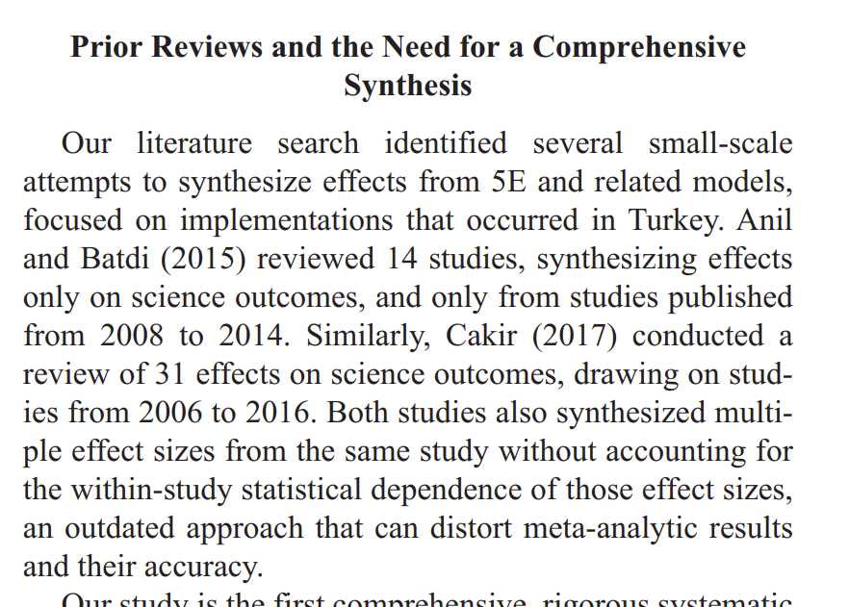
Step 3: Example for Prior Reviews
Prior 5E reviews:
Small-scale (14 studies)
Geographically limited (Turkey)
Outdated (published in 2015)
Narrow (only science outcomes)
Methodologically flawed
44

Slide 45
Problem Formulation
Goldilocks principle
Too small/narrow: No studies
Too large/broad: Not feasible (often the bigger problem early on)
Example: Effectiveness of...
All K-12 STEM interventions (broad)
Only after-school programs in middle school (narrow)
  What questions interest me?
  Is this an answerable question?
  What is known (and remains unknown) about this topic?
  Is the scope aligned with my budget and/or timeline?
45

Slide 46
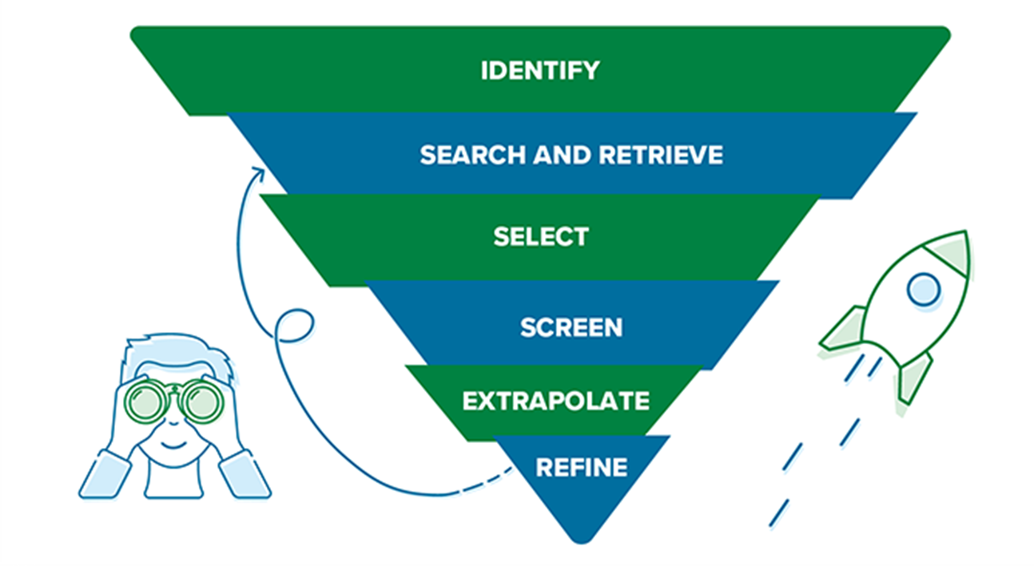
Step 4: How Do I Estimate Scope?
Conduct a scoping review: We'll cover in more depth during the in-person workshop!
Image credit: https://www.air.org/sites/default/files/2023-08/Scoping-Review-Infographic-v2-2023.pdf
46

Slide 47
Suggestions for Directly After This Call
Find a relevant past review: Go to Google Scholar and type:
  Your topic + "systematic review"
  Your topic + "meta-analysis"
Identify gaps: First based on abstract, then full text:
  How closely does this align with my research question?
  What does it leave unanswered?
  Are there methodological gaps/limitations?
Use MUTOS framework: Write down your initial thoughts on scope for each component of the MUTOS framework introduced earlier (M + U + T + O + S).
47

Slide 48
Deciding on Traditional vs. Systematic
Consider a systematic review when…
Reconsider a systematic review when…
You need a comprehensive, unbiased synthesis
Multiple studies address the same specific question
The question is well‑defined
Existing reviews are outdated or low quality
Identifying evidence gaps for future research
The question is too broad or unclear
Little or no primary research exists
Only a rapid or high‑level summary is needed
Timelines/resources are too limited
A recent, high‑quality systematic review already exists
48

Slide 49
What's Directly Next After Defining Scope?
Write a review protocol formalizing your scope and procedures.
Identify search terms for finding relevant studies.
Develop a search string/strategy with a feasible # of hits.
Screen for eligibility, first based on the abstracts.
Each one of these starting steps could be its own separate webinar!
49

Slide 50
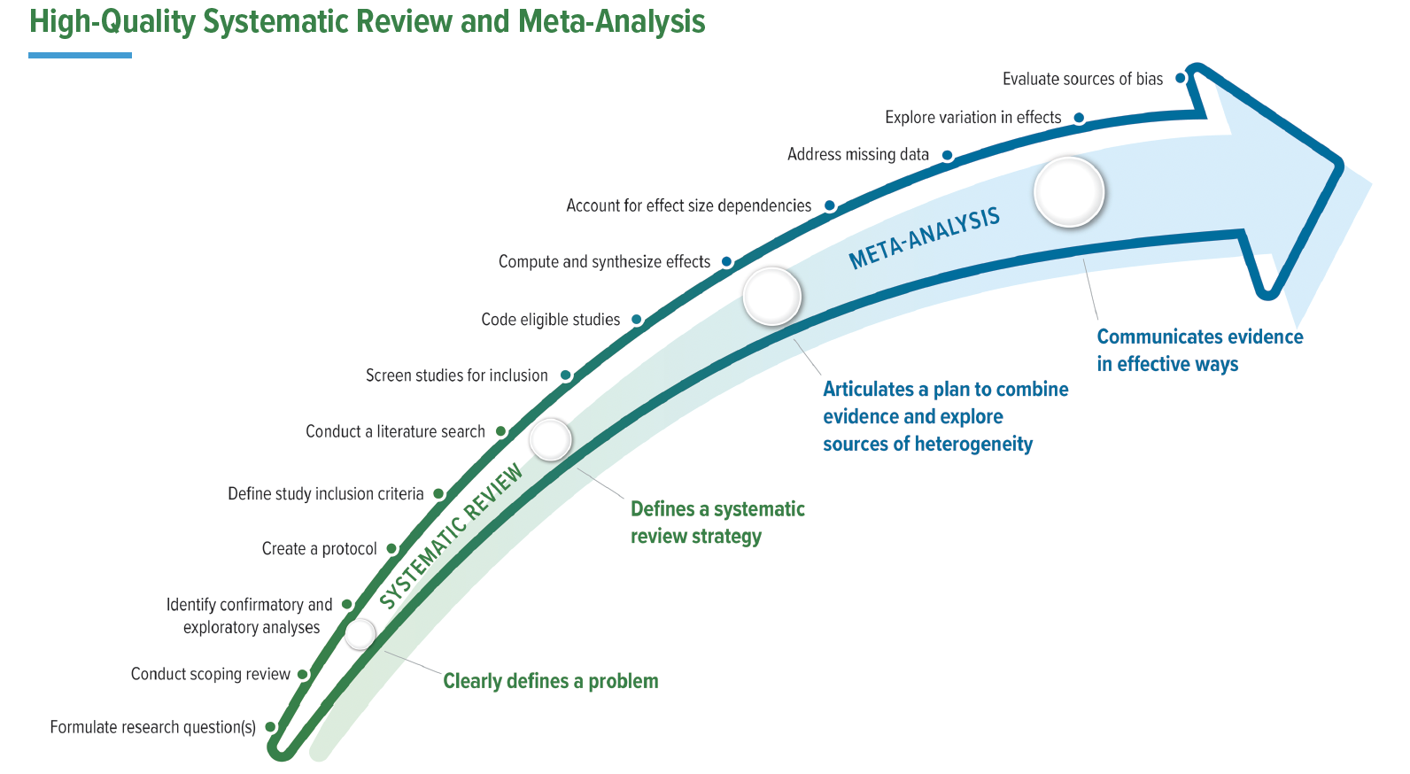
Reminder of the Full Review Process
50

Slide 51
Hence: Come Train With Us in Chicago!
Conducting a Meta-Analysis: From Search to Synthesis
AIR Office, downtown Chicago, IL
Apply now through April 10!
QR code and link to application:
https://bit.ly/QuEST_IT_2026
August 3–7, 2026
Open to doctoral students at US P3 institutions
Travel, hotel, meals fully covered by the AIR Pipeline Partnership Program
Up to one year of project planning support following the training

Slide 52
Q & A
From chat moderators
52

Slide 53
Panel Discussion: Learn About the In-Person Training From Members of the 2025 Cohort
Three doctoral students to share their past experiences in the 2025 training
53

Slide 54



Meet Our Student Panelists
Allyson Clarke
Lia Haddadian
Mackenzie DeForest
Howard University
Higher education leadership and policy studies
Georgia State University
Learning sciences
Georgia State University
Research, measurement, and statistics
54

Slide 55
Thank You For Joining
AIR Pipeline Partnership Program (P3)
Apply now for the in-person training!
Quantitative Evidence Synthesis Training
QuEST@air.org
https://bit.ly/QuEST_IT_2026

