Slide 1
Proposal Development Training Series
Session 2: Key Components of Technical Proposal
David Seidenfeld, PhD | Adria Molotsky, PhD | Marlous de Milliano, PhD
African Evaluation Association & American Institutes for Research

Slide 2


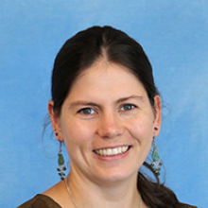
Meet the Presenters
Dr. David Seidenfeld
Dr. Adria Molotsky
Dr. Marlous de Milliano
Vice President at AIR
Sr. Economist at AIR
Sr. Economist at AIR

Slide 3
Proposal Development Training Series
Date | Topic
May 14th, 2026: 1pm-2pm GMT | Session 1: Reviewing RFPs and Win Themes
May 21st, 2026: 1pm-2pm GMT | Session 2: Components of the Proposal
May 28th | -- No session --
Jun 5th, 2026: 1pm-2pm GMT | Session 3: Components of Proposal Continued, Reviews and Writing tips

Slide 4
Brief Review of Last Session

Slide 5
Review of Key Terms
RFP = Request for Proposal
  Solicitation announcement for contractual opportunity, solicits bids from qualified contractors
TOR = Terms of Reference
  Typically defines the scope of work, defines the objectives, scope and responsibilities of consultant or team
Win Themes – statements you make in your proposal illustrating why the client should select you over others (aim for 2-3 strong win themes)

Slide 6
What do RFPs include?
May vary by country, region, and/or contract mechanism, client, RFPs normally contain the following elements:
  Scope of work
  Evaluation criteria and weighting
  Proposal preparation instructions
  Deliverables
  Contract requirements
  Budget or level of effort constraints (sometimes)
  Submission instructions

Slide 7

Elements of Win Themes
Features: Aspects of the service you are offering
Benefits: An advantage to your service that meets a client’s need
Proof Points: Qualitative or quantitative proof that your statement is true
Discriminators: How your advantage is differentiated from our competitors

Slide 8
Writing Your Technical Proposal

Slide 9

Steps to Producing a Technical Volume
Review source documents closely
Create proposal outline following documents
Draft technical proposal
Review and edit
Finalize and submit

Slide 10
Outline of Technical Proposal
The titles of sections and the order may vary based on RFP requirements. → Make it easy for the reviewers to find information!
But it can look like:
  Cover page
  Introduction with win themes
  Capabilities statement
  Technical approach/research design
  Management plan and staffing
  Workplan and timeline

Slide 11
Capabilities Statement

Slide 12
Capabilities and Past Performance
Funders often want to know the capacity of the researcher/institution to conduct and manage projects of a similar size and scope
They will often ask for past performance, where you explain similar projects undertaken in the past
This section is meant to highlight your relevant experience so the funder knows you are capable of doing the work
Make sure that you describe how your past experiences contribute to the proposed assignment!
The funder might also ask for references from previous clients so be prepared to provide contact information for related work

Slide 13
Technical Approach - Research Design

Slide 14
What does a Technical Approach Include?
Background (on issues, project) or Statement of Need
A general approach to the work that includes:
  Theory of Change/Conceptual Framework
  Research Questions
  Research Design (detailed technical approach to the work)
In addition, the RFP may require other technical section elements (e.g. data collection procedures, ethics, quality assurance etc.) in the text or as annexes.

Slide 15
Why does a background section matter?
It demonstrates that you understand the problem.
It shows that you are up-to-date with the latest information on the problem.
It identifies nuanced dynamics to which your approach responds
What does a background section include?
Explains what the problem is especially in the given context
Explains why we care about the problem
Explains how the intervention helps the problem or how the study fills research gaps
Notes:
Begins with a problem statement
Includes basic information about the situation – as up to date as possible
Includes big-picture stats about the country, situation, and recent history
Goes more in-depth into the content area, including a focus on elements that the evaluation or project will likely address; for example:
What is the nuance within the broader topic?
How can we draw out contextual features, e.g., certain geographies within a country?
Builds on the background information presented in the RFP (does not repeat)
Justifying the project approach that the client is taking using research
This could also be if our proposal is for a TA project - literature supporting the approach we propose to take.
- Introducing how our research will illuminate the strengths of their approach, what works, and why it works

Slide 16
Outline of the Background Section
Factors to include in the Background section:
Status of the Technical Area in Country X
  Include significant political, cultural, geographic, environmental, gender factors
Knowledge of the Relevant Institutional Environment
  Here’s where we show all the relevant players and projects on the ground
Client and other Donor Support of the Technical Sector
  Show our understanding of the client’s strategy
Knowledge of the Project you would implement/evaluate
Specific Issues or Challenges
  Never offer up an issue or challenge without suggesting a solution

Slide 17
Research or Evaluation Questions
The RFP will either provide specific research questions they want you to address or you will have to come up with research questions
Either way, list them out explicitly
For evaluations, many funders are using the OECD-DAC criteria:
    RELEVANCE is the intervention doing the right things?
    COHERENCE how well does the intervention fit?
    EFFECTIVENESS is the intervention achieving its objectives?
    EFFICIENCY how well are resources being used?
    IMPACT what difference does the intervention make?
    SUSTAINABILITY will the benefits last?
Oftentimes funders want to you to tie each question to specific indicators, research methods and data sources so they can see how you plan to address each one → sometimes called an evaluation matrix
Notes:
OECD Development Assistance Committee

Slide 18
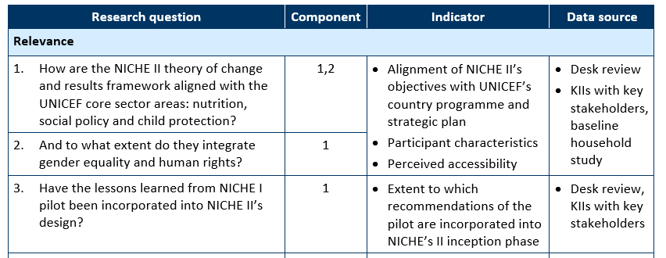
Example Evaluation Matrix

Slide 19
Theory of Change/Conceptual Framework
Depicts the story you expect to tell / that you’re testing
Maps the expected relationship between variables as well as the underlying assumptions
Helps define the relevant variables to include in your study and how they relate to each other
Hours spent studying
Exam score

Slide 20
Example Theory of Change
Initial Conditions
What is the problem you’re trying to address?
What are some facts about the current state of affairs in your target context/population/etc.?
Notes:
Initial conditions – Malnutrition in Sri Lanka affects nearly 1/3 of children: 13% of all children under 5 stunted, 25% underweight, and 15% wasted

Slide 21
Example Conceptual Framework
Initial Conditions
Malnutrition in Sri Lanka affects nearly 1/3 of children: 13% of all children under 5 stunted, 25% underweight, and 15% wasted
Activities
What will your intervention do to try to address this problem?
Notes:
Provide school meals, train school meal providers in safe food prep and storage

Slide 22
Example Theory of Change
Initial Conditions
Malnutrition in Sri Lanka affects nearly 1/3 of children: 13% of all children under 5 stunted, 25% underweight, and 15% wasted
Activities
Provide school meals
Train school meal providers in safe food preparation and storage
Outcomes
What do you expect the result of this activity to be?
Notes:
School meal providers are trained, daily school meals provided to school children

Slide 23
Example Theory of Change
Initial Conditions
Malnutrition in Sri Lanka affects nearly 1/3 of children: 13% of all children under 5 stunted, 25% underweight, and 15% wasted
Activities
Provide school meals
Train school meal providers in safe food preparation and storage
Outcomes
Reduced student hunger and increased attentiveness
Increased use of safe food preparation and storage practices
Impact
What is the larger end goal of this work?
What are you hoping to ultimately influence/change?
Notes:
Improved student health and nutrition

Slide 24
Example Theory of Change
Initial Conditions
Malnutrition in Sri Lanka affects nearly 1/3 of children: 13% of all children under 5 stunted, 25% underweight, and 15% wasted
Activities
Provide school meals
Train school meal providers in safe food preparation and storage
Outcomes
Reduced student hunger and increased attentiveness
Increased use of safe food preparation and storage practices
Impact
Improved student health and nutrition
Potential Influencing Factors / Characteristics
What factors/characteristics may affect your story?
Notes:
Age
Gender
Availability of ingredients
Cultural norms
School infrastructure

Slide 25
Example Theory of Change
Initial Conditions
Malnutrition in Sri Lanka affects nearly 1/3 of children: 13% of all children under 5 stunted, 25% underweight, and 15% wasted
Activities
Provide school meals
Train school meal providers in safe food preparation and storage
Outcomes
Reduced student hunger and increased attentiveness
Increased use of safe food preparation and storage practices
Impact
Improved student health and nutrition
Potential Influencing Factors / Characteristics
Age Gender
Cultural norms School infrastructure
Availability of ingredients
Why are you introducing these meals and training? What are you trying to influence? Why? – This is the story you’re trying to tell

Slide 26
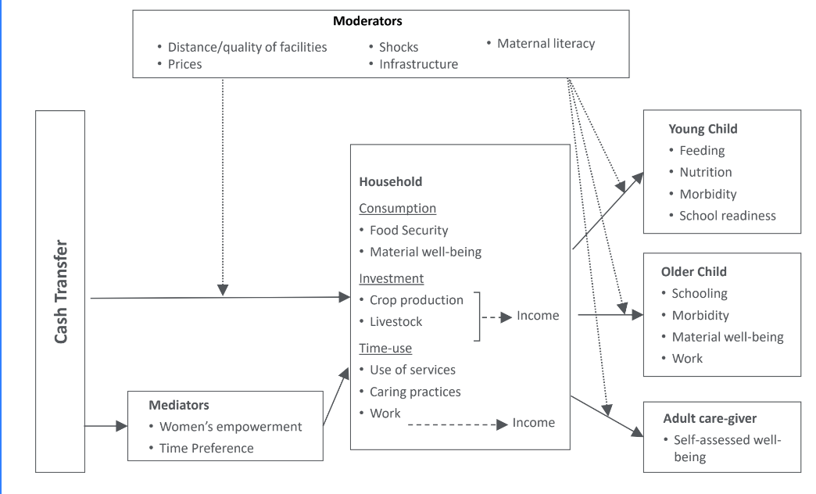
Example: Cash Transfer

Slide 27
Research Design
Key components:
  Methodological approach
    Quantitative only? Mixed-methods?
    RCT? Quasi-experimental? Descriptive study?
  Sampling
    Who? How many?
    Ethical reviews required?
    Power calculations
  Tools
    Main domains
    Respondents
  Data Collection
    In person or online?
    Electronic or paper?
  Analysis Plan
    What kind of analysis will you perform?
    Why is this best to answer main research questions?

Slide 28
Management and Staffing Plan

Slide 29
Management Plan
The purpose of the management plan is to relay the client that you can manage this project feasibly and smoothly. Necessary pieces are:
  Text describing organization of the entire project.
  Graphic depicting relationships with the client and project partners.
  Discussion of systems and processes in place to support the project that is specific to the opportunity.
  Discussion of management challenges critical to the project (e.g., multiple field offices, security concerns, cost containment, grants management) and how you will address them.

Slide 30
Organizational Chart
An organizational chart is a visual representation of how the team will work together
Clearly identify who fills each role and their position title
Differentiate between types of working relationships
Don’t forget the client!

Slide 31
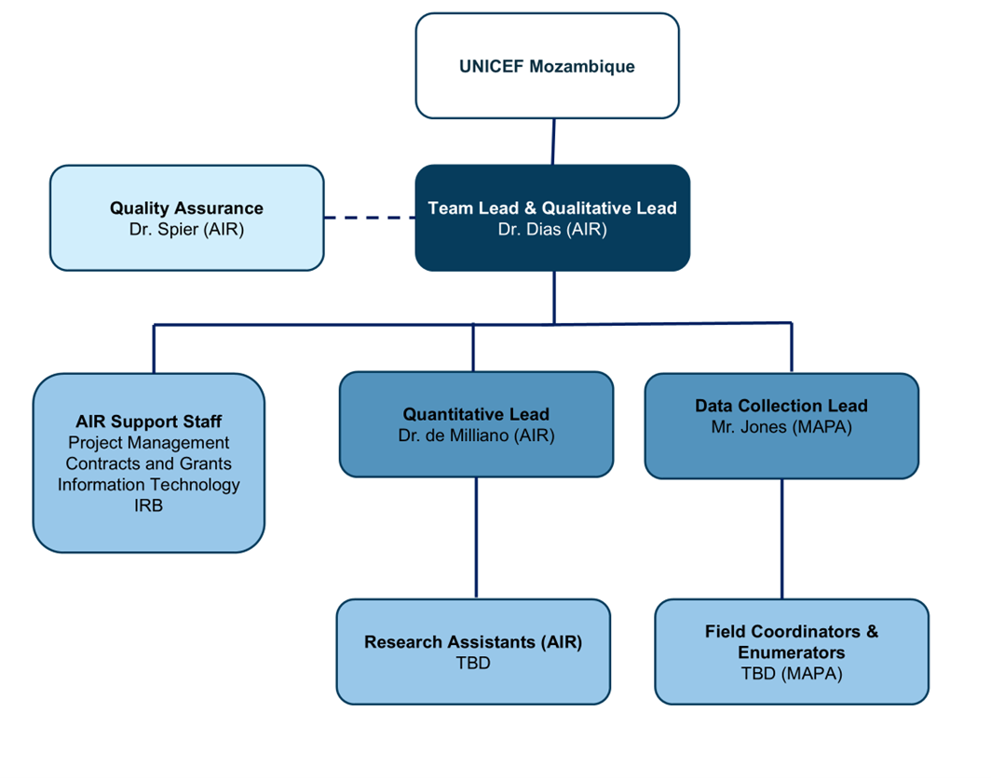
Example org chart

Slide 32
Staffing Plan
You will need to talk about proposed personnel in the technical section.
Introduce the staffing plan upfront in the proposal especially if it is a win theme. You can then describe specific positions in the staffing section.
As you describe activities or tasks, you will need to mention which positions are primarily responsible and how they work together with other staff. You can mention the position by title and the name of the person as appropriate.

Slide 33
Staffing Plan, continued
Make sure you understand the key personnel positions identified in the RFP and their qualifications
Bio blurbs must show how key personnel meet the qualifications.
Make sure to include either in the bio or narrative what each person is going to do in the proposal – by doing this you will realize quickly whether that person is needed.
This will be important for budgeting later!

Slide 34
Thank you!

