Slide 1
Proposal Development Training Series
Session 1: Reviewing RFPs and Win Themes
David Seidenfeld, PhD | Adria Molotsky, PhD | Marlous de Milliano, PhD
African Evaluation Association & American Institutes for Research

Slide 2

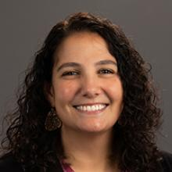
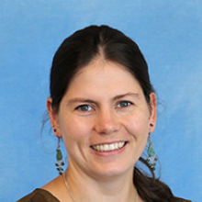
Meet the Presenters
Dr. David Seidenfeld
Dr. Adria Molotsky
Dr. Marlous de Milliano
Vice President at AIR
Sr. Economist at AIR
Sr. Economist at AIR

Slide 3
Proposal Development Training Series
Date | Topic
May 14th, 2026: 1pm-2pm GMT | Session 1: Reviewing RFPs and Win Themes
May 21st, 2026: 1pm-2pm GMT | Session 2: Components of the Proposal
May 28th | -- No session --
Jun 5th, 2026: 1pm-2pm GMT | Session 3: Budget, Admin, Reviews and Writing tips

Slide 4
Introduction to Proposal Development

Slide 5
Why do we write proposals?
To get money or win work!
But more importantly our objective is:
  To persuade potential clients that you are competent and capable of implementing the project (research or technical). SKILLS, EXPERIENCE
  To show potential clients you have a reasonable and actionable idea that meets their needs. UNDERSTANDING OF NEEDS
  To convince potential clients you offer the best value for money. BUDGET

Slide 6
Main Types of Proposals
Solicited – proposals submitted in response to client’s need
Unsolicited – proposals used to advertise to potential clients
Non-competitive/Continuation – usually request next year’s funding within multi-year agreement/contract already awarded
Renewal – request for continued funding of a project for which funding is about to end

Slide 7
Basic Concepts
Grant Proposal: Document or set of documents submitted to an organization with the explicit intent of securing funding for a research or implementation project.
Notice of Funding Opportunity (NOFO): publicly available document usual from government agency intending to award competitive funds.
Request for Proposal (RFP): Type of solicitation announcing contractual opportunity is available and solicits bids from qualified contractors.
Terms of Reference (TOR): defines all aspects of how to conduct an assignment. It defines the objectives and the scope, outlines the responsibilities of the consultant or team.
Technical and Financial Proposal: RFPs will often request you to prepare separate technical and financial volumes. → Today we will focus on the technical proposal.
Notes:
Other names for similar announcements of funding opportunities including:
--RFQ: requesting quotes from potential suppliers of a good or service
--Notice of Funds Available (NOFA): describes type of funding available and provides contact of where application can be submitted
--Notice of Funding Opportunity (NOFO): publicly available document usual from Federal agency intending to award competitive funds
--Notice of Award (NOA): official notice notifying the contractor/applicant that their bid has been accepted/selected
-- Request for Application (RFA): Type of solicitation announcing grant funding is available and solicits bids from qualified individuals/organizations

Slide 8
Skills needed for successful proposal writing
Industry Knowledge: Deep understanding of industry trends, regulations, and challenges relevant to clients.
Relationship Building: Exceptional interpersonal skills and ability to build trust and rapport with clients and colleagues.
Communication Skills: Strong verbal and written communication skills to articulate complex concepts and proposals effectively.
Strategic Thinking: Ability to identify opportunities, anticipate client needs, and develop strategic solutions.
Results Orientation: Focus on achieving business goals and driving growth through effective business development efforts.

Slide 9
Proposal Development Process: Today’s focus
How do we get started?
How are we going to win this proposal?
Anticipate
Submit
Follow-up
Review the RFP
Plan
Write
Review the proposal
RFP released
Are we eligible to apply?
Are we well-positioned to apply?
What are some of the ideas, strengths and experiences we have to offer?
Notes:
Anticipation: use NOFOs or industry/client knowledge; use the time to build relationships, prepare strategy and create a team, write those components that you are sure of.

Slide 10
Reviewing the RFP

Slide 11
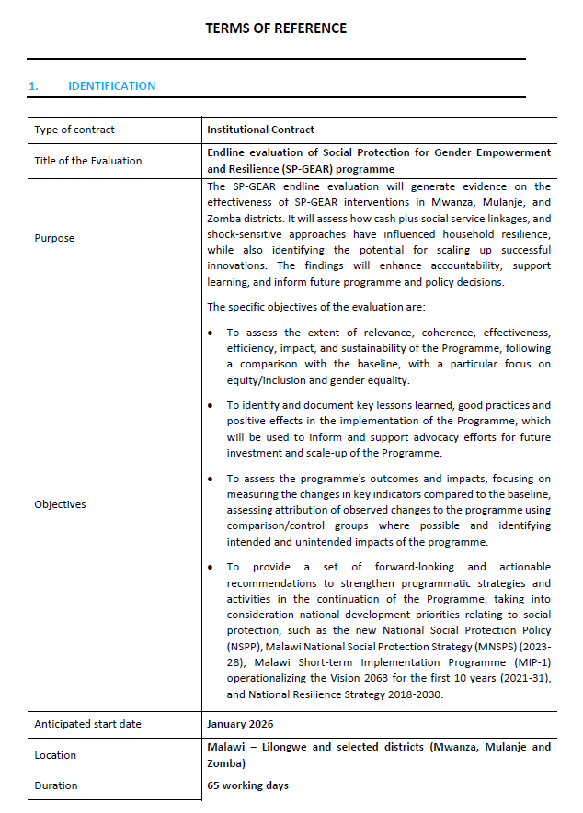
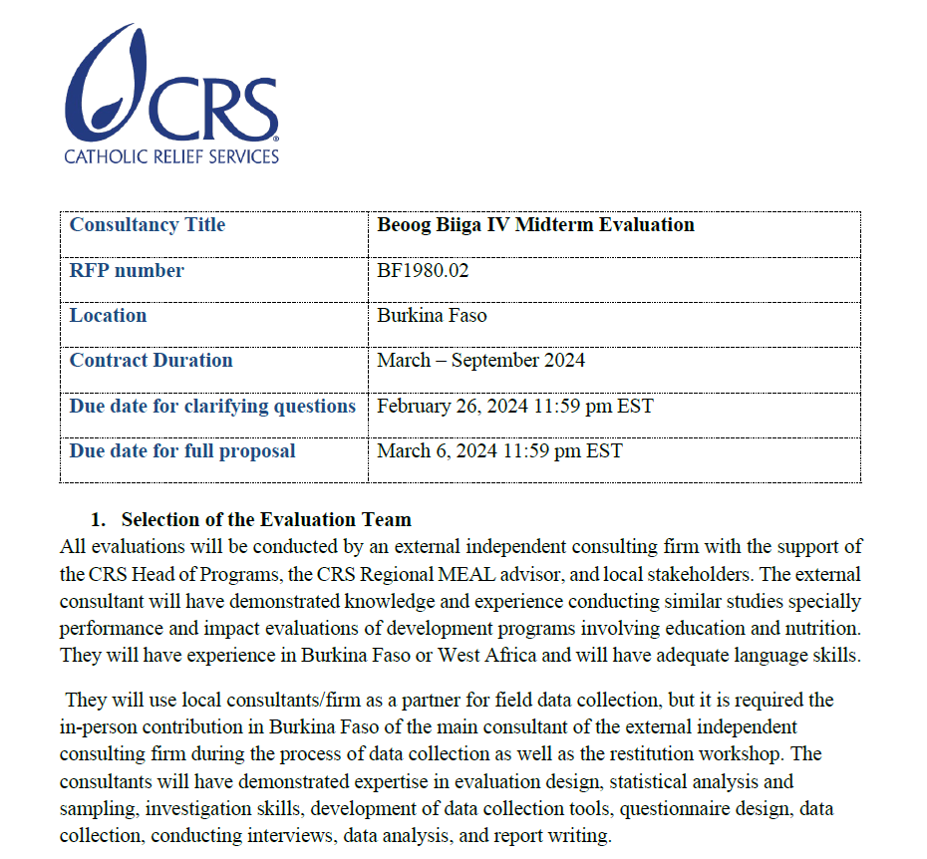
RFPs come in different formats, but they are they key starting point to your technical proposal
Notes:
Note: We won’t go in detail through each of these (no need for full translation). We will show these to indicate that there are different types of RFPs with different ways to show important information such as the purpose and objectives, anticipated starting date, location, duration, submission date and information, requirements, scope of work.

Slide 12
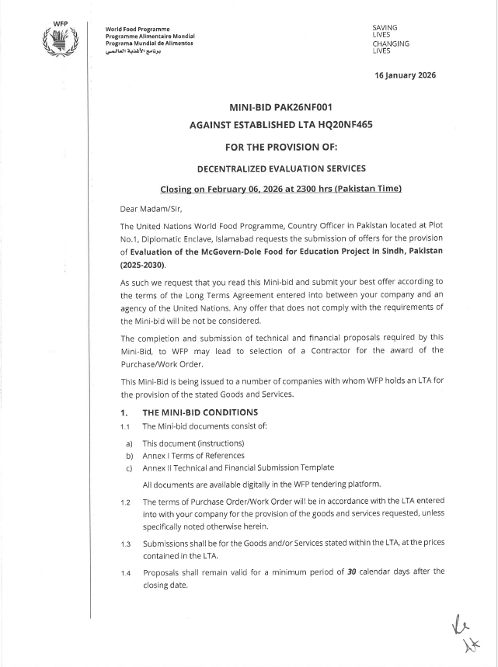
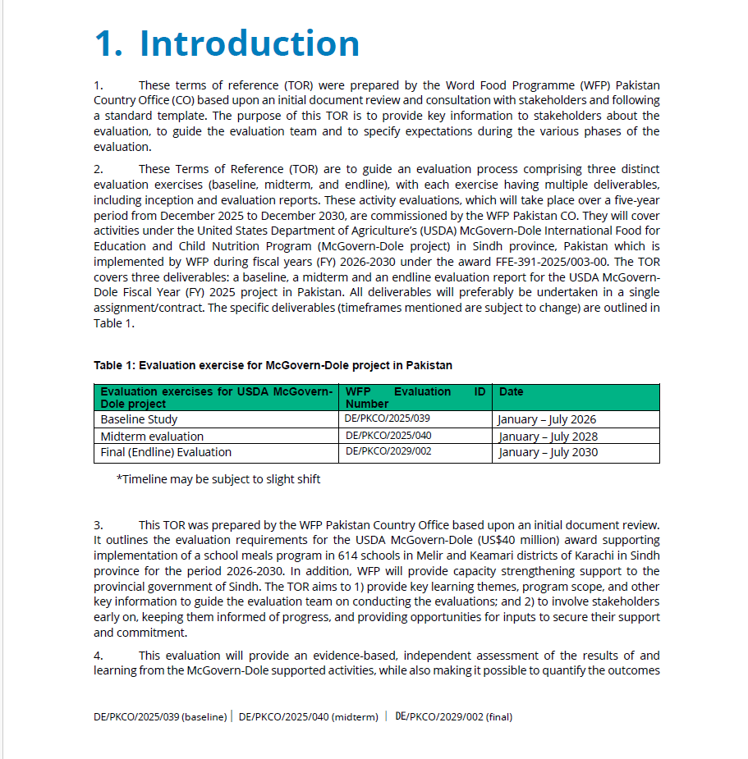
RFPs come in different formats, but they are they key starting point to your technical proposal

Slide 13
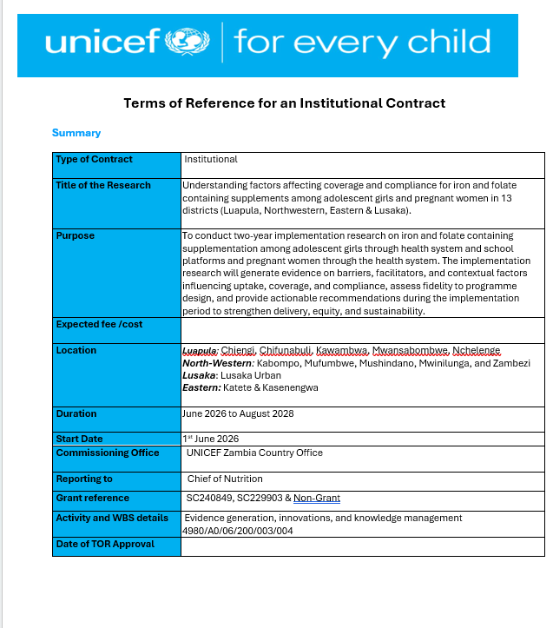
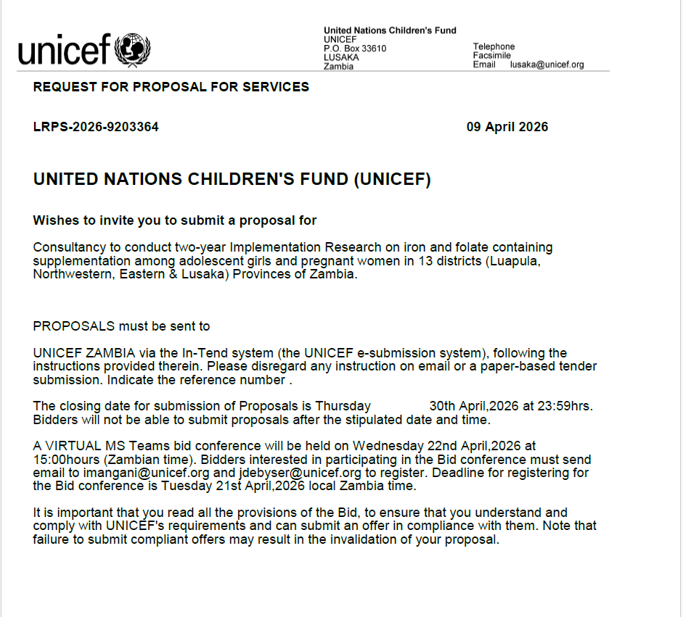
RFPs come in different formats, but they are they key starting point to your technical proposal

Slide 14
What do RFPs include?
Although they may vary by country, region, and/or contract mechanism, client, RFPs normally contain the following elements:
  Scope of work
  Evaluation criteria and weighting
  Proposal preparation instructions
  Deliverables
  Contract requirements
  Budget or level of effort constraints (sometimes)
  Submission instructions

Slide 15
What are we looking for when we review the RFP?
All sections of your proposal, must respond to the requirements in the RFP.
This means it is very important to review the RFP multiple times to understand what the client is looking for and the issues we must address.
  AI tools can be useful to distill information especially when scanning large volumes of RFPs - but be mindful of biases.
The technical proposal has a key role regardless of the weight it is given in the RFP selection criteria.
A good technical also is a valuable guide for later events: contract negotiations, work planning, and project implementation.
Make sure to review whether you can fulfill business requirements: business registration, language skills, people in country/travel, past performance, etc.

Slide 16
Other important things to note
The RFP guides proposal development; it tells you what the client wants you to do.
  For a successful bid, you must follow the specifications; a missed requirement can eliminate you from competition.
  The proposal must follow closely the RFP selection criteria.
  Make the information easy to find for reviewers or AI screening tools.
RFPs are not perfect, and you may find contradictions and ambiguities; therefore, ask questions, read, and reread.
  The RFP provides instructions for asking questions about the RFP.
  You can deviate from the RFP, but you should note whenever you do so with a well-developed justification for the change.

Slide 17
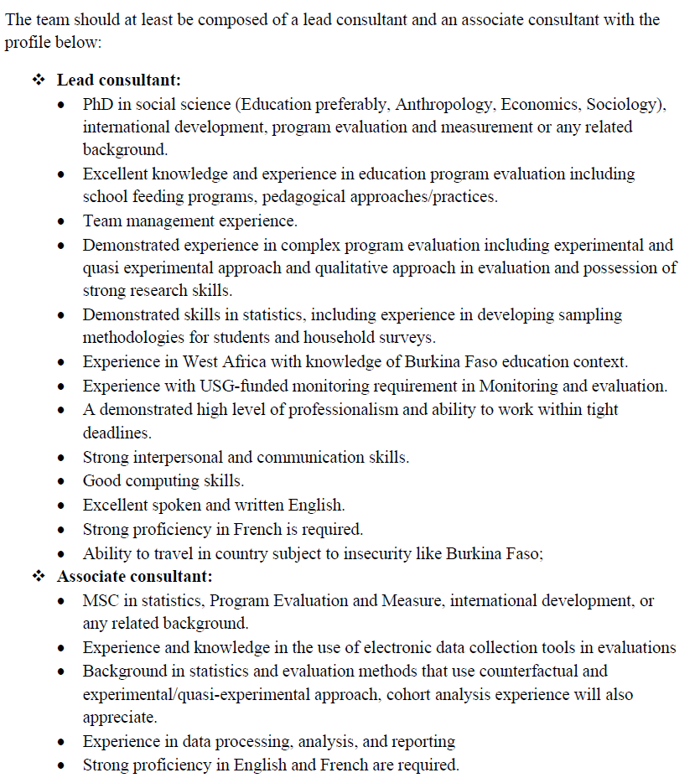
RFP Components: Evaluation criteria and weighting
Does your team fulfill all the criteria?
Can you get additional team members/partnerships that will address the any gaps?
Do you really think this opportunity is the right fit for you?

Slide 18
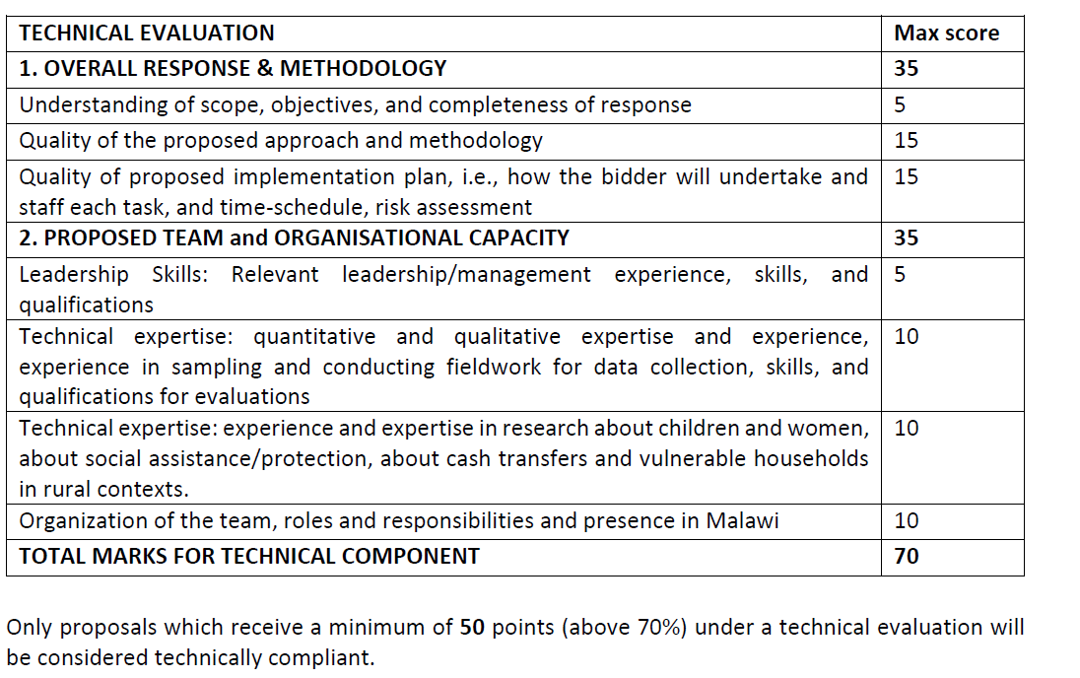
RFP Components: Evaluation criteria and weighting
Key questions:
  Which sections will give us the most points?
  Are there any sections where we think we will lose points?
    If yes, can we form partnerships/extend our team to fill these gaps?

Slide 19
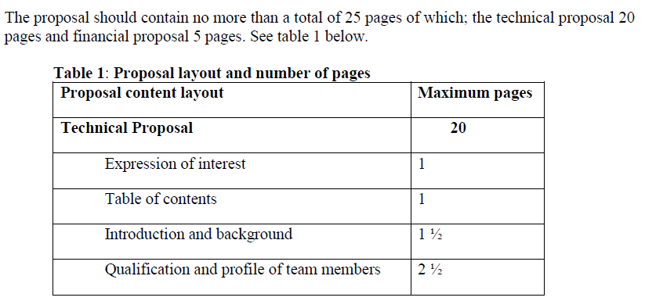
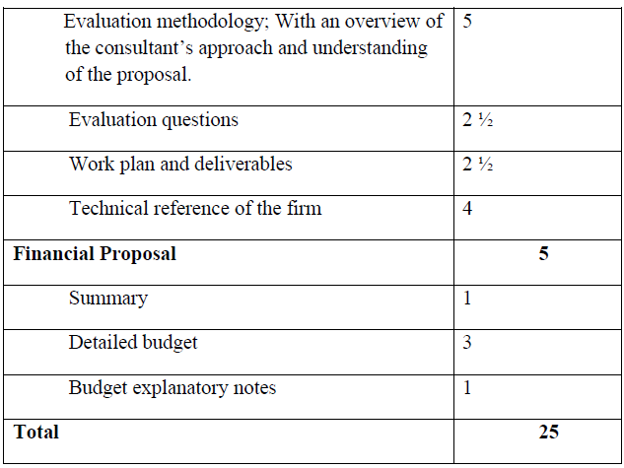
RFP Components: Preparation instructions
If instructions are given, follow them closely (and avoid getting disqualified).
If no instructions are given, refer back to the evaluation criteria and make it easy for the reviewers to score your proposal.

Slide 20
Introduction & Win Themes

Slide 21
The Lead Sentence
The lead sentence sets the whole tone for the proposal and should lead right into your arguments why you are ‘the best for the job’.
So, what do we need to include in the lead sentence?
  Your name
  What you are applying for
  Thanks to the client and generates excitement about your proposal
  Tone setting statement – the seed you want to plant with the reviewer that will carry through the rest of your proposal
Now – each one of you will be able to write your lead sentence!

Slide 22
Lead Sentence Examples
The American Institutes for Research® (AIR®) has carefully constructed a team of evidence synthesis and subject matter experts to deliver rigorous evidence syntheses that will generate practical evidence-based recommendations to UNICEF on interventions to prevent child marriage.
The American Institutes for Research® (AIR®), with our consortium of local researchers and local data collection partner, Makerere University, is excited to respond to UNICEF’s request to support the Government of Uganda in the review and implementation of the 2023 FSNA in refugee settlements and host communities.

Slide 23
What are Proposal Win Themes?
Proposal win themes are statements you make in your proposal that illustrate why a client should choose you.
Win themes are the ‘golden threads’ that will run throughout your proposal.
They should be the at the heart of your introduction and wherever possible – at least one of them should feature in every response or area of your bid.

Slide 24
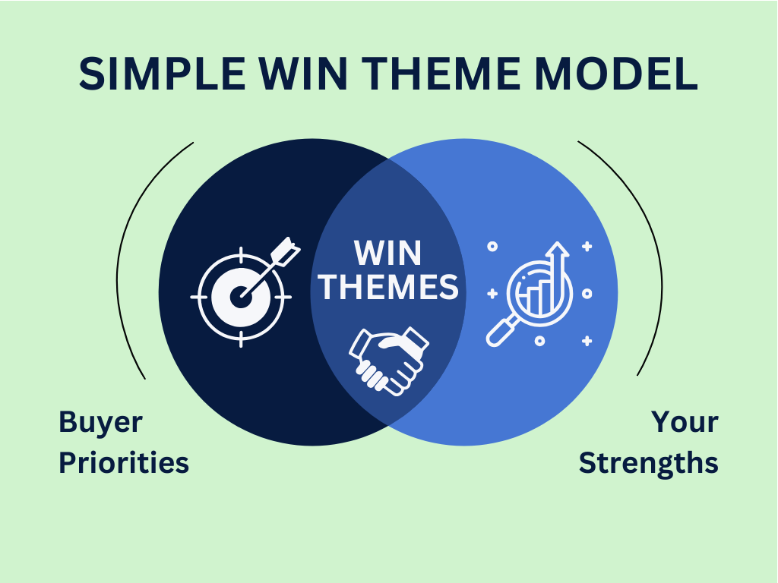
Win Themes
Your bid needs to be exciting and memorable to the client!
Your bid needs to tell the client what’s in it for them and why they should select you – very clearly and quickly.
Having well defined win themes that permeate throughout your proposals helps you achieve that.
They provide three hooks that draw the client in and help them believe you are the supplier for them.

Slide 25

The 3 Hooks
Hook #1 – Developing Proposal Win Themes at the outlining stage motivates the bid team and serves as an excellent starting point for proposal development.
Hook #2 – Well developed win themes give the proposal team the belief that we can win this proposal!
Hook #3 – Gives the client the belief that we went the extra mile and thought about their offering and prepared a proposal that is differentiated from the competition.
Why do Hooks #1 and #2 matter?
Strengthen your structure and create a comprehensive proposal.
The best proposals are those that you believe in!!
Notes:
Hooks #1 and #2 matter because if the proposal team thinks they can win and are excited about the proposal it comes out in the writing thereby exciting the client. I can’t tell you how many times I have read a proposal from an offeror where it was clear they just didn’t care about me as the client and what they were writing.

Slide 26

Elements of Win Themes
Features: Aspects of the service you are offering
Benefits: An advantage to your service that meets a client’s need
Proof Points: Qualitative or quantitative proof that your statement is true
Discriminators: How your advantage is differentiated from our competitors

Slide 27
Win Theme Examples
Bad example:
AIR has conducted qualitative and quantitative evaluations in various sectors in over 70 countries.
Still Bad example:
AIR is a trusted education partner for several UNICEF offices as we routinely conduct rigorous qualitative and quantitative evaluations providing rigorous evidence to various UNICEF offices on what works.
Better example, but not great:
AIR is a trusted education evaluation partner working closely with your regional office on generating and disseminating evidence on what works. One particular education evaluation AIR conducted was voted by UNICEF as the top evaluation of the year.
Notes:
Assume this is for a UNICEF proposal asking for mixed-methods evaluation of education program

Slide 28
Win Theme Examples
Even better example:
When other evaluators simply just report out results, AIR goes the extra mile and routinely triangulates the results of comprehensive qualitative assessments with rigorous impact evaluations in the education sector so that UNICEF ESARO understands both how and why an intervention works or not. One particular education evaluation AIR conducted was voted by UNICEF as the top evaluation of the year!
Best example:
Because of our strong relationship built across several rigorous education evaluations, AIR and UNICEF ESARO are trusted partners that together create and disseminate important evidence about key education interventions that add to the evidence base on what works. We do this by integrating local perspectives obtained through comprehensive qualitative assessments with rigorous impact evaluations to understand the mechanisms of change for education interventions. One education evaluation AIR conducted for ESARO was voted by UNICEF as the top evaluation of the year!

Slide 29
Thank you!

