Slide 1
Proposal Development Training Series
Session 3: More Components of Technical Proposal, Writing and Review Tips
David Seidenfeld, PhD | Adria Molotsky, PhD | Marlous de Milliano, PhD
African Evaluation Association & American Institutes for Research

Slide 2

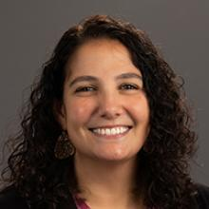
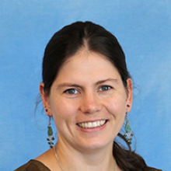
Meet the Presenters
Dr. David Seidenfeld
Dr. Adria Molotsky
Dr. Marlous de Milliano
Vice President at AIR
Sr. Economist at AIR
Sr. Economist at AIR

Slide 3
Proposal Development Training Series
Date | Topic
May 14th, 2026: 1pm-2pm GMT | Session 1: Reviewing RFPs and Win Themes
May 21st, 2026: 1pm-2pm GMT | Session 2: Components of the Proposal
May 28th | -- No session --
Jun 5th, 2026: 1pm-2pm GMT | Session 3: Components of Proposal Continued, Reviews and Writing tips

Slide 4
Brief Review of Last Session

Slide 5
Outline of Technical Proposal
The titles of sections and the order may vary based on RFP requirements. → Make it easy for the reviewers to find information!
But it can look like:
  Cover page
  Introduction with win themes
  Capabilities statement
  Technical approach/research design
  Management plan and staffing
  Workplan and timeline

Slide 6
What does a Technical Approach Include?
Background (on issues, project) or Statement of Need
A general approach to the work that includes:
  Theory of Change/Conceptual Framework
  Research Questions
  Research Design (detailed technical approach to the work)
In addition, the RFP may require other technical section elements (e.g. data collection procedures, ethics, quality assurance etc.) in the text or as annexes.

Slide 7
Example Theory of Change
Maps the expected relationships and assumptions
Helps to define relevant variables to include in your study
Initial Conditions
Malnutrition in Sri Lanka affects nearly 1/3 of children: 13% of all children under 5 stunted, 25% underweight, and 15% wasted
Activities
Provide school meals
Train school meal providers in safe food preparation and storage
Outcomes
Reduced student hunger and increased attentiveness
Increased use of safe food preparation and storage practices
Impact
Improved student health and nutrition
Potential Influencing Factors / Characteristics
Age Gender
Cultural norms School infrastructure
Availability of ingredients

Slide 8
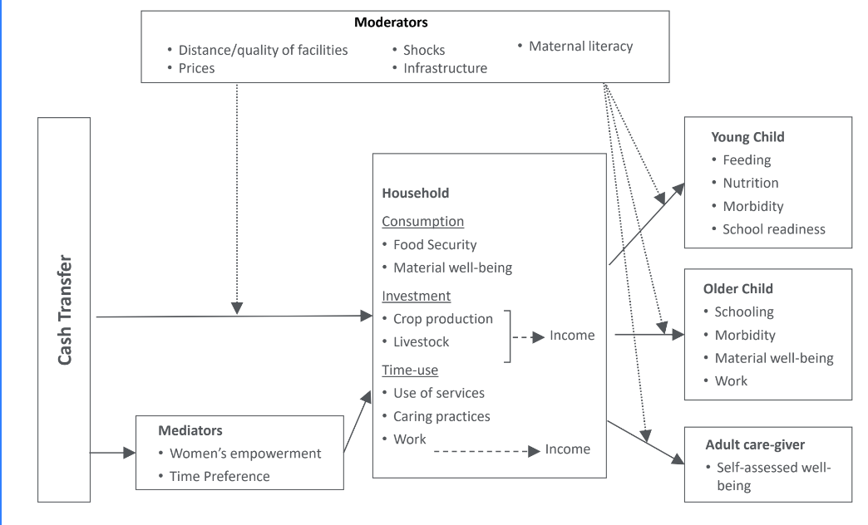
Example: Cash Transfer

Slide 9
Work Plan and Timeline

Slide 10
Outlining the Work Plan or Timeline
Initially, we must identify in the RFP the period of performance of the project. Is this enough time to conduct the project or service the client wants?
If it isn’t enough time, how can we save time to accomplish initial client objectives?
If we cannot think of anything to save time, we should include a question to the client asking for more time.
It is best to show the work plan graphically either through a basic chart or GANTT chart.
The work plan chart should follow the technical section or be placed in the annex, depending on the RFP – this should be noted in the outline.

Slide 11
ZARA MIRA Impact Evaluation Work Plan and Timeline
Activity | 2023 |  |  |  |  |  |  | 2024
 | June | July | Aug | Sep | Oct | Nov | Dec | Jan
Inception
Contract Signing | X
Inception Workshop | X
Finalizing Research Design | X
Developing survey instruments and interview protocols | X | X
Discuss instruments with UNICEF | X | X
IRB approval |  | X
Evaluation
Complete recruitment of enumerators and data entry clerks |  | X
Enumerator and data entry training |  | X
Piloting instruments |  | X
Quantitative surveys |  | X | X
Qualitative interviews |  | X | X
Data entry and cleaning |  |  |  | X
Data analysis |  |  |  |  | X | X
Report writing |  |  |  |  |  | X
Deliver draft |  |  |  |  |  | X
Deliver final report, survey instruments, and raw data |  |  |  |  |  |  |  | X

Slide 12
Deliverable Schedule
Another type of timeline funders often request is a deliverable schedule or timeline
  This plan shows the proposed deadlines for all key deliverables over the life of the project
  Often this ties back to the budget and payment dates
Deliverable | Due date –18 months
Contract signing | Jan 2022
Finalizing design and draft inception report | Feb 2022
Baseline data collection | Mar-Apr 2022
Baseline analysis | May-Jun 2022
Baseline report | Jul 2022
Mid-term data collection | Dec-Jan 2023
Mid-term analysis | Feb-Mar 2023
Mid-term report | May 2023
Dissemination (including additional products e.g., presentation, blogs) | Jun 2023

Slide 13
Other Technical Proposal Sections

Slide 14
Cover letter
Grants requesting a cover page usually want a no more than 1 page, showing the project title, grant number, PI and his/her contact, lead institution and partners
Fill up the space with text that shows why the funder should choose you!
  Win themes
  Brief introduction to the team

Slide 15
Ethical Considerations
Many funders have specific ethical guidance they require researchers to use – ensure you are aware of these guidelines and your design meets these standards
Describe how you will ensure duty of care and the do no harm principle
  How will you obtain assent/consent?
  How will you ensure confidentiality and privacy?
  How will you ensure data security?
  Will there be any special protections or considerations for vulnerable populations?

Slide 16
Quality Assurance
This section is sometime requested by the client and enables you to show that you thought through how you would provide the highest quality work to the client.
  Discuss systems and processes in place to guarantee smooth implementation, high quality work.
  If the client has a certain QA or review system in place, it allows you to show that you are familiar with their standards and that you incorporated them in your approach.

Slide 17
Risks and Mitigation Strategies
Sometimes required by the funder
Demonstrate you have thought about potential risks to the study and how you can potentially mitigate these risks
  Some risks to consider:
    Data collection (e.g., accessing certain areas due to rainy season)
    Sample size and power (e.g., not enough students at schools to meet sample quota)
    Political pushback or refusal to participate by local authorities
    Response bias (e.g., Hawthorne effect, social desirability bias)

Slide 18
Review Process

Slide 19
Proposal Review Process
Reviewing your proposal throughout its development with people outside the writing team is critical to submitting a high quality competitive bid. We tend to follow an adaptation of the Shipley review process.
The Shipley review process is a structured business development and proposal framework consisting of sequential "Color Team" reviews designed to increase the probability of winning (Pwin) bids. It guides teams from early market strategy through strict compliance checks, competitive positioning, and final proposal readiness.

Slide 20
Modified Shipley Color Review Process
Blue Team (Win Strategy Review): Conducted early, often before the final Request for Proposal (RFP) drops. It evaluates the capture plan, discriminators, win themes, and overall solution strategy.
Pink Team (Compliance Check): Conducted early in proposal development, typically when outlines and initial drafts are ready. It verifies that all sections meet RFP compliance requirements and logical flow.
Red Team (Proposal Evaluation): The most critical review, occurring when the draft proposal is mostly complete. An independent group reviews the document through the lens of the customer's evaluation criteria to score it and identify weaknesses.
Green Team (Pricing Review): Conducted parallel to the late proposal stages to review and approve the final pricing and business model.
Gold Team (Final Approval): The final step before submission. Leadership reviews the completed proposal—incorporating all Red/Green team changes—to approve it for submittal.

Slide 21
Proposal Development Calendar
We recommend creating a calendar with deadlines for completing and submitting the proposal
Work backwards from when it needs to be submitted, paying attention to the date, time, and timezone for submission
Then enter the color reviews, allowing sufficient time for reviewers to do their work and the writing team to make the necessary edits
The proposal team should strictly follow the calendar and communicate closely with the reviewers if they are off schedule.
A rush at the end of the process often leads to mistakes, poorer quality, and sometimes missed submissions – you want to avoid this problem!

Slide 22
Writing Tips

Slide 23
Conveying Your Message Clearly
Good writing is fundamental to a successful proposal
You want your proposal to be engaging and easy to understand. Reviewers have a lot of proposals to read. You do not want to make your reader work to understand your proposal.
You want to be as succinct as possible; less is more.
State main points up front and repeat them throughout proposal. Pay attention to topic paragraphs at the beginning of sections and topic sentences at the beginning of paragraphs.
Avoid burying your main points.

Slide 24
Some Writing Tips to Engage Your Reader
Be direct, use active tense, avoid passive voice.
Eliminate unnecessary clauses like: "as previously mentioned", "it is usually the case", "it should be noted", "finally"
Try to eliminate the naked "this". Example "This makes . . ." This what? Follow the word "this" should always have something following it that is being referred to. "This result makes …"
Avoid technical jargon

Slide 25
Thank you!

